Slide 1

STUDY SMART
Using GCSEPod with cognitive learning techniques. A guide for parents and carers.

Slide 2


First, a quick reminder:
We have invested in an award-winning digital content and learning provider, called GCSEPod.
Pod Credentials:
Supporting students at KS4 for over 10 years
Used in over 1,300 schools worldwide
Recommended by the Association of School and College Leaders
Winner of multiple educational technology awards:

Slide 3


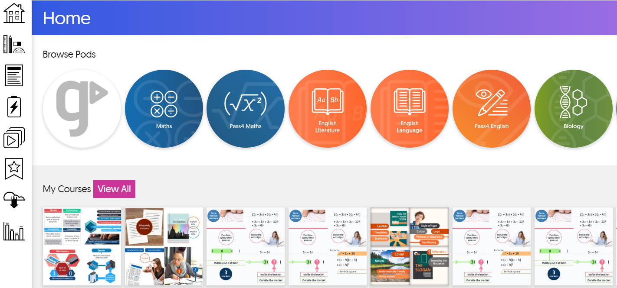

GCSEPod helps your child to:
Accelerate progress
and raise results.
Consolidate subject knowledge
and improve recall.
Improve engagement and encourage independent learning.

Slide 4
We’re going to look at:
GCSEPod and retrieval practice
GCSEPod and spaced learning
GCSEPod and dual coding
GCSEPod and flipped learning
GCSEPod and interleaving

Slide 5


“Retrieval Practice” is a learning strategy where we focus on getting information OUT. Through the act of retrieval, or calling information to mind, our memory for that information is strengthened and forgetting is less likely to occur.

Slide 6
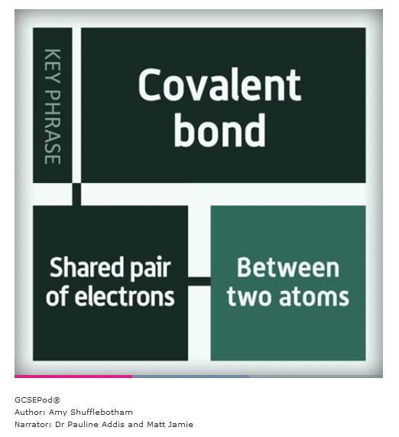
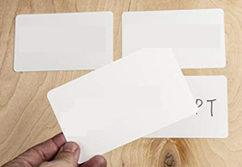
At-home activities using Retrieval Practice
Watch a Pod with your child.
Ask your child to write key words on a flash card.
Watch the Pod again – your child should summarise their knowledge of each key word on the back of each flash card.
Allow your child time to flesh out their cards with as much information as they can remember.
Test your child by asking them to define the flash card words without looking.
Covalent bond

Slide 7
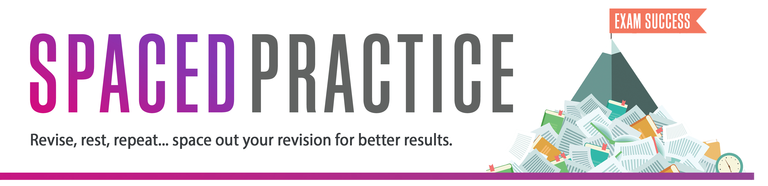
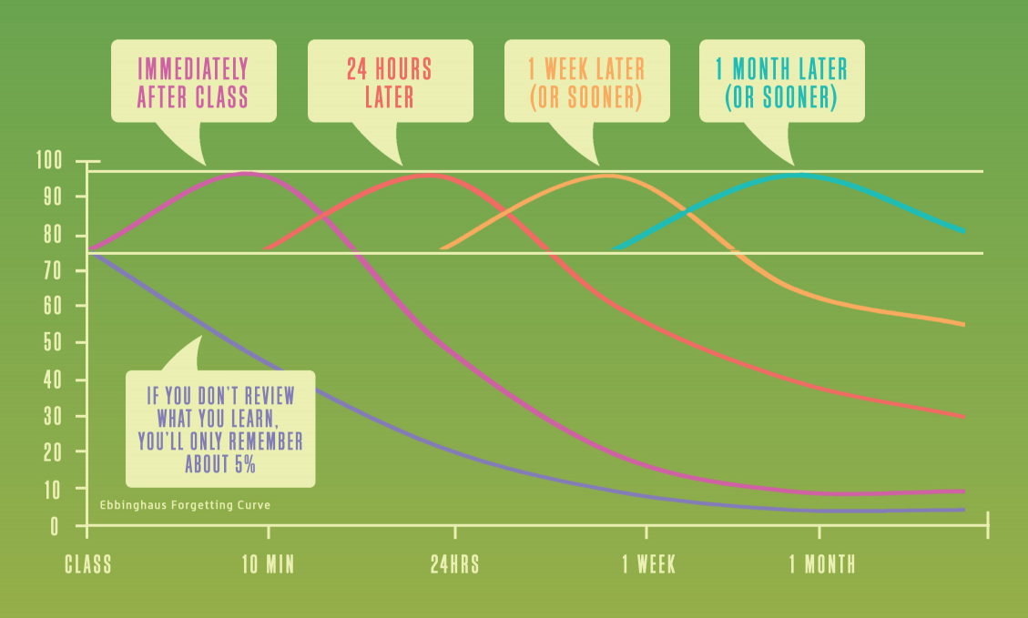
It has been proven that by reviewing at regular intervals, you can reduce how much you forget to just 10%.

Slide 8
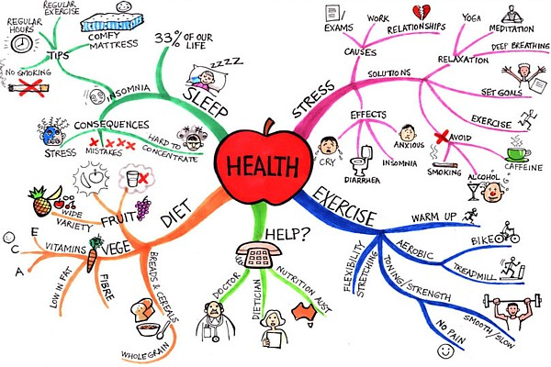
Reviewing 4 times within a month can help you remember nearly 100%
Immediately After Class
4 Hours Later
Mind Mapping
Encourage your child to watch a Pod and write down all the key words. Then, from memory, ask them to fill in as much information as they remember on a mind map.
Review Maps
Cover your child’s mind map and see how much they remember. Highlight the information they couldn’t remember and recommend revising the topic again.

Slide 9
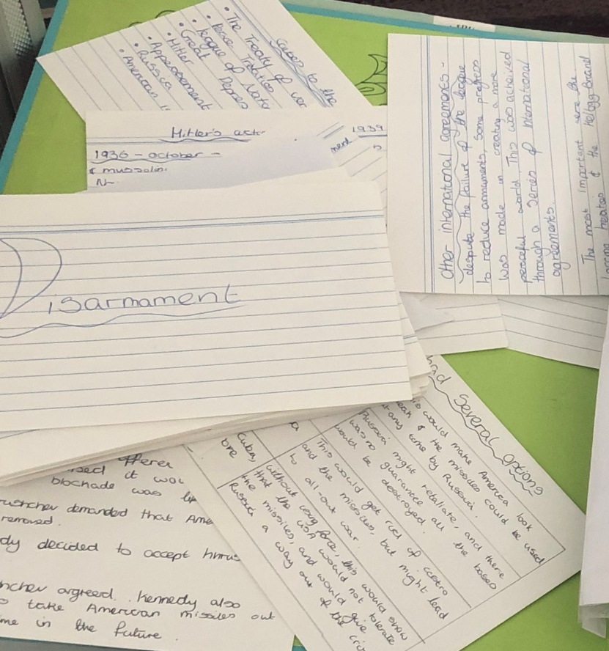

Reviewing 4 times within a month can help you remember nearly 100%
1 Week Later
1 Month Later
Memory Cards
Encourage your child to create their own questions with the answers on the reverse. Then, test their knowledge.
Past Papers
Encourage your child to watch GCSEPod’s Pods again and then practice past papers.

Slide 10


Combine both words and visuals for quicker and stronger recall

Slide 11

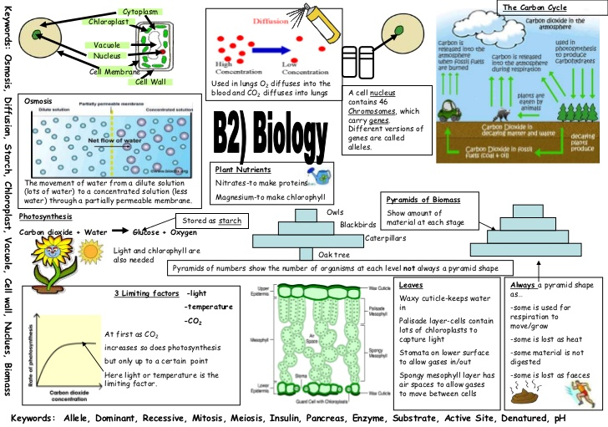
Just reading text alone improves our memory by 10% in 3 days but looking at the picture we are likely to remember 65%.
Watch a Pod together, then using the images from the Pod, suggest your child draws a poster combining the images with keywords and definitions. Copying the labelled diagrams in the Pods helps the knowledge to stick!

Slide 12


Interleaved practice is a learning technique that involves switching between topics and ideas and has been shown to improve long-term learning relative to blocked study of the same idea or topic.

Slide 13
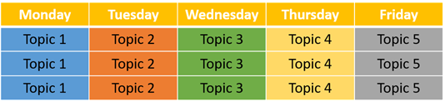
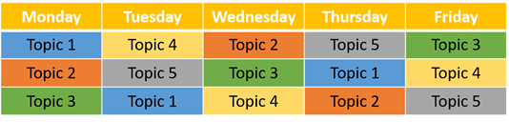
Ask your child to create a learning/revision timetable using the interleaved practice example below. They should choose topics that are similar and related either from the same subject or a different one.
The Pods on GCSEPod are set out in a very clear and organised way. This makes it easier for your child to plan out their revision so that similar and related ideas and concepts, such as in Maths and Science, are studied together and in different orders, rather than separately and/or always in the same order.
Less Effective Blocked Practice
Highly Effective Interleaved Practice
Your child can watch the Pods on each topic and then complete active tasks from the previous slides.

Slide 14

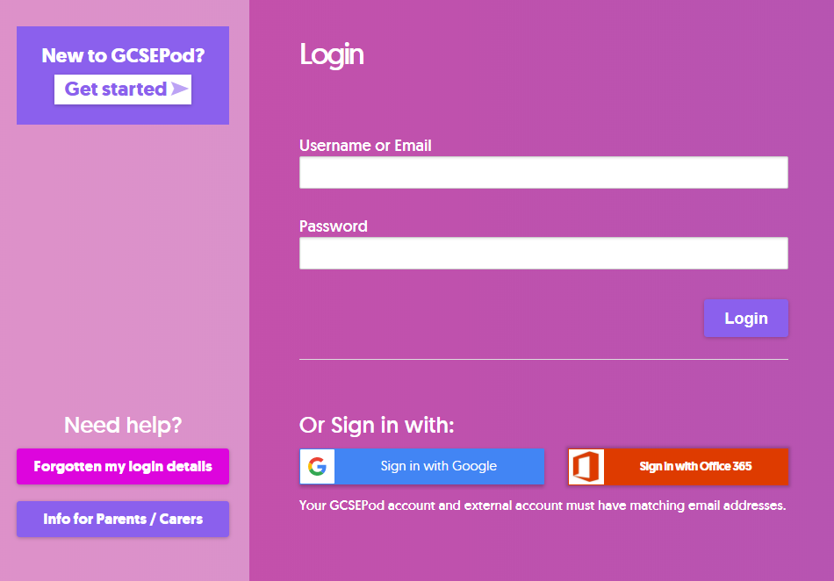
Not Activated Yet?
1
Go to: https://members.gcsepod.com
2
Click New to GCSEPod? Get Started!
3
Enter your details
4
Create your username and password

Slide 15



