Slide 1
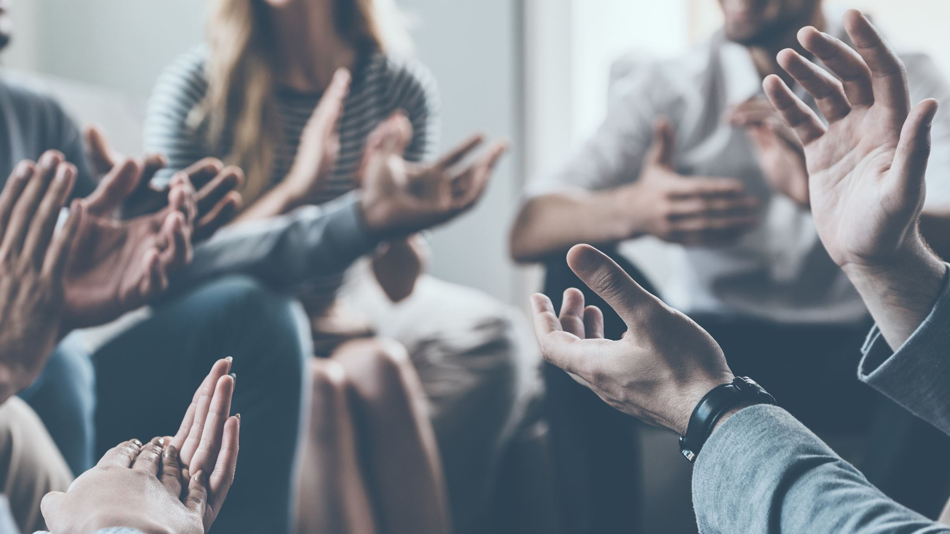
Daily Prayers
21-24 October

Slide 2
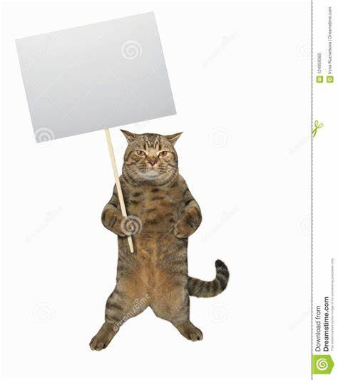
Monday Notices
Faith in Action club cancelled this evening

Slide 3
Monday : God's Word
Just before he ascended to heaven, Jesus passed his mission onto his disciples. This is known as 'The Great Commission'
A Reading from Matthew's Gospel
Jesus told them "Therefore, go and make disciples of all nations, baptising them in the name of the Father and of the Son and of the Holy Spirit, and teaching them to obey everything I have commanded you. And surely I am with you always, to the very end of the age.”
The word of the Lord: Thanks be to God

Slide 4
Monday: to think about
Yesterday, the Church celebrated World Mission Sunday. This day reminds us that we are part of a global church community with members across the world, all fulfilling the same mission which Jesus gave his disciples in today’s reading.
Watch this video

Slide 5
Let us pray the prayer we share with Christians throughout the world

Slide 6
Tuesday Notices

Slide 7
Tuesday God's Word
A reading from the Prophet Isaiah
Israel, the Lord who created you says,
“Do not be afraid—I will save you. I have called you by name—you are mine. When you pass through deep waters, I will be with you; your troubles will not overwhelm you. When you pass through fire, you will not be burned; the hard trials that come will not hurt you. For I am the Lord your God, the holy God of Israel, who saves you”
The word of the Lord
Thanks be to God

Slide 8
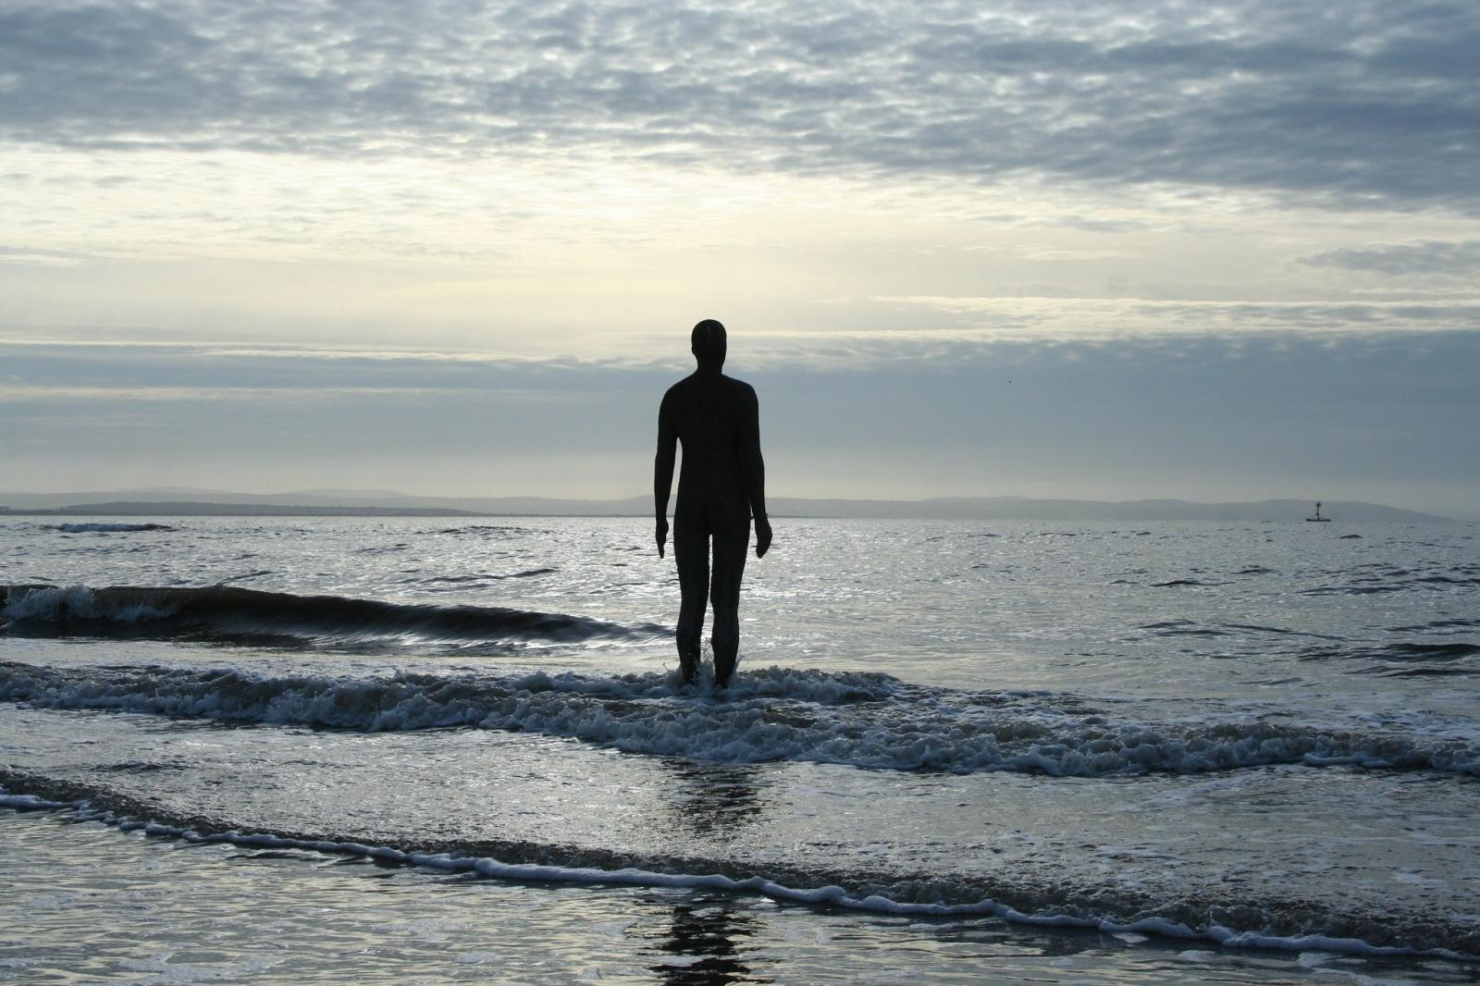
Tuesday To think about
In today’s reading we hear how God will not allow us to be overwhelmed by our troubles. Notice that God does not promise us a trouble free life – but that if we stand firm and trust in him, we will not be overwhelmed by these difficulties
Cast your mind back over the last half term – what challenges have you faced? How have you responded to these challenges?
Do you need to ask God for his help with anything?
Do you need to thank God for supporting you?

Slide 9
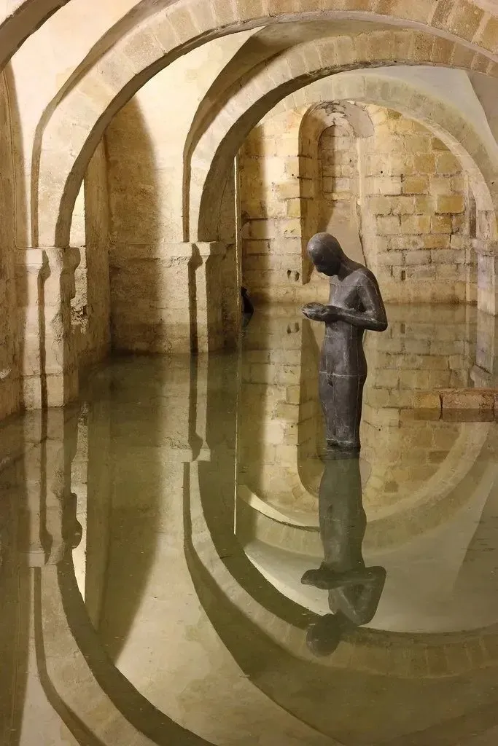
Tuesday Let us pray
Lord, here is my day.
I gather all my thoughts about the day ahead, my hopes and fears, and I put them in your hands. In the course of today may I reach out for your hand in peace and in panic. May we meet the day together so that I can grow in love and honesty with others.
We ask this in Jesus’ name
Amen
St Edward: Pray for us!

Slide 10
Wednesday Notices

Slide 11
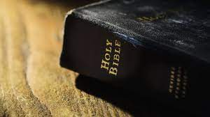
Wednesday: God's Word

Slide 12
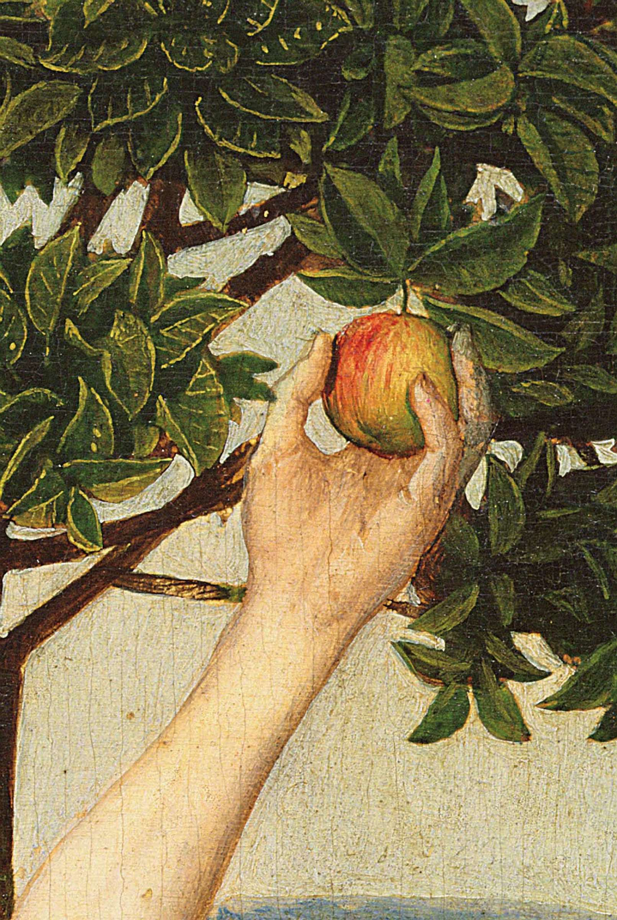
Wednesday Praying with 8R

Slide 13
Wednesday Let us pray
Dear Lord
As the half term comes to an end, let us express our gratitude. Thank you for the opportunity to learn, discover, and grow. Thank you for letting each day be filled with knowledge, inspiration, and meaningful connections. Bless our teachers, classmates, and everyone who has helped and supported us on our educational journey this term. Thank you for helping us to stay focused, motivated, and resilient, even when we have been faced with challenges. Thank you for helping this time be a time of personal growth, where we unlock our potential and embrace new experiences. Thank you for the memories that we have made to last a lifetime. Thank you for all the blessings this school term has brought to us.
Amen.
Grace Byrne

