Slide 1
Daily Prayers
14-18 October

Slide 2
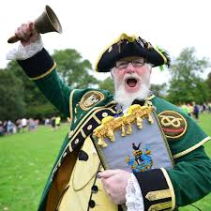
Monday Notices
Year 11 Mass – Period 1 Faith in Action F104
Come and receive God's forgiveness – Receive the sacrament of reconciliation (confession) in the chaplaincy 10.40-11.20 (Clare building)

Slide 3
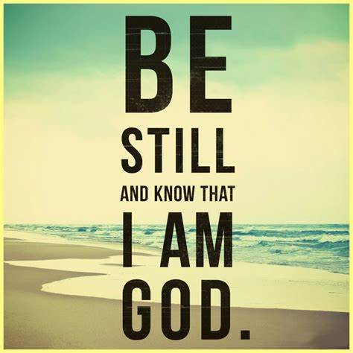
Monday God's Word
These are words from Psalm 46. People have used this phrase to remind them how to reach God for thousands of years.
This morning, take a few moments of silence to say these words to yourself.

Slide 4
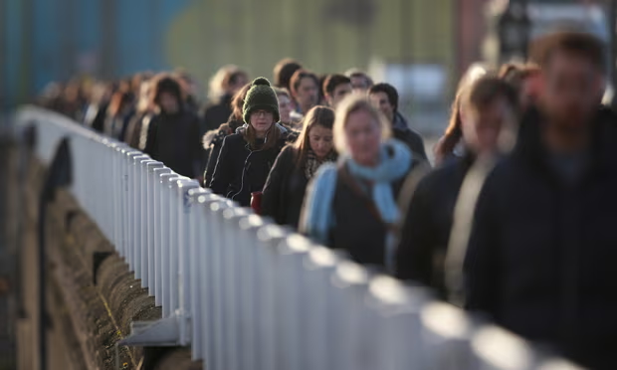
Monday To think about
As Christians we do not need to fill our lives with noise, business or many people. It is good to stop and let the dust of activity settle: to know that I can meet God in the silence.
In the silence of your heart this morning ask yourself:
Where will I find stillness today?
Who are the people in my life who help me to feel calm and settled?
How can I bring this sense of stillness and calm to others?
Is there anyone or any situation which I should try to avoid today?

Slide 5
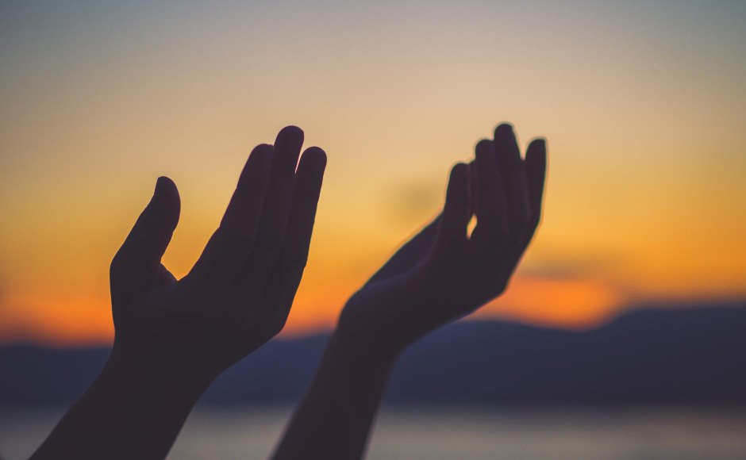
Monday Let us pray
Lord, I offer you this unused day.
I offer you my enthusiasm but also any reluctance I feel for what lies ahead.
Be with me in my fears, to calm my mind. Be with me in success and surprises to help me celebrate.
Be with me in the silence, to deepen my faith and love for you today.
Amen

Slide 6
Tuesday Notices

Slide 7
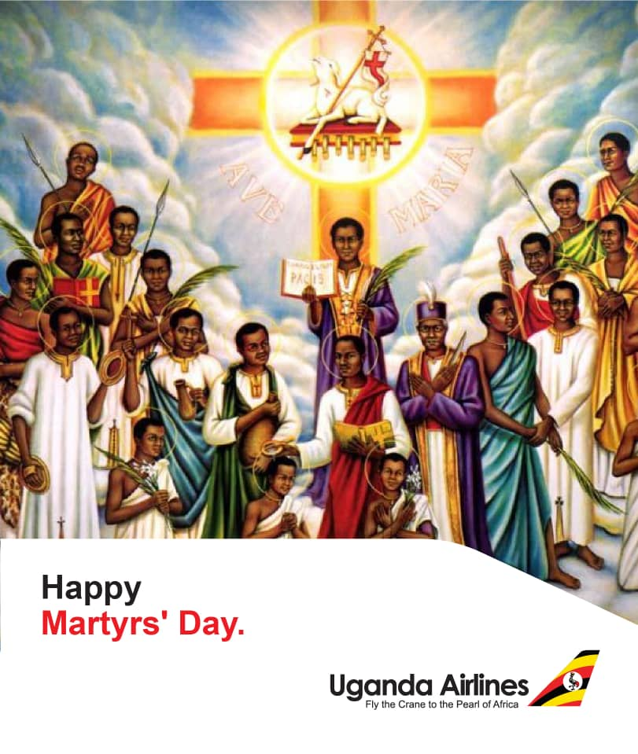
Tuesday Black History Month – Remembering The Uganda Martyrs
On 3 June 1886, thirty-two young men aged between 15 and 25, were burned to death in Uganda for their refusal to renounce Christianity. King Mwanga was angry that these young men put loyalty to Christ above the traditional loyalty to the king and resolved to wipe out Christianity.
Their martyrdoms produced a result entirely opposite to Mwanga's intentions. The example of these martyrs, who walked to their deaths singing hymns and praying for their enemies, so inspired many of the bystanders that many more became Christian.

Slide 8
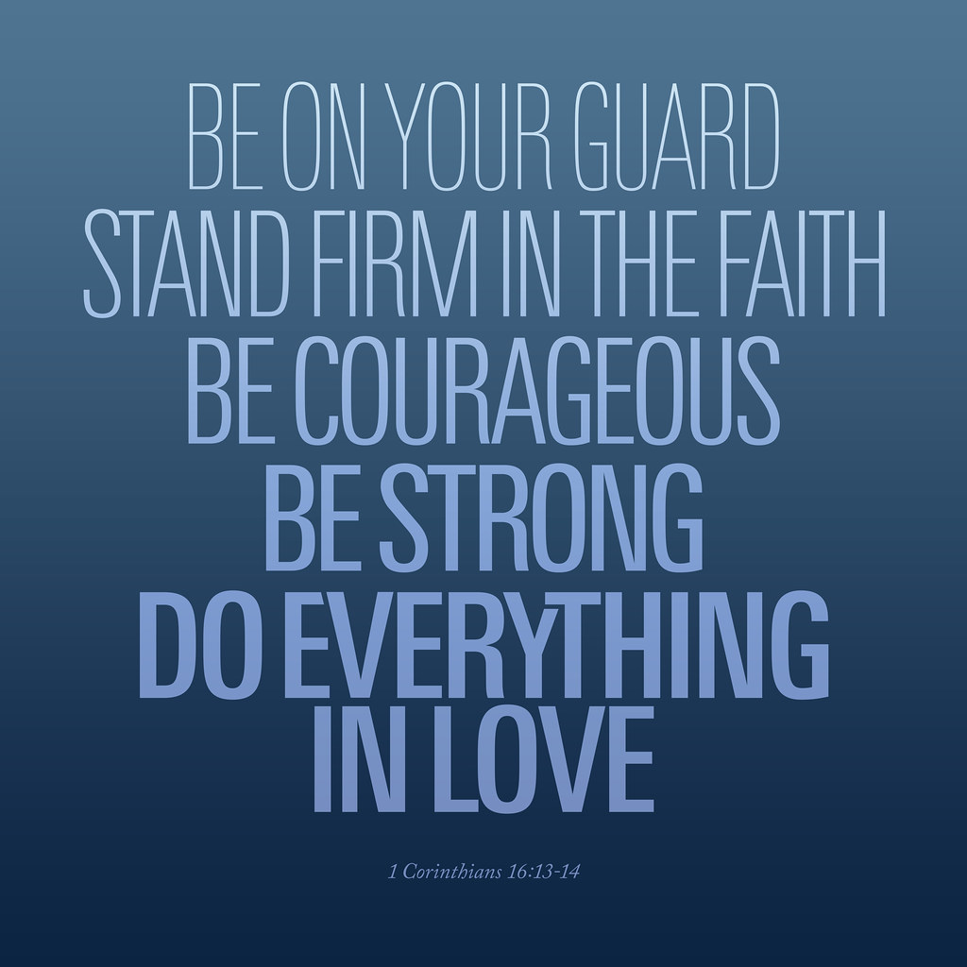
Tuesday God's Word
St Paul wrote these words to encourage the first Christians who were facing persecution for their faith
What do you need courage to face in your life?
Spend a few moments in prayer asking God for the courage you need.

Slide 9
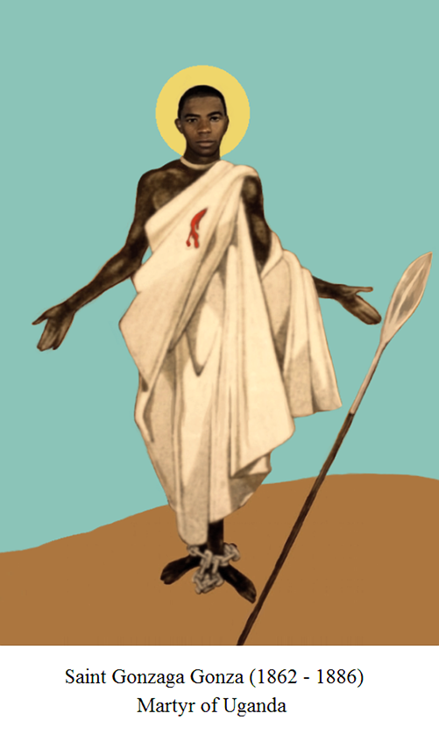
Tuesday Let us pray
Holy Martyrs who overcame all difficulties with outstanding courage, obtain for us courage when things are difficult.
Let us pray for all those today who are suffering for their Christian faith. We pray especially for Christians living in the middle East.
Lord, inspire us to be proud of our Christian Faith.
Amen

Slide 10
Wednesday Notices

Slide 11
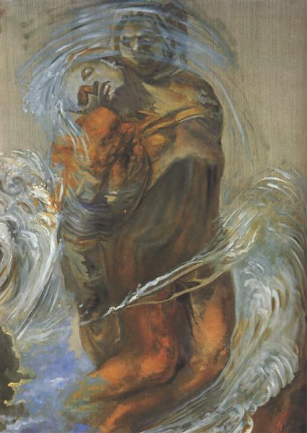
Wednesday: To think about
The reports we hear on the news coming from the Middle East leave us without words to pray. It staggers us. How do you pray in the face of such terrible happenings? What words are adequate? What difference will my prayer make?
In times like this Christians and Jews down the centuries have used the psalms of lament. The word lament means a passionate expression of sorrow. These psalms teach us that it’s not wrong to cry out to God in anger and sorrow. God hears us and joins us in our pain.

Slide 12
Wednesday God's Word
Psalm 44
Rise up, O Lord! Why are you sleeping? Awake, and cast us not away for ever. Why do you hide your face? and forget our misery and trouble? For our soul is brought low, even to the dust; our belly cleaves to the ground. Arise, O Lord, and help us, and deliver us for your mercy’s sake.

Slide 13
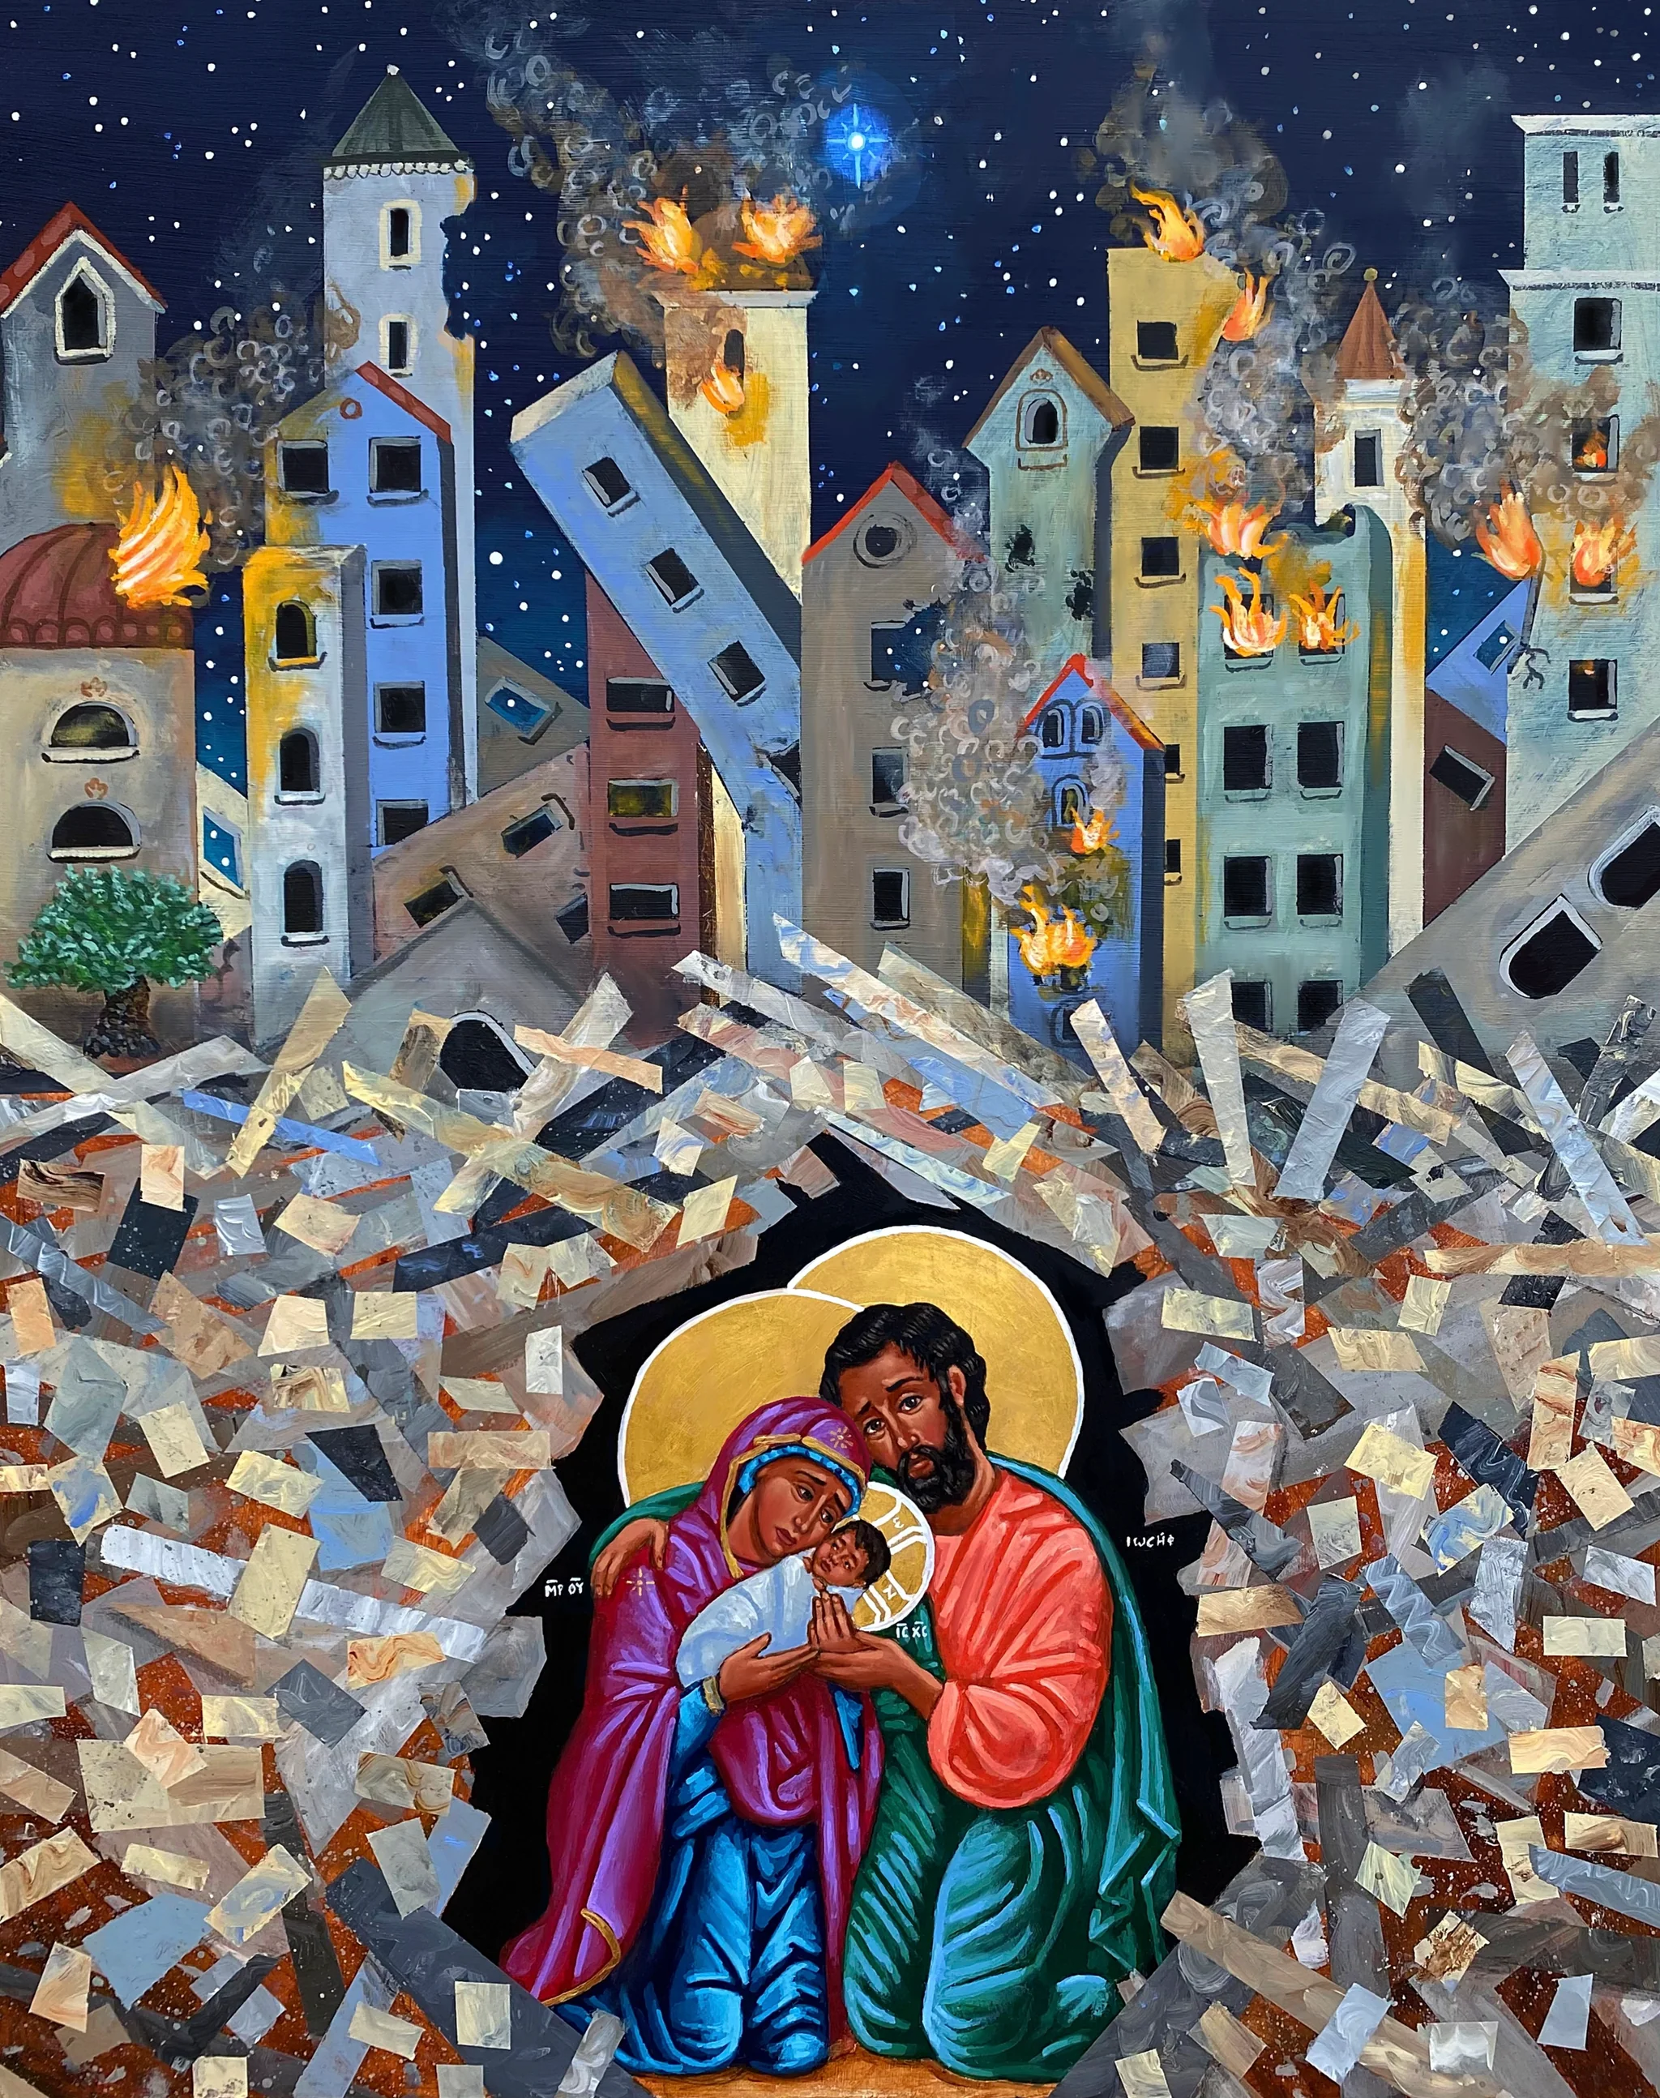
Wednesday Let us pray
Pope Francis has called us to join with the Church in the Holy Land in prayer. So we pray with Catholic Christians across the world:
Hail, Mary, full of grace, the Lord is with thee. Blessed art thou amongst women and blessed is the fruit of thy womb, Jesus. Holy Mary, Mother of God, pray for us sinners, now and at the hour of our death. Amen.
Mary Queen of Peace: Pray for Us
A nun inside the Church of the Holy Sepulchre, Jerusalem

Slide 14
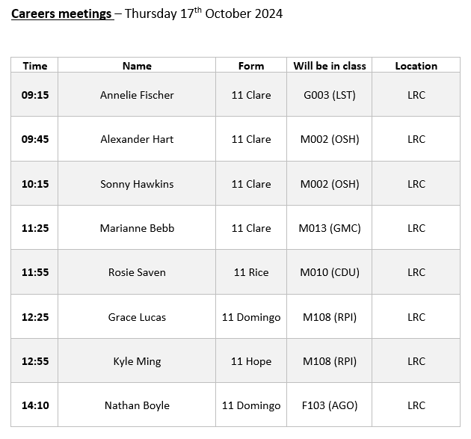
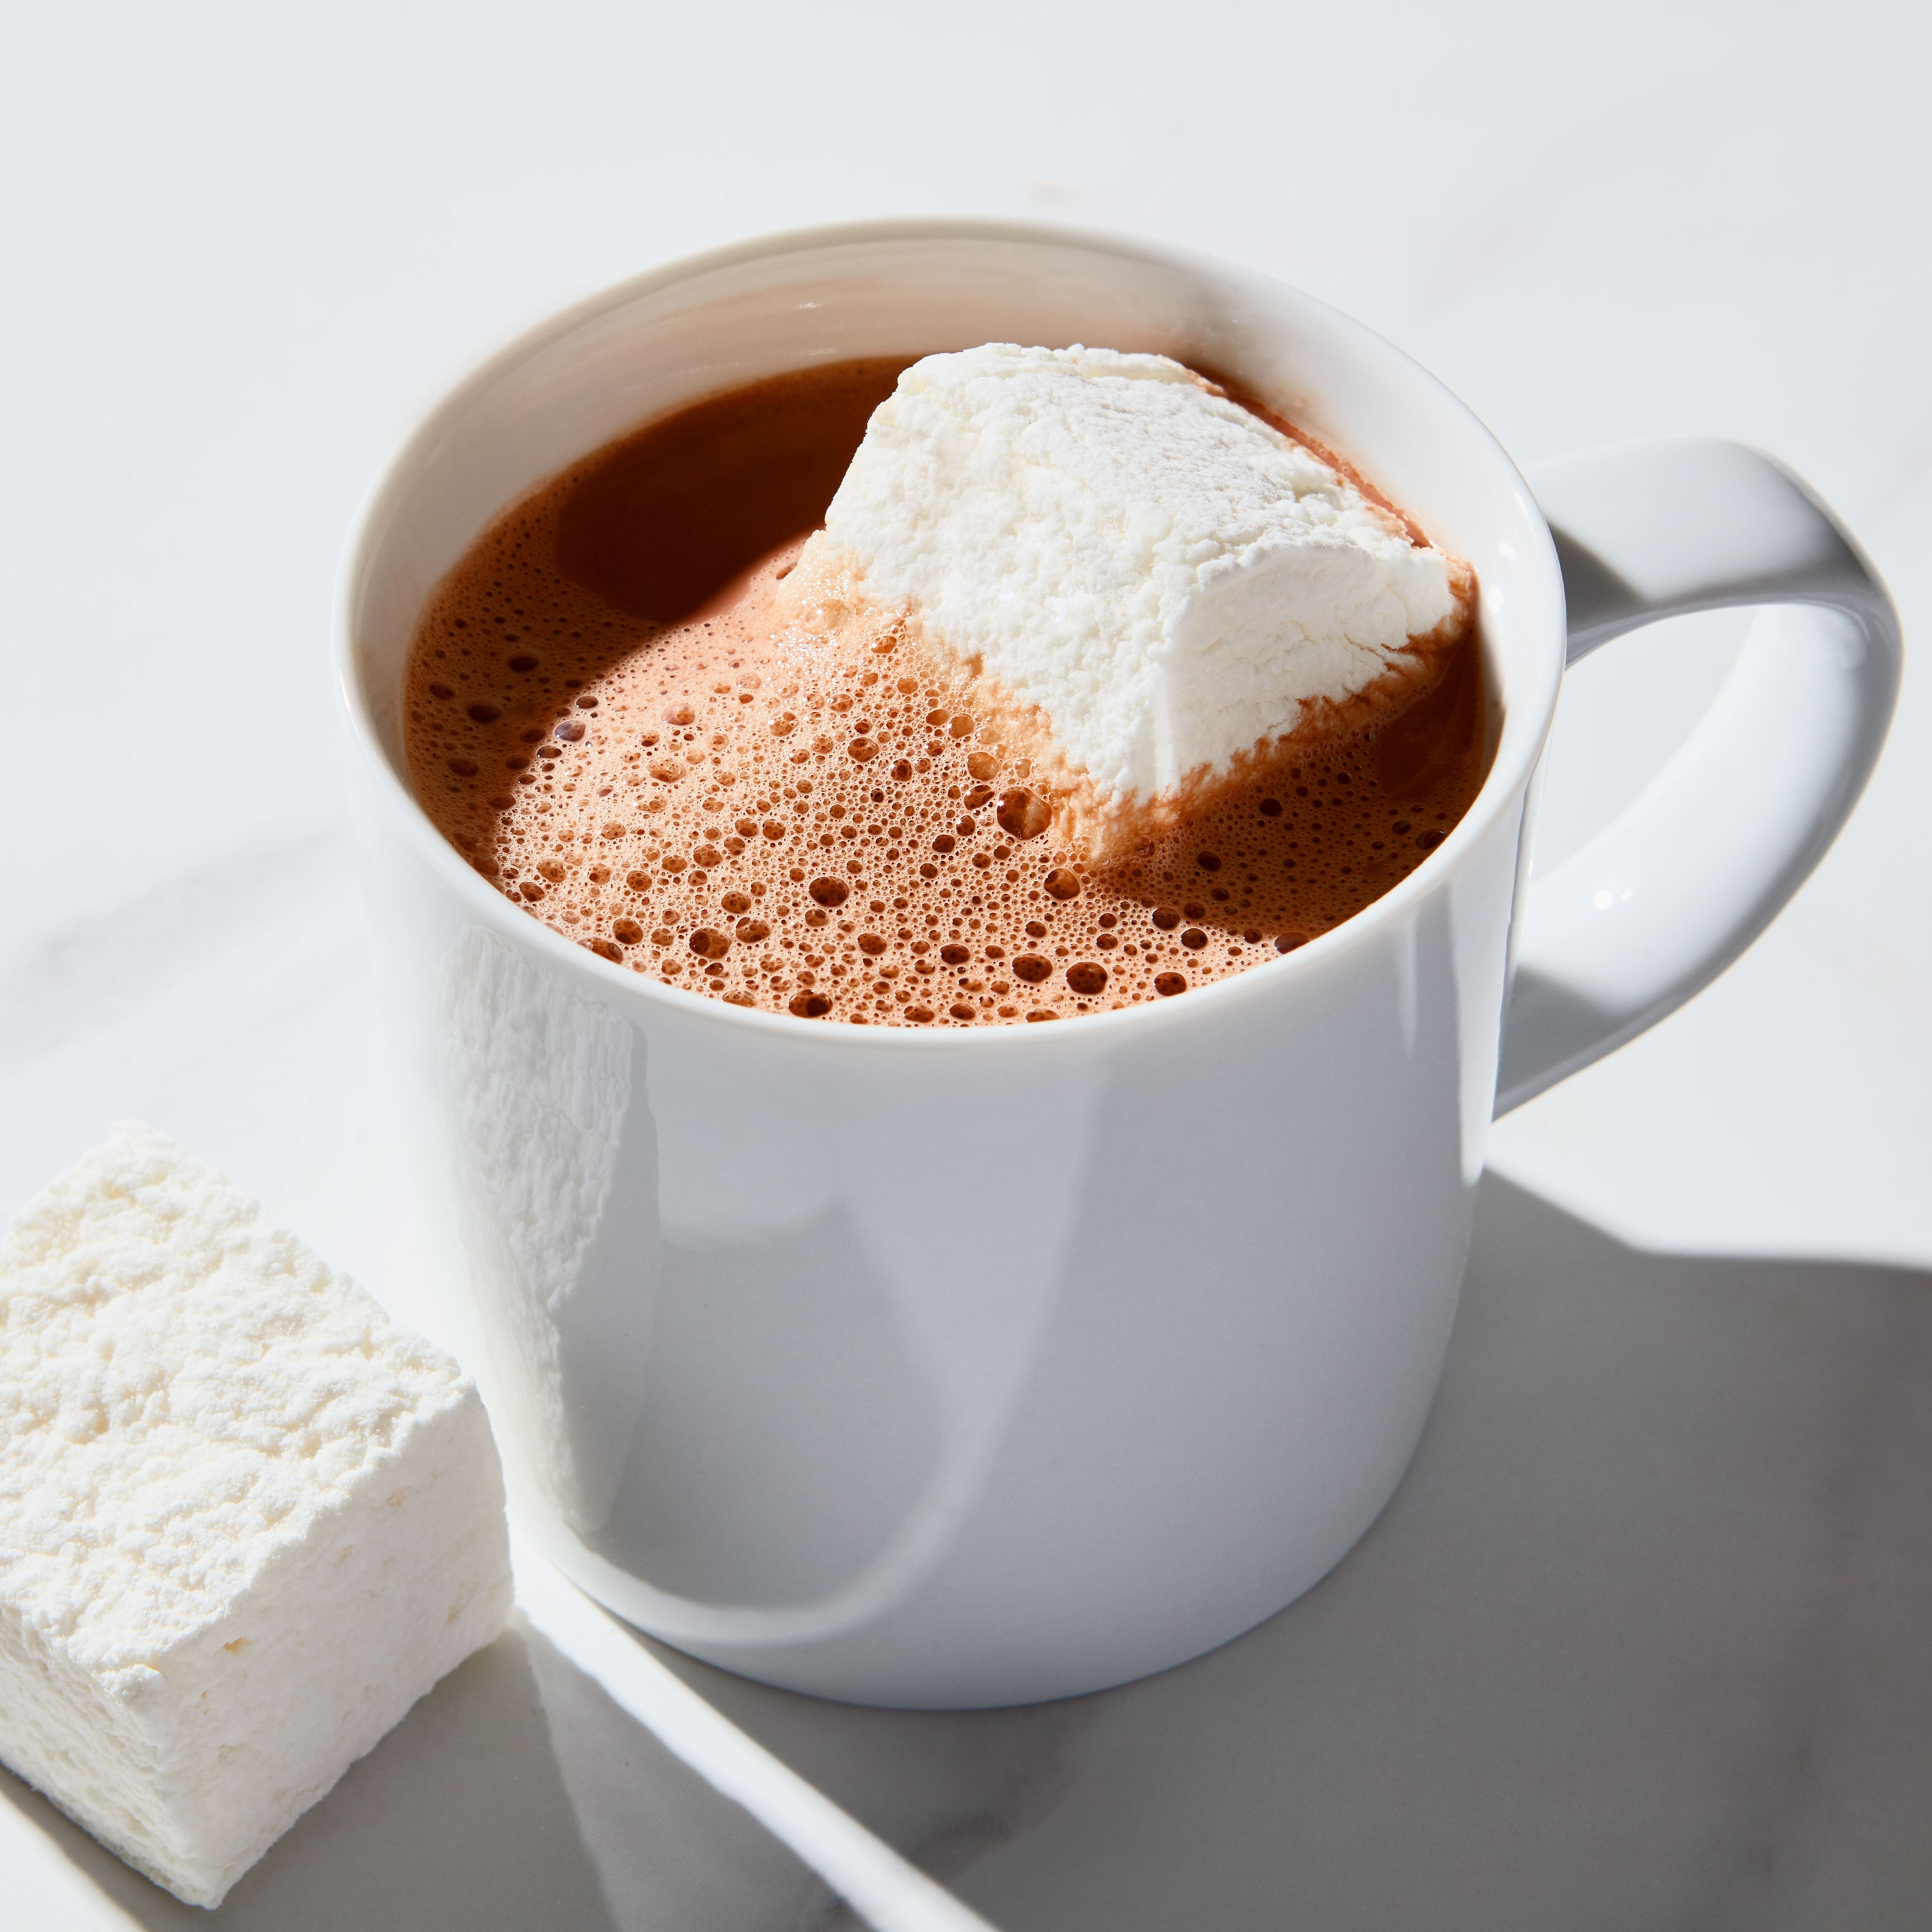
Thursday Notices
Tomorrow (Friday)
Breakfast with God
8.20am in the chapel.
Morning meditation: arrive early for hot chocolate & a pastry

Slide 15
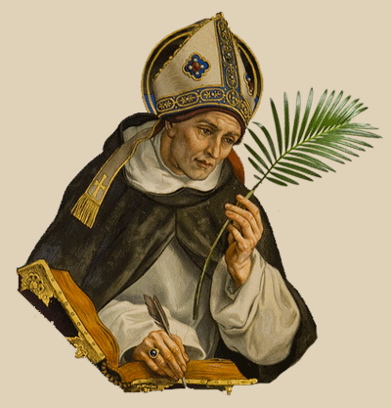
Thursday: Praying with our Patron Saints
Saint Albertus Magnus made significant contributions to botany, zoology, chemistry, and astronomy, emphasizing observation and empirical knowledge. Albertus Magnus is revered as the patron saint of scientists, philosophers, and theologians. His life shows us how science and Christian faith are complementary and compatible.
Saint Albert
Patron Saint of the Science Department

Slide 16
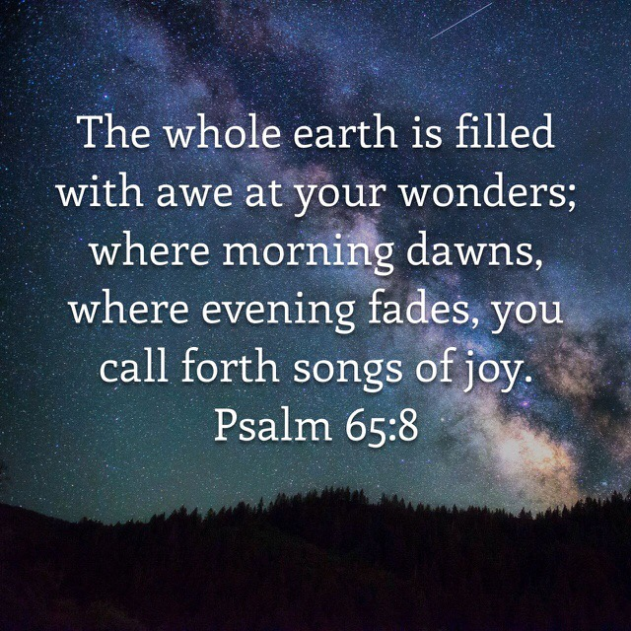
Friday God's Word
Thursday God's Word

Slide 17
Thursday Let us pray
Dear Lord,
May I have a sense of awe and wonder at your created world.
Inspire me to enjoy learning and to be curious about new things.
Show me how to use my knowledge to make the world a better place.
Saint Albert, I ask for your prayers and protection as I grow and learn. Be with me every day, and help me to persist when learning is challenging.
We ask this in the name of Jesus Christ our lord
Amen.
St Albert: Pray for Us

Slide 18
Friday Notices
Next week:
Early Mass Monday 8.15am in the chapel – all welcome

Slide 19
Friday God's Word
Today’s reflection and prayers have been written by pupils in 8 Hope
Friday God's Word
Luke 10:1-9
The Lord appointed seventy-two others and sent them out ahead of him, in pairs, to all the towns and places he himself was to visit. He said to them, ‘The harvest is rich but the labourers are few, so ask the Lord of the harvest to send labourers to his harvest. Start off now, but remember, I am sending you out like lambs among wolves. Carry no purse, no haversack, no sandals. Whenever you go into a town where they make you welcome, eat what is set before you. Cure those in it who are sick, and say, “The kingdom of God is very near to you.”’

Slide 20
Friday: Pupils in 8 Hope have written about what today’s reading means to them
To me, Jesus sending out his disciples to spread the word and tell others shows that Jesus really cares about us and wants us to be as holy as we possibly can be.
Todays reading makes us also think about all refugees who have had to leave their homes due to war and unrest. We should also think about those who are seriously ill and those who care for such ill of health people.
For me Jesus gives his disciples an important job and he needed his best people to do it and follow his instructions. He was putting a very risky task on them, he tells them to leave all possessions behind. Now in this day and age most people have and rely on phones incase of an emergency and he made the disciples leave without anything only each other.

Slide 21
Friday Let us pray
Dear God,
Thank you for guiding and protecting us each day. We are grateful for your unwavering love and care in our lives. We thank you for the blessings of our parents, teachers, and friends, who support us and nurture us in so many ways. We also ask for your healing touch on the refugees and people who are suffering. May they find comfort and strength in your presence. We are grateful for people who selflessly tend to those in need. Bless them with resilience and compassion as they continue to serve others.
Help us to be instruments of your peace and love in the world.
Amen
Dear Lord,
Today we pray for those who are ill and those who care,
We give the families all our support and hope,
Today we can try and realise the true value of a good healthy life for us
Amen

