Slide 1
Daily prayer
16-20 September 2024

Slide 2
Monday
Tuesday
Wednesday
Thursday
Friday

Slide 3
Monday Notices
Today
Period 1 year 9 Mass in the hall
Faith in Action club starts for year 8 – F104
Sacrament of Reconciliation (Confession) with Fr Taras​ Available at breaktime in the chaplaincy on Monday, drop in anytime 10.40-11.20 ​ ​You just spend a few minutes telling God the things you are sorry for and then Fr Taras gives you God's forgiveness​

Slide 4
Monday Praying for the week ahead
Think about the week ahead;
What are you looking forward to?
Is there anything which you are dreading or worried about?
Is there someone you know who needs your prayers this week?
Let's begin the week together in prayer, offering everything which will happen to God and asking for his guidance.

Slide 5
Monday God's Word
Psalm 90, A Prayer of Moses
Lord, you have been our dwelling-place in all generations. Before the mountains were brought forth, or ever you had formed the earth and the world, from everlasting to everlasting you are God.
Satisfy us in the morning with your steadfast love, so that we may rejoice and be glad all our days. Let your work be manifest to your servants, and your glorious power to their children. Let the favour of the Lord our God be upon us, and prosper for us the work of our hands

Slide 6
Monday Let us pray
Father God,
You give us the gift of life to be celebrated, shared and enjoyed. Thank you for the gift of this new week.
Let us remember your presence us in all that is good this week.
May we enable those around us to be fully alive.
Lord, in the week that lies ahead
there will be times when we will be challenged.
Be with us at those times,
Keep us calm and controlled.
And help us learn the hard lessons
As well as the easy ones.
We all respond: Amen.

Slide 7
Tuesday Notices

Slide 8
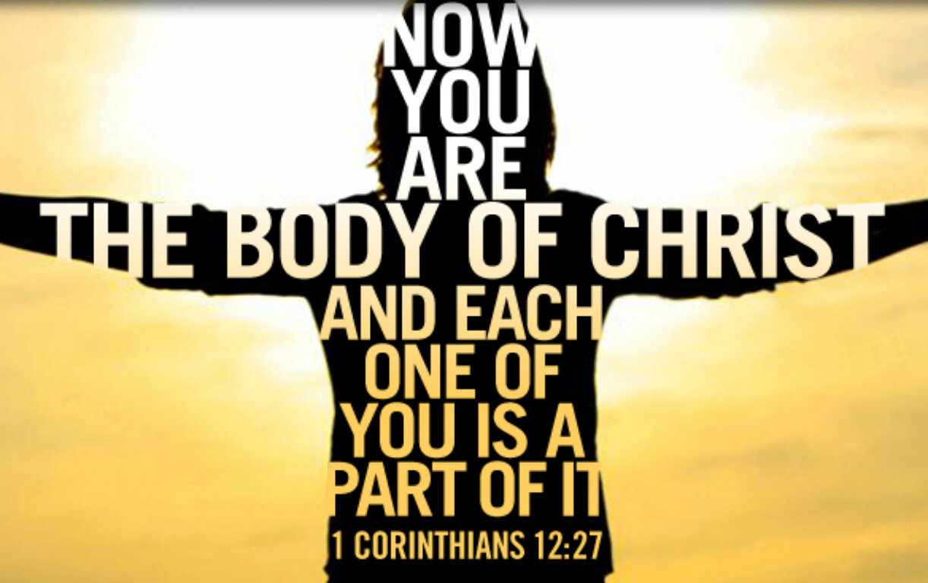
Tuesday God's Word
1 Corinthians 12:12-14,27-31 Just as a human body, though it is made up of many parts, is a single unit because all these parts, though many, make one body, so it is with Christ. In the one Spirit we were all baptised, Jews as well as Greeks, slaves as well as citizens, and one Spirit was given to us all to drink. Nor is the body to be identified with any one of its many parts. Now you together are Christ’s body; but each of you is a different part of it. The word of the Lord Thanks be to God

Slide 9
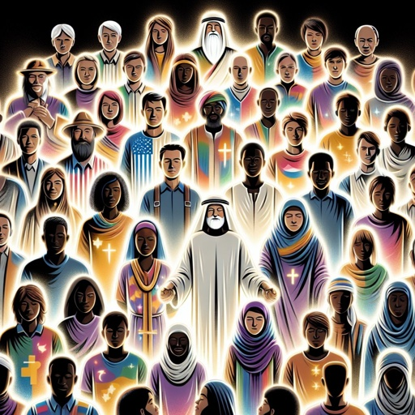
Tuesday Jesus’ outrageous message The message that ‘all are one in Jesus’ –would have been a shocking one in Jesus’ time. The idea that slaves and citizens were equal was so outrageous that the Roman Emperor tried to get rid of Christianity. Today the message feels familiar and less radical. However 2000 years after Jesus proclaimed that ‘all are one’, we still live in a society of inequality and discrimination.
To think about:
What does it mean to be part of Christ’s body?
What can you do today to put Jesus’ teaching of equality into action?

Slide 10
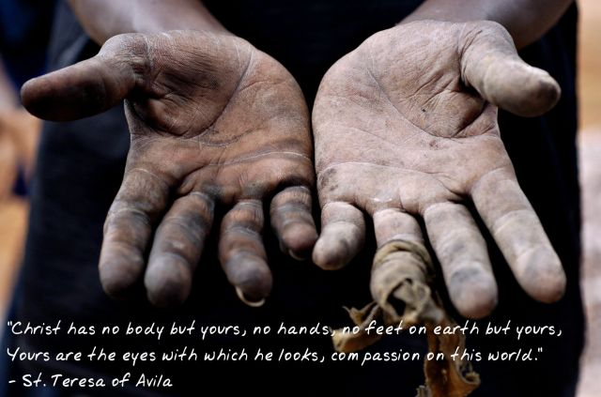
Tuesday Let us pray
The prayer of St Theresa of Avila
Christ has no body but yours, no hands, no feet on earth but yours. Yours are the eyes with which he looks compassionately on this world. Yours are the feet with which he walks to do good. Yours are the hands, with which he blesses all the world. Yours are the hands. Yours are the feet. Yours are the eyes. You are his body. Christ has no body now but yours, no hands, no feet on earth but yours. Yours are the eyes with which he looks compassionately on this world. Amen.

Slide 11
Wednesday Notices

Slide 12
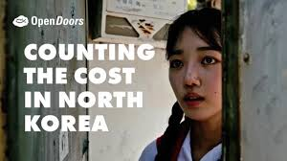
Wednesday Sts. Andrew Kim Taegon, Paul Chong Hasang, and Companions
Today we remember one hundred and three members of the early Korean Christian community who were killed for being Christian during the terrible persecutions that occurred in Korea the 19th century. They were killed because the ruling regime did not allow Christianity. Among the martyrs were a few bishops and priests, but for the most part lay people, men and women, married and unmarried, children, young people, and the elderly. All suffered greatly and bravely for their Faith.
Today in North Korea, people are still persecuted for being Christian, watch this short video to find out more https://vimeo.com/895874588

Slide 13
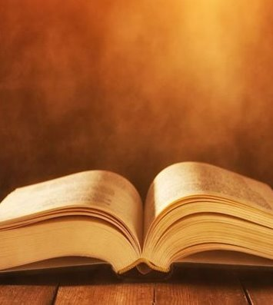
Wednesday God's Word
Matthew 5:10-12
Jesus said
‘Blessed are those who are persecuted for righteousness’ sake, for theirs is the kingdom of heaven.
‘Blessed are you when people revile you and persecute you and utter all kinds of evil against you falsely on my account. Rejoice and be glad, for your reward is great in heaven, for in the same way they persecuted the prophets who were before you.
The word of the Lord
We all say:Thanks be to God

Slide 14
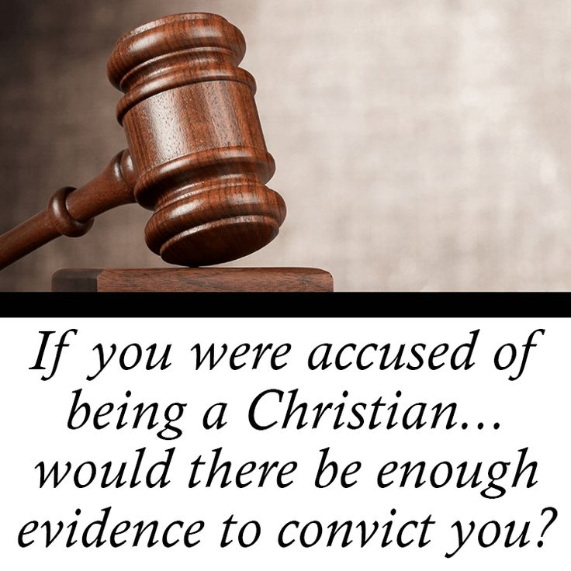
Wednesday Let us pray
Father God,
We thank you for the example of the Korean Martyrs and all who have gone before us in faith.
Give us the courage to openly live by our Christian faith. May we not deny our beliefs in fear of being judged by others.
We pray for Christians who are today persecuted for their faith in Pakistan, Nigeria and Iraq. Give them the courage they need and grant a spirit of religious tolerance in their communities.
We all respond: Amen.

Slide 15
Thursday Notices

Slide 16
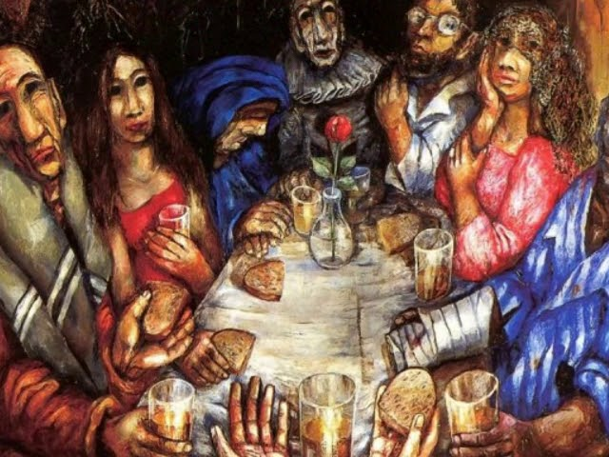
Thursday God's Word
To think about
Why does Jesus choose to socialise with the kind of people that others think are bad or unsuitable?
Who would Jesus eat with today?
A Reading from Matthew's Gospel
As Jesus was walking on, he saw a man named Matthew sitting by the customs house, and he said to him, ‘Follow me.’ And he got up and followed him.
While he was at dinner in the house it happened that a number of tax collectors and sinners came to sit at the table with Jesus and his disciples. When the Pharisees saw this, they said to his disciples, ‘Why does your master eat with tax collectors and sinners?’ When he heard this he replied, ‘It is not the healthy who need the doctor, but the sick. Go and learn the meaning of the words: What I want is mercy, not sacrifice. And indeed I did not come to call the virtuous, but sinners.’
The word of the Lord
Thanks be to God

Slide 17
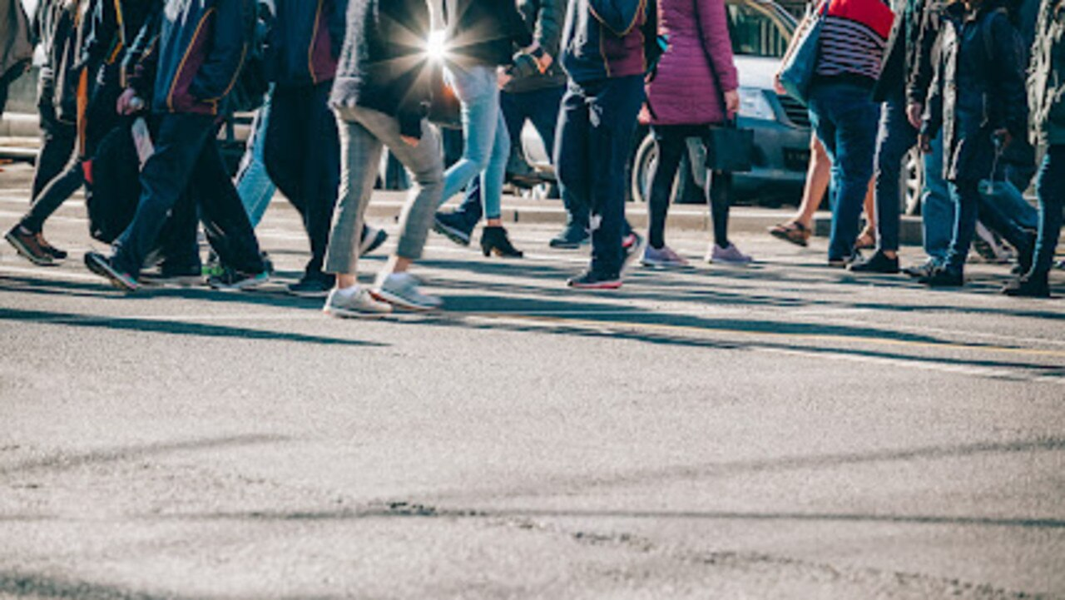
Thursday
Saturday is the feast day of the apostle Matthew. In the Gospel story we have just heard, Jesus and Matthew did not plan to meet. They just came across each other. But in that chance meeting Matthew’s life was completely changed.
God often comes to us in the chance encounters of a day: in the people we accidentally meet, in those we pass or who we come across. The story also reminds us that God often works through those people we write off as unsuitable.
Let us pray that we might recognise God’s presence in the people and situations we come across today.

Slide 18
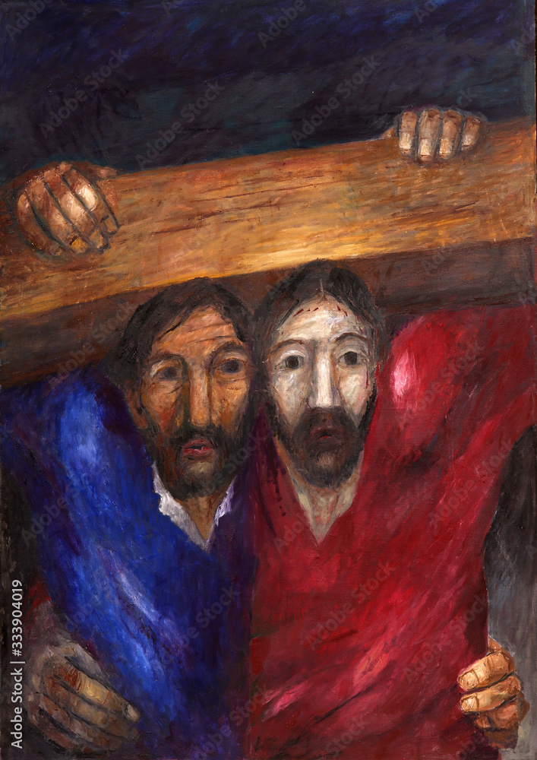
Thursday Let us pray
Lord, I offer you this day and invite you to share it with me. Touch my day with your hand. Guide all my actions, my thoughts and feelings.
May I recognise you in those I meet today.
Give me the courage to respond when you invite me into action.
Amen

Slide 19
Friday Notices
Y8 – Science STEM club in M001 @ 15:15 (Term theme: Witchcraft and Wizardry)
Next Monday
8.15am Mass in the chapel – all welcome (years 7-11 enter school via the front door)
Faith in Action club for year 8 – F104
Sacrament of Reconciliation (Confession) with Fr Taras​ Available at breaktime in the chaplaincy on Monday, drop in anytime 10.40-11.20 ​ ​You just spend a few minutes telling God the things you are sorry for and then Fr Taras gives you God's forgiveness​

Slide 20
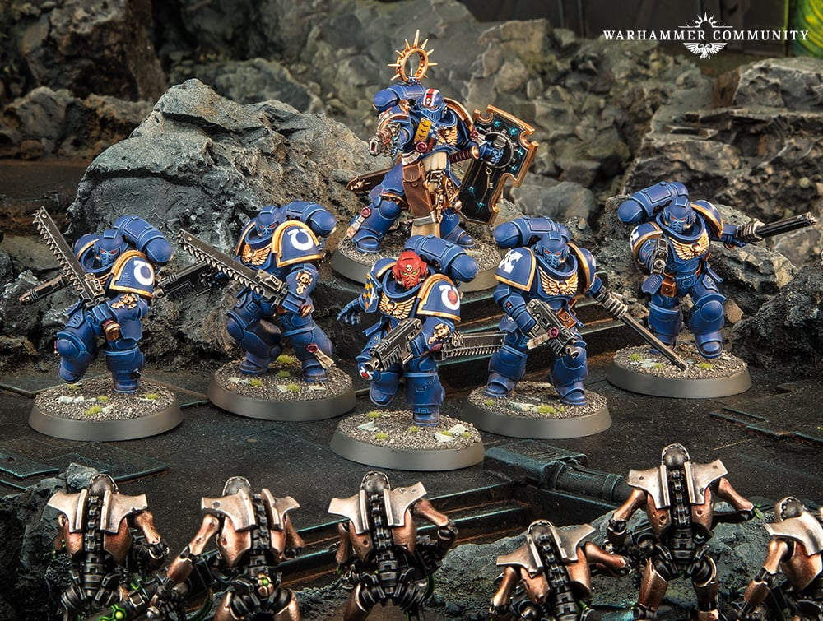
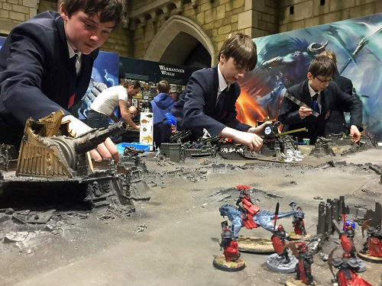
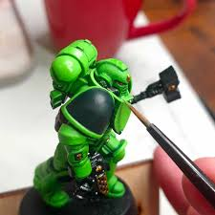
CLUB
STARTS TONIGHT
LEARN to play TABLETOP STRATEGY GAMES like
WARHAMMER
WARHAMMER 40K
LEARN to assemble and paint FIGURES
F104
3.10-4.10pm
Fridays
(A week only)

Slide 21
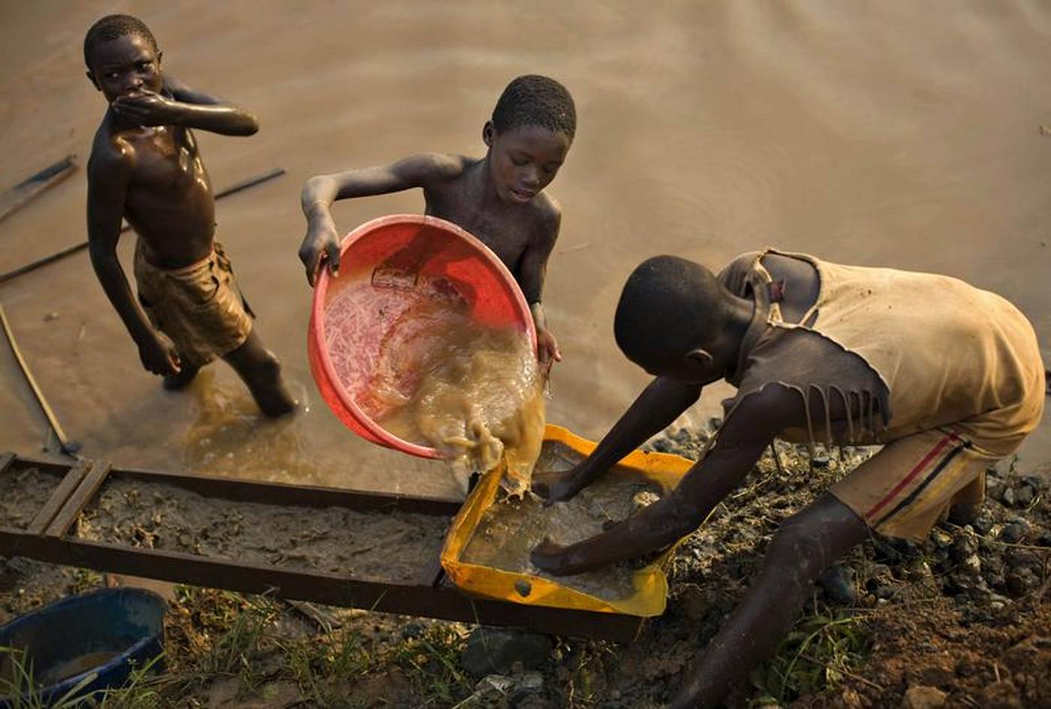
Friday to think about INJUSTICE
Todays prayer was written by pupils in 8 Domingo
Some of us feel really angry that football clubs like Man City have not obeyed the rules and used more money than they should to give them an advantage. This is unfair.
There are many other unfair situations in the world which we should also be angry about for example:
Countries where girls can't go to school
People who have to migrate because of war and then get treated badly in the country they go to
the kids in the Congo who are forced to mine Coltan
Dear brothers and sisters, today we turn our hearts and minds to a grave injustice happening in the shadows of our world—an injustice that strikes at the most innocent among us: the children of the Congo. These children, too young to bear such burdens, are being forced into the depths of the earth to mine coltan, a precious mineral that powers the devices we use every day.

Slide 22
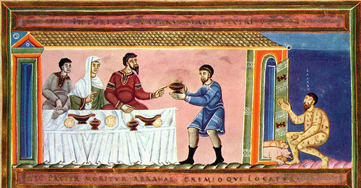
Friday God's Word
Luke 16
The parable of Lazarus and the Rich man
Jesus told this story,
“There was a rich man who was dressed in purple and fine linen and lived in luxury every day. At his gate was laid a beggar named Lazarus, covered with sores and longing to eat what fell from the rich man’s table. Even the dogs came and licked his sores.
“The time came when the beggar died and the angels carried him to Abraham’s side. The rich man also died and was buried. In Hades, where he was in torment, he looked up and saw Abraham far away, with Lazarus by his side. So he called to him, ‘Father Abraham, have pity on me and send Lazarus to dip the tip of his finger in water and cool my tongue, because I am in agony in this fire.’
“But Abraham replied, ‘Son, remember that in your lifetime you received your good things, while Lazarus received bad things, but now he is comforted here and you are in agony. And besides all this, between us and you a great chasm has been set in place, so that those who want to go from here to you cannot, nor can anyone cross over from there to us.’
The word of the Lord We all respond: Thanks be to God
Friday God's Word
To think about
What how does God treat those who act without justice and compassion?
Which character are you more like, Lazarus or the rich man?
How can you make a difference to the lives of those children who are forced to mine coltan?

Slide 23
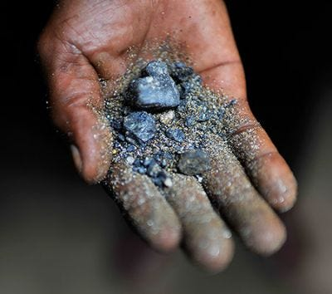
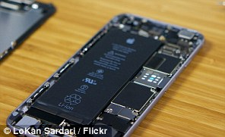
Friday Let us pray
Loving God,
We come before you, humbly acknowledging the inequality that exists in our world. Forgive us for the times when we have turned a blind eye to the suffering of others, or when our own actions have deepened the divide.
We thank you for the blessings we enjoy, but we also ask for the strength to use them right. Open our hearts to the voices of the marginalized and the forgotten, and empower us to stand up for them. Give us the wisdom to question the systems of oppression and the courage to act in ways that will uplift and restore fairness. Help us become your hands in creating a world where all are equally valued and no one is left behind.
In Your grace, we find unity; in your mercy, a better world, one of justice.
Amen

