Slide 1
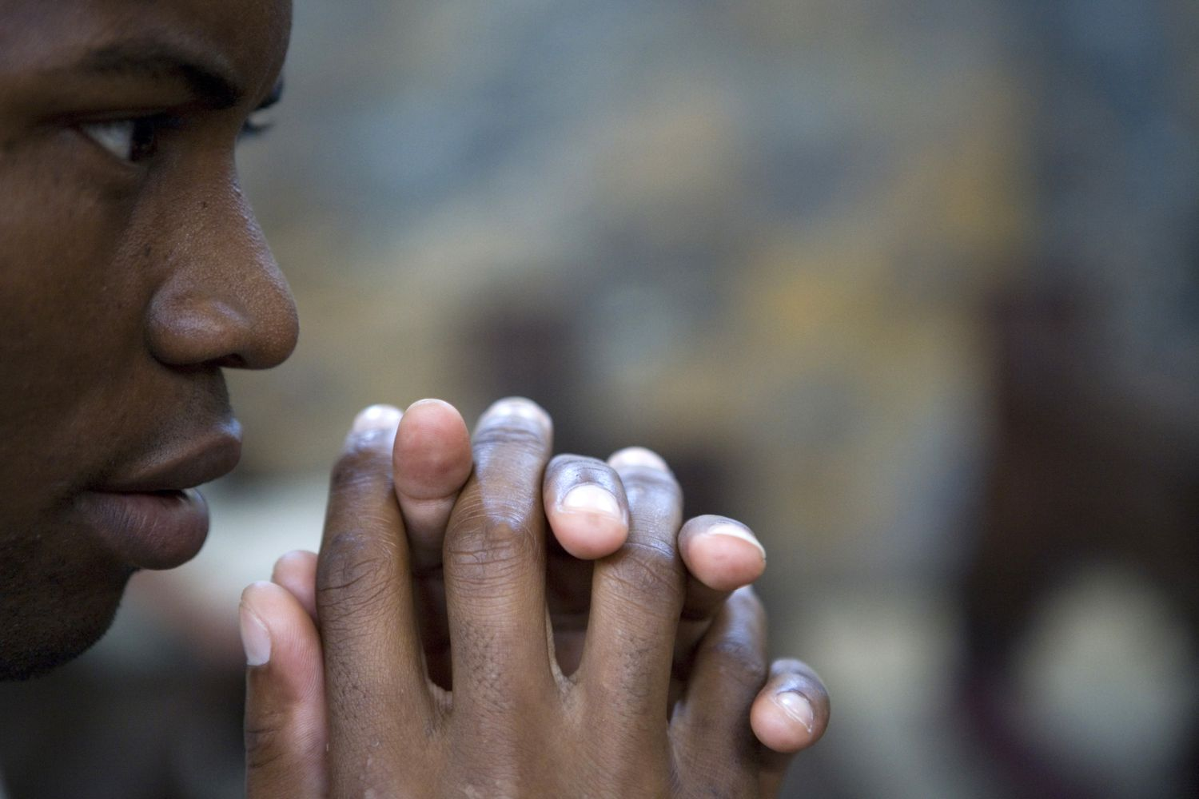
Daily Prayers
18th-22nd November

Slide 2
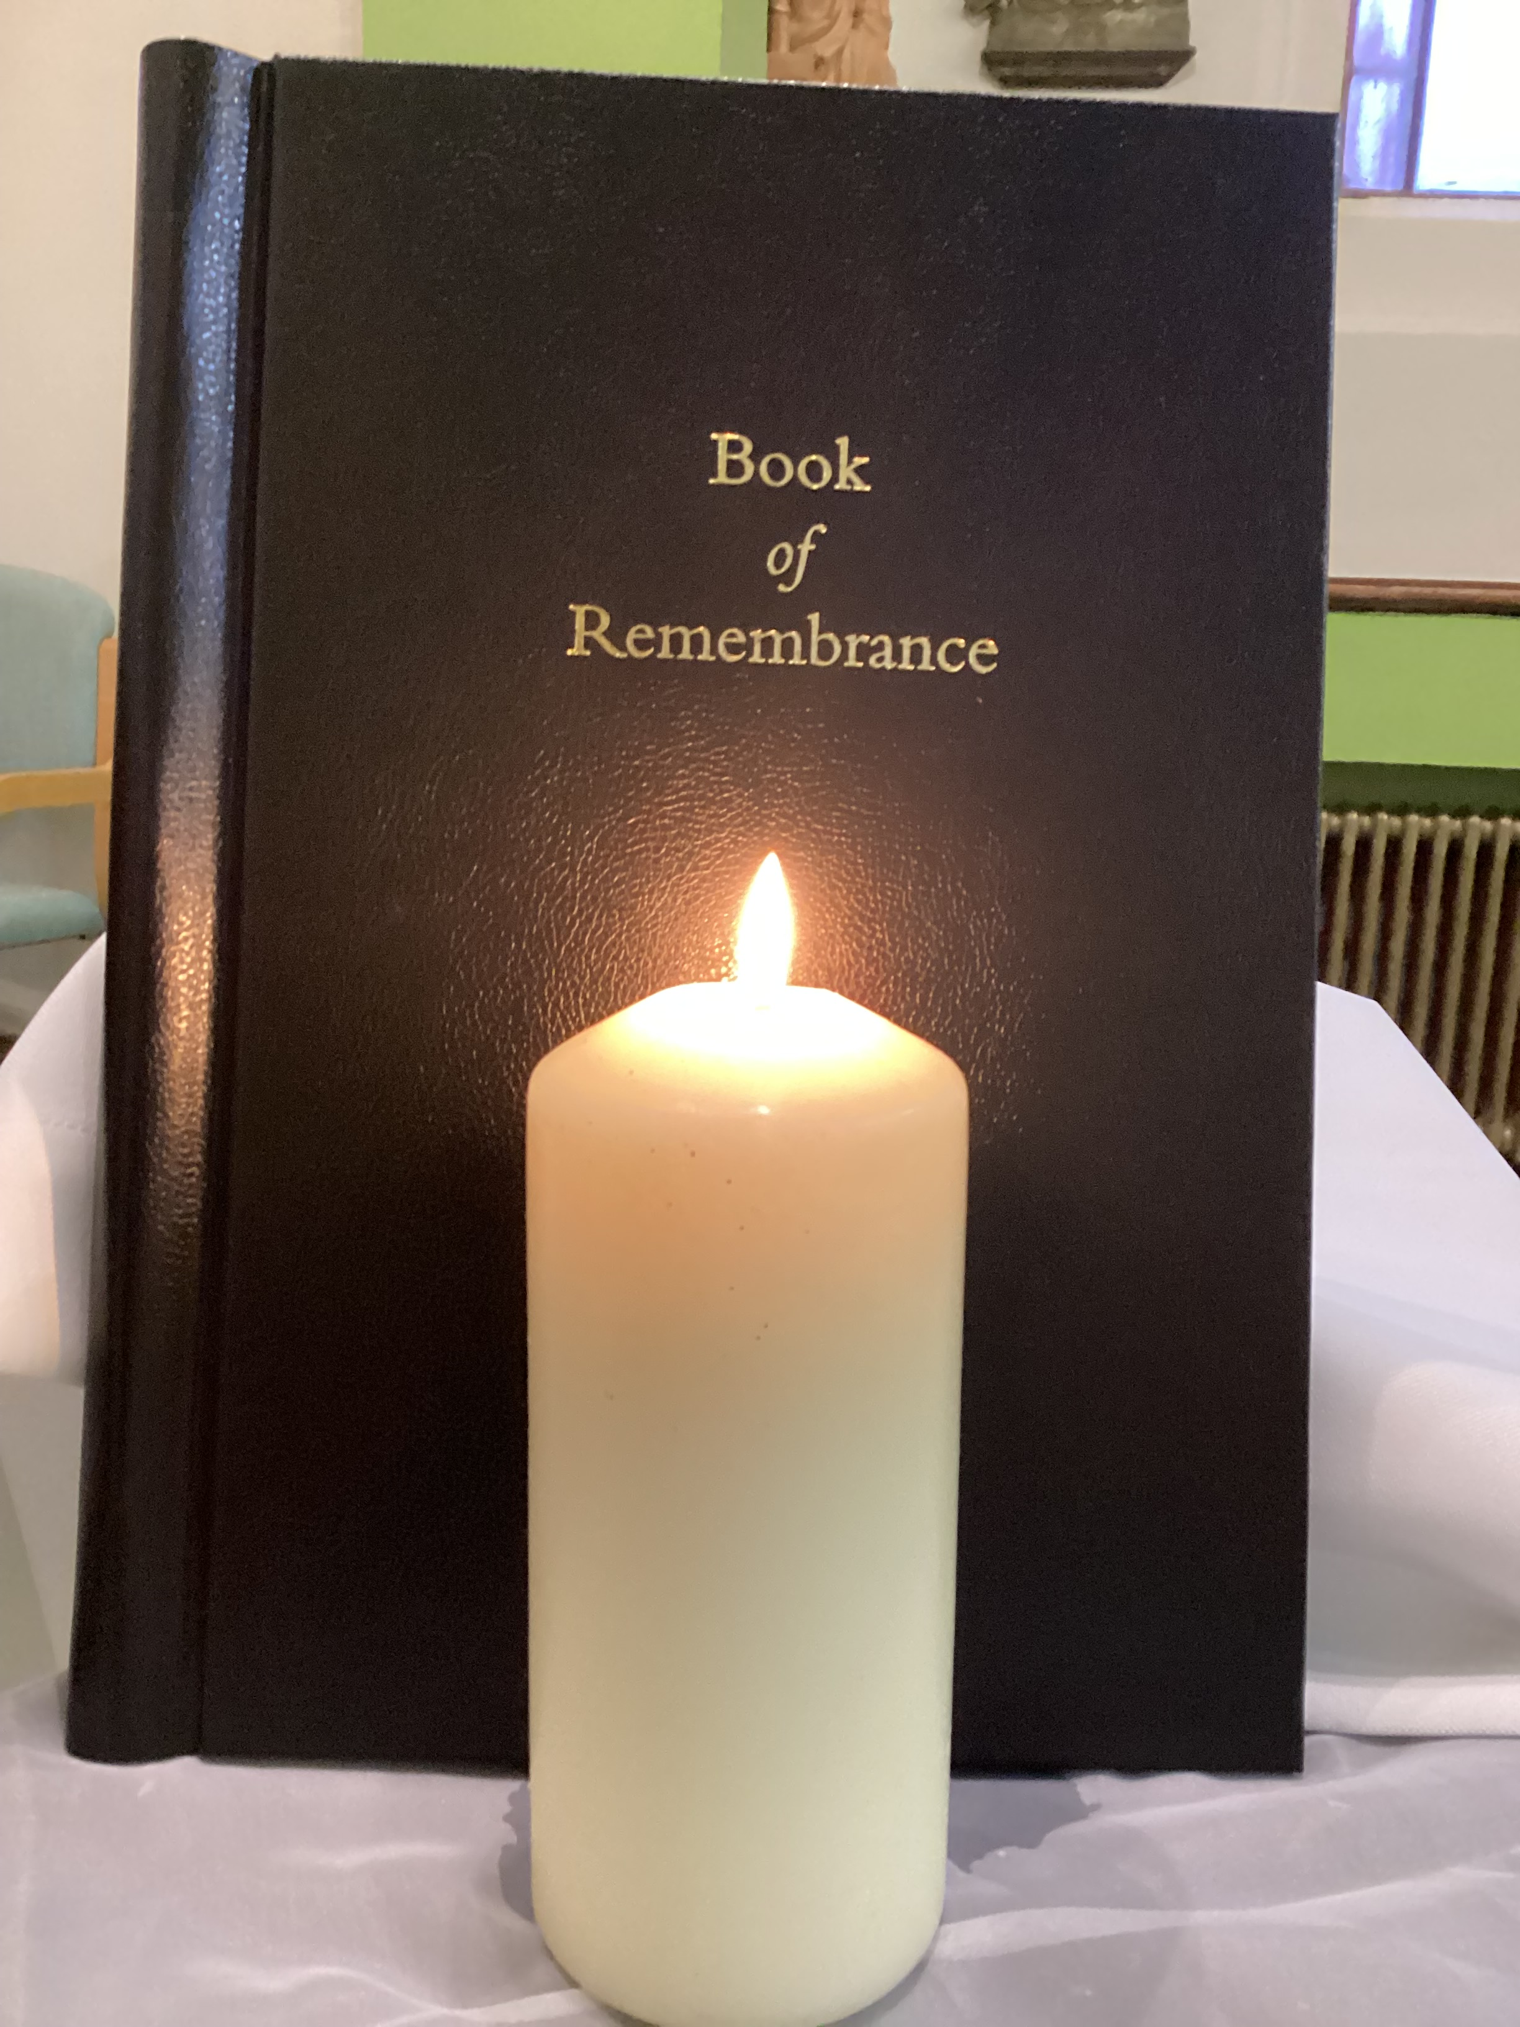
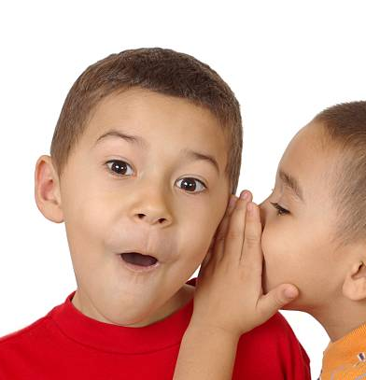
Monday Notices
Mass – year 10 period 3
Sacrament of reconciliation (confession) available 10.40-11.20 in the chaplaincy
St Edward’s College
Book of Remembrance
Is now open in the chapel. During November you are invited to write in the names of loved ones who have died in our Book of Remembrance. They will prayerfully be remembered throughout the month and especially at our All Souls Mass on Monday 25th November..
Pupils are welcome in the chapel at breaktimes, lunchtime and before or after school.

Slide 3
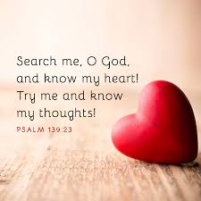
Psalm 139
The Inescapable God
O Lord, you have searched me and known me. You know when I sit down and when I rise up; you discern my thoughts from far away. You search out my path and my lying down, and are acquainted with all my ways. Even before a word is on my tongue, O Lord, you know it completely. You hem me in, behind and before, and lay your hand upon me. Such knowledge is too wonderful for me; it is so high that I cannot attain it.
Monday God's Word

Slide 4
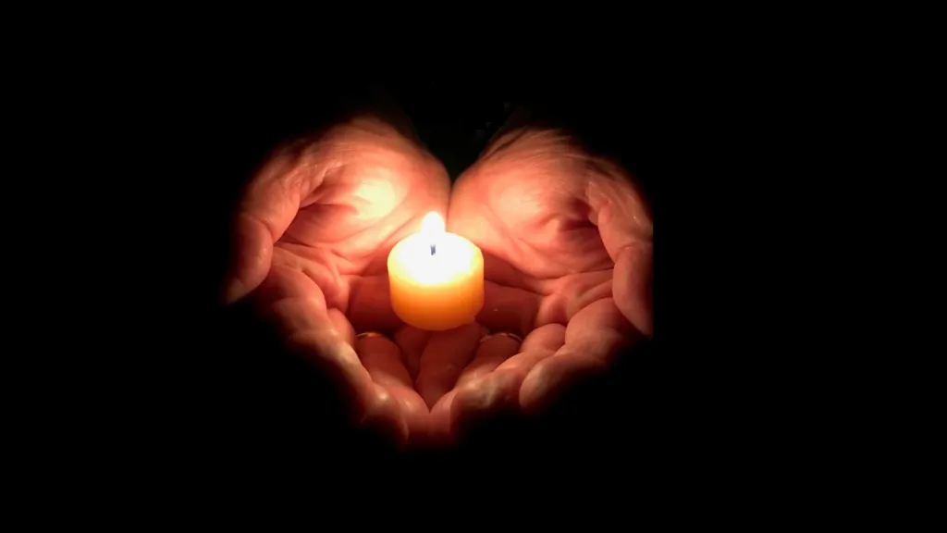
Monday – to think about
God the Father knows you better than you know yourself.
At the beginning of a new week spend some time in silence with God.
Just try to open your heart to let God look in.

Slide 5
Tuesday: Words from Pope Francis
Monday: Let us pray
Father,
You have brought us to the beginning of a new week.
Your hand is upon us to care for and protect us.
We offer you our lives and hearts,
May we always do your will,
And love our neighbour as ourselves
Amen
St Edward: Pray for us!

Slide 6
Tuesday Notices
TOMORROW is RED WEDNESDAY All members of the school community are encouraged to replace an item of their uniform with something red in support of victims of religious discrimination globally. (This is not a non uniform day)
Pupils in Years 7 - 11 have the opportunity to purchase St Edward's College coats. These can be worn at break and lunch.
Pupils who come to school in a non-St Edward's College coat must remove the coat at the Foley Gate in the morning. The coat must be stored in a locker or bag - not carried around school and not worn during the school day at all

Slide 7
Tuesday Praying for those who mourn
Death is an inevitable part of life. Losing those we love is something which we will all have to face during our lives. Grief can feel overwhelming. One way we can help those who are grieving is by our prayers.

Slide 8
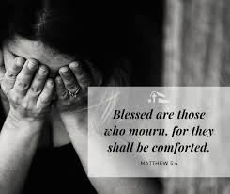
Tuesday God's Word
A reading from Matthew's Gospel
Jesus said:
'Blessed are those who mourn, for they will be comforted'
Psalm 30:11
“You have turned my mourning into dancing, you have stripped off my sackcloth and clothed me with joy. ”

Slide 9
Tuesday: Let us pray
Bless those who mourn, eternal God, with the comfort of your love. That they may face each new day with hope, and the certainty that nothing can destroy the good that has been given. May their memories become joyful, their days enriched with friendship, and their lives encircled by your love. Amen.
and for all whose names are written in our Remembrance book we pray:
Eternal rest grant unto them, O lord;
And let perpetual light shine upon them.
May they rest in peace
Amen

Slide 10
Wednesday Notices
Pupils in Years 7 - 11 have the opportunity to purchase St Edward's College coats. These can be worn at break and lunch.
Pupils who come to school in a non-St Edward's College coat must remove the coat at the Foley Gate in the morning. The coat must be stored in a locker or bag - not carried around school and not worn during the school day at all

Slide 11
Wednesday To think about
Today is Red Wednesday. Christians across the world are remembering those who are not free to practice their Faith. This year the focus is on Christian persecution in Africa.
In parts of Africa, especially Sub-Saharan Africa, an explosion of terrorism has seen a 70% increase in extremist violence against Christians and other minority faith minorities. The destruction and displacement of communities, torture, killings and sexual slavery are the reality for millions of people.
For example sixteen-year-old Maryamu from Nigeria escaped Boko Haram in July after being held against her will for nine years. Her family were murdered by the Boko Haram.

Slide 12
Wednesday – God's Word
A Reading from Matthew's Gospel
But I say to you, Love your enemies and pray for those who persecute you, so that you may be sons of your Father who is in heaven; for he makes his sun rise on the evil and on the good, and sends rain on the just and on the unjust. – Jesus Christ
The word of the Lord
Thanks be to God

Slide 13
Wednesday Let us pray
God our Father,
We offer our heartfelt prayers for persecuted Christians throughout the world, and for all people of goodwill who suffer violence, religious discrimination and intolerance on religious grounds.
We ask you Lord to accompany our Christian brothers and sisters who endure persecution. Give them the strength to respond to hatred with love.
Through Christ our Lord,
Amen

Slide 14
Thursday Notices
Year 11 are banned from playing football at break and lunchtime for the foreseeable
NO footballs allowed
Congratulations to all those pupils who Join In and are selected for sports fixtures. It's a fantastic thing to do. Remember that for fixtures you always come to school in your uniform and change for the match later in the day. Just sometimes, there may be a reason why this will be different. If this happens, your teacher will inform you and inform all staff.
Pupils in Years 7 - 11 have the opportunity to purchase St Edward's College coats. These can be worn at break and lunch.
Pupils who come to school in a non-St Edward's College coat must remove the coat at the Foley Gate in the morning. The coat must be stored in a locker or bag - not carried around school and not worn during the school day at all

Slide 15
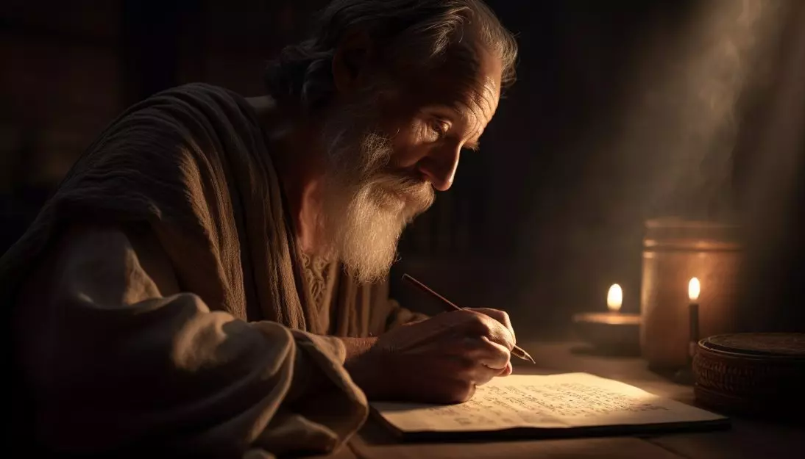
Thursday God's Word
2 Thessalonians 3:10-13
St Paul writes to the Christian community in Thessalonica (northern Greece):
“Do not let anyone have any food if he refuses to do any work. Now we hear that there are some of you who are living in idleness, doing no work themselves but interfering with everyone else’s. In the Lord Jesus Christ, we order and call on people of this kind to go on quietly working and earning the food that they eat. My brothers, never grow tired of doing what is right”
The word of the Lord
Thanks be to God

Slide 16
Thursday to think about
St Paul’s letters give us a glimpse of what it was like at the beginning of Christianity and it seems that humans were not much different to now: some people were relying on others to do their share of work, and some people liked interfering in other’s business!
‘Never grow tired of doing what is right’
Doing the right thing is often the harder thing to do, it is tiring.
Think of a time when was hard to do what you knew was right.
Are you finding it hard to do the right thing at the moment?
Ask God for courage and enthusiasm.

Slide 17
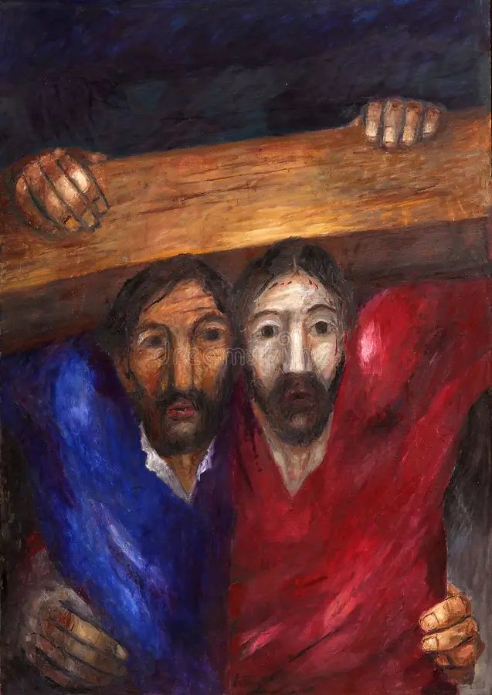
Thursday: Let us pray
Father of love,
You created humans in your infinite wisdom.
Energise us when we find life hard work.
Guide us when we are tempted to do the wrong thing.
We ask this through Jesus your son
Amen

Slide 18
Friday Notices
Year 11 are banned from playing football at break and lunchtime for the foreseeable
NO footballs allowed
Congratulations to all those pupils who Join In and are selected for sports fixtures. It's a fantastic thing to do. Remember that for fixtures you always come to school in your uniform and change for the match later in the day. Just sometimes, there may be a reason why this will be different. If this happens, your teacher will inform you and inform all staff.
All Souls Mass
Monday period 3
Representatives from each form will attend to pray for all of our family and friends who have died.
Each Form should collect a page of the remembrance book to complete in form time today

Slide 19
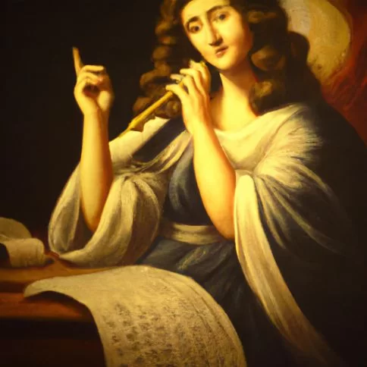
Friday – Feast of St Cecilia
To think about:
Think of a piece of music you like.
How does it make you feel when you listen to it?
What would the world be like without music?
St Cecilia is the patron saint of music. She was one of the earliest Christian martyrs and sang in her heart during very difficult circumstances.
Today we thank God for the gift of music in our lives, for work of the music department and all those involved in music in our school

Slide 20
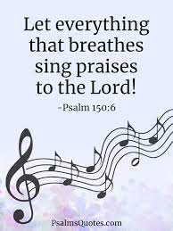
Friday: God's Word
Psalm 150
^{Praise the Lord!}
^{Praise God in his Temple!} ^{Praise his strength in heaven!} Praise him for the mighty things he has done. ^{Praise his supreme greatness.}
^{Praise him with trumpets.} Praise him with harps and lyres. Praise him with drums and dancing. Praise him with harps and flutes. ^{Praise him with cymbals.} ^{Praise him with loud cymbals.} Praise the Lord, all living creatures!

Slide 21
Friday: Let us pray
St. Cecilia, We are grateful for the music in our lives. Help us to use our talents for your glory and good of others. May we bring joy to those around us with our musical talents just as you did by singing.
We ask for your blessing and protection for all involved in music at our school – the staff, choristers, and musicians.
We ask this in the name of Jesus Christ. Amen.

