Slide 1
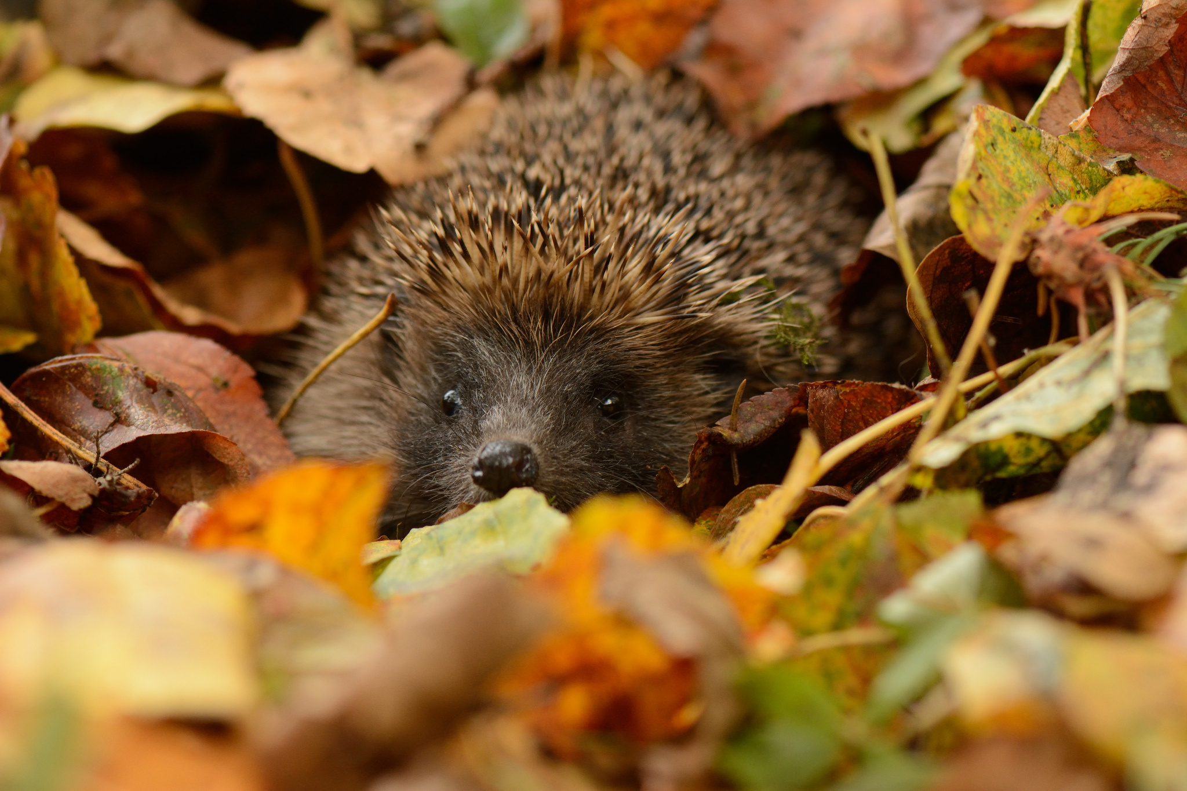
Daily prayer
30 September – 4 October 2024

Slide 2
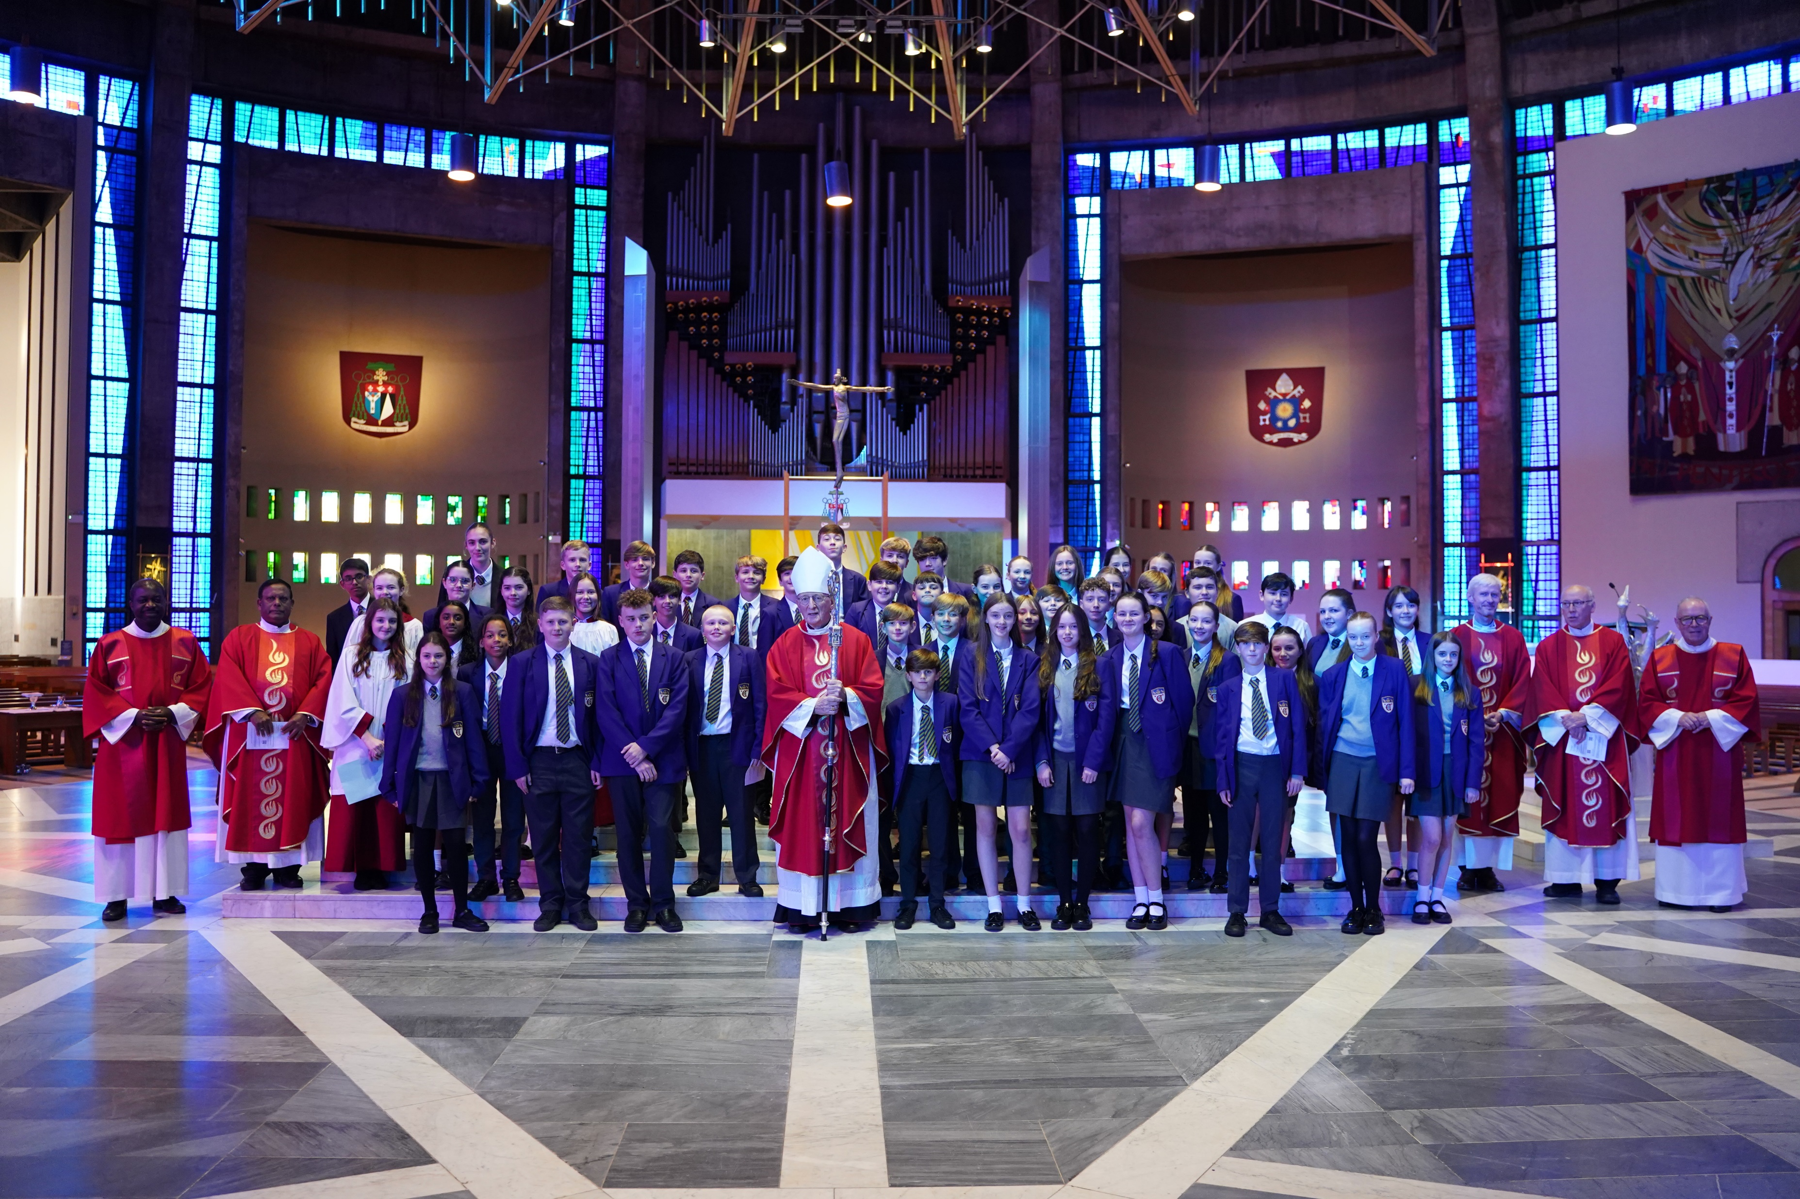
Monday Notices
Today
Year 8 Mass period 1 Monday
Confirmation preparation day is TODAY periods 2-5
Pupils in Years 9-11 who are due to be confirmed should go to F104 at the start of period 2. If you don’t attend you will not be able to be confirmed
Come and receive God's forgiveness – Receive the sacrament of reconciliation (confession) in the chaplaincy 10.40-11.20 (Clare building)

Slide 3
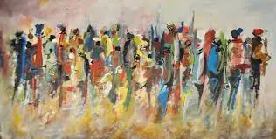
Monday God's Word
A reading from Luke's Gospel
The Lord appointed seventy-two others and sent them out ahead of him, in pairs, to all the towns and places he himself was to visit. He said to them, ‘The harvest is rich but the labourers are few, so ask the Lord of the harvest to send labourers to his harvest. Start off now, but remember, I am sending you out like lambs among wolves. Carry no purse, no haversack, no sandals. Salute no one on the road. Whatever house you go into, let your first words be, “Peace to this house!” The word of the Lord
Thanks be to God

Slide 4
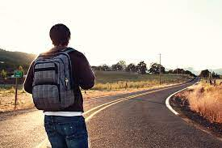
Monday – to think about
In today's reading we hear Jesus sending out his disciples to help him in his mission. He makes it clear that they don't need any material possessions.
Which possessions would you find it hard to leave behind?
What might God be asking you to do today?

Slide 5
Monday Let us pray
At the start of a new week, lets have a few moments silence…
Lord, I offer you this unused day. I offer the enthusiasm and also any reluctance I feel for what lies ahead. Be with me in my fears, to calm my mind. Be with me in success and surprises, to help me celebrate. Be with me in the silence, to deepen my love for you today. Amen

Slide 6
Tuesday Notices
Year 8 Colours Celebration Assembly – 11.05
Football at lunchtime: Year 8 and 9 on the astro - cannot use the yards
Year 7 have both yards – cannot use the astro

Slide 7
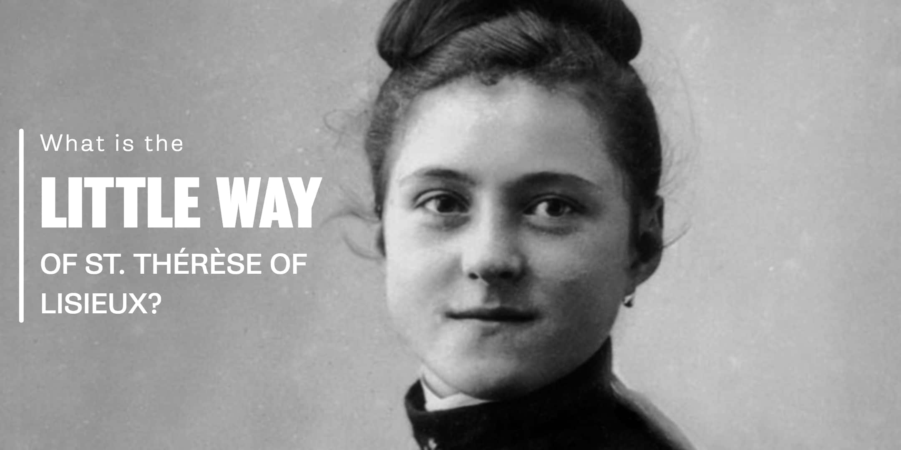
Tuesday: the feast of St Therese of Lisieux
St Therese lived an unknown and quiet life – she entered a French convent at age 15 and remained there until she died at age 24. However she remains one of the world’s favourite saints because of her ‘Little Way’.
The Little Way is about being unimportant and doing the smallest actions with great love. Instead of focusing on large actions, we should bring God into our smallest ones.
It is easy to spend a lot of time thinking about ourselves and what others think of us. Thérèse, shows us how to look beyond ourselves, to forget ourselves in quiet acts of love.

Slide 8
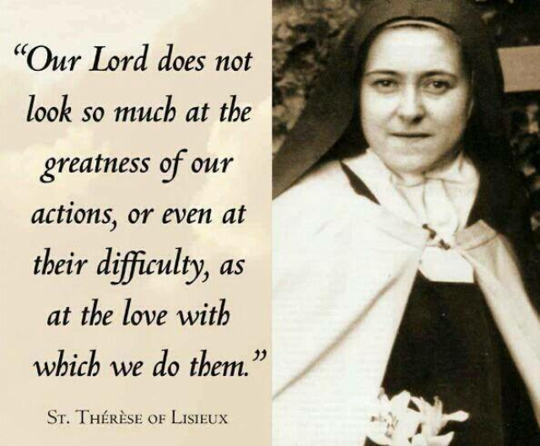
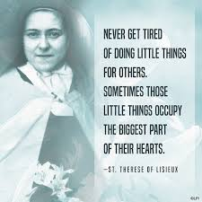
Tuesday God's Word
To think about:
Who do you know who is good at doing ‘little things with great love’?
Challenge: Do one small thing with love today

Slide 9
Tuesday Let us pray
Today’s prayer is a blessing written by St Therese.
Sit quietly, lower or close your eyes and as you listen let the blessing rest on you today.

Slide 10
Wednesday Notices
Confirmation candidates – all years
Meeting with Archbishop Malcom today
Come to the hall at the start of period 5 today (do not go to your lesson first).
Year 10 Colours Celebration Assembly – 10.45
Football at lunchtime: Year 7 and 8 on the astro - cannot use the yards
Year 9 have both yards – cannot use the astro

Slide 11
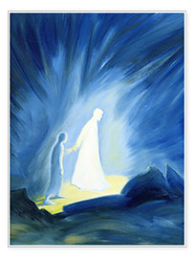
Wednesday Feast of Guardian Angels
It is Catholic tradition that each and every human soul has a Guardian Angel who protects them from both spiritual and physical evil. The bible tells us how Jesus was strengthened by an angel in the Garden of Gethsemane, and that an angel delivered St. Peter from prison.
Today's feast reminds us that God cares for us each individually. We all know this in theory, but it is easy to convince ourselves that we are too small to matter.
Also today let's pray for our own Guardian Angel. What hard work some of us must give them!

Slide 12
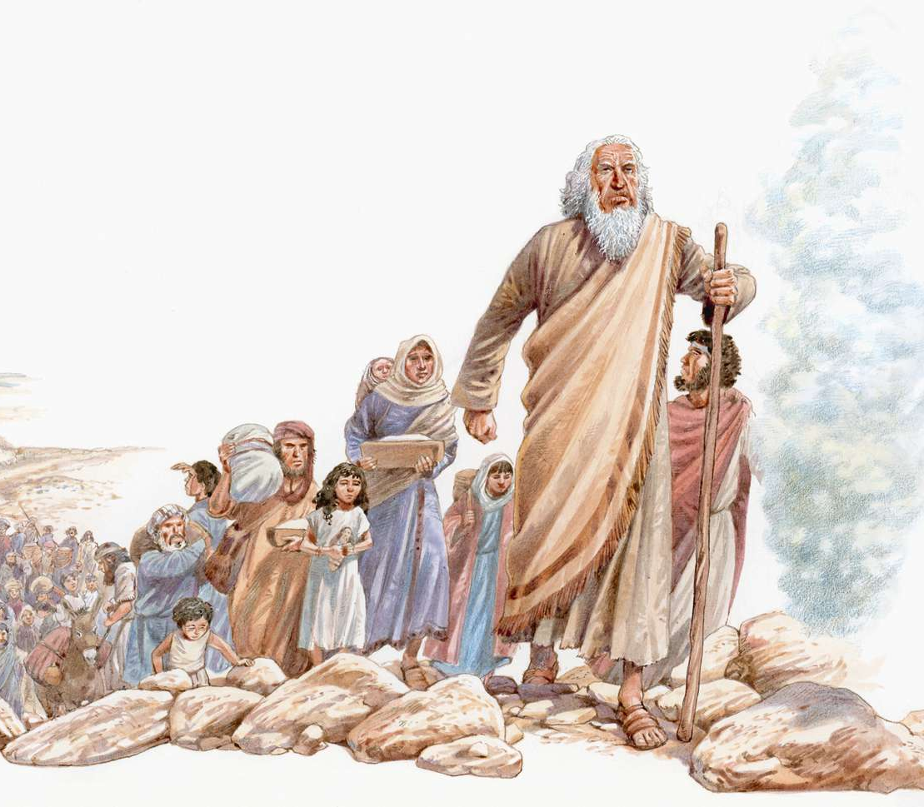
Wednesday God's Word
A Reading from the Book of Exodus
The Lord said to Moses: ‘I myself will send an angel before you to guard you as you go and to bring you to the place that I have prepared. Give him reverence and listen to all that he says. Offer him no defiance; he would not pardon such a fault, for my name is in him. If you listen carefully to his voice and do all that I say, I shall be enemy to your enemies, foe to your foes. My angel will go before you.
The word of the Lord
Thanks be to God

Slide 13
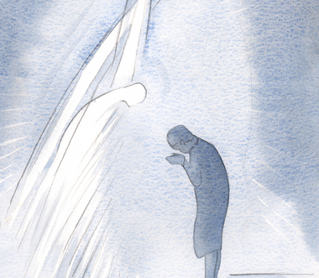
Wednesday Let us pray
In a moment of quiet think about what you would like to ask for help with today
We say together:
Angel of God, my Guardian dear, to whom His love commits me here, ever this day be at my side, to light and guard, to rule and guide. Amen.

Slide 14
Thursday Notices
Today
Year 9 Colours Celebration Assembly – 11.05
Football at lunchtime: Year 7 and 9 on the astro - cannot use the yards
Year 8 have both yards – cannot use the astro
Tomorrow
Friday morning meditation – 8.25am in the chapel
Begin the day with a few minutes of quiet prayer – all welcome

Slide 15
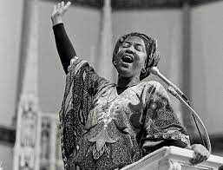
Thursday Black History Month
There are so many black Christians whose holy lives have inspired others in faith. Today we remember Sr Thea Bowman, an African- American who fought prejudice, suspicion, hatred and things that drive people apart until her death in 1990. Watch the first minute of this short film to learn more about Thea's life.

Slide 16
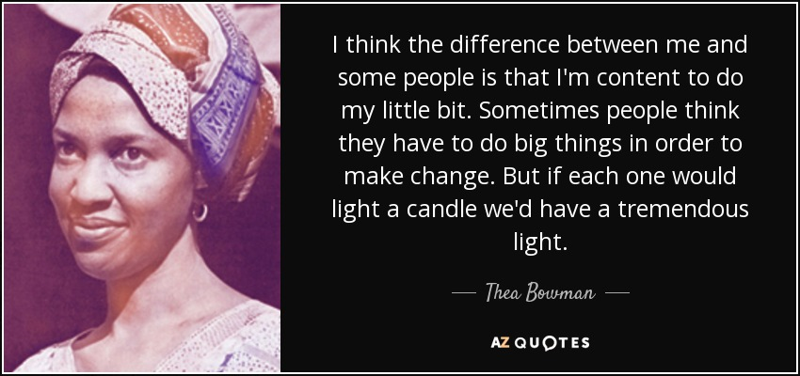
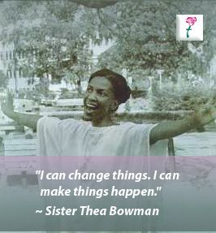
Tuesday God's Word
To think about
What would you like to change about the world?
What difference can you make today to the lives of those around you?

Slide 17
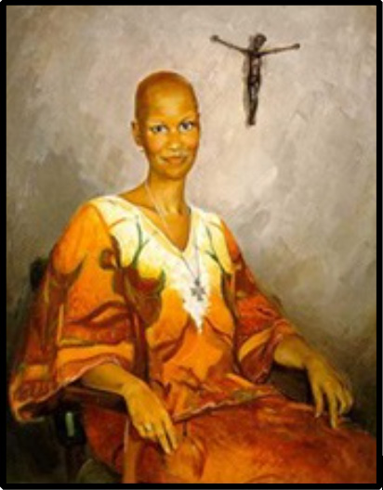
Tuesday Let us pray
Gracious God, Grant us the grace and perseverance that you gave your servant, Sister Thea. For in turbulent times of racial injustice, she sought equity, peace and reconciliation. In times of intolerance and ignorance, she brought wisdom, awareness, unity and charity. In times of pain, sickness and suffering, she taught us how to live fully.
May I imitate her love for you.
We ask this through your Son and our Saviour, Jesus Christ. Amen.

Slide 18
Friday Notices
Today
Year 7 form captains please go to the chapel in form time
Next week:
Early Mass Monday 8.15am in the chapel – all welcome
Year 7 Mass period 1 Monday
Football at lunchtime: Year 7and 8 on the astro - cannot use the yards
Year 9 have both yards – cannot use the astro

Slide 19
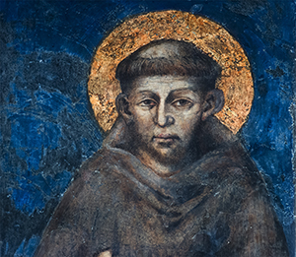
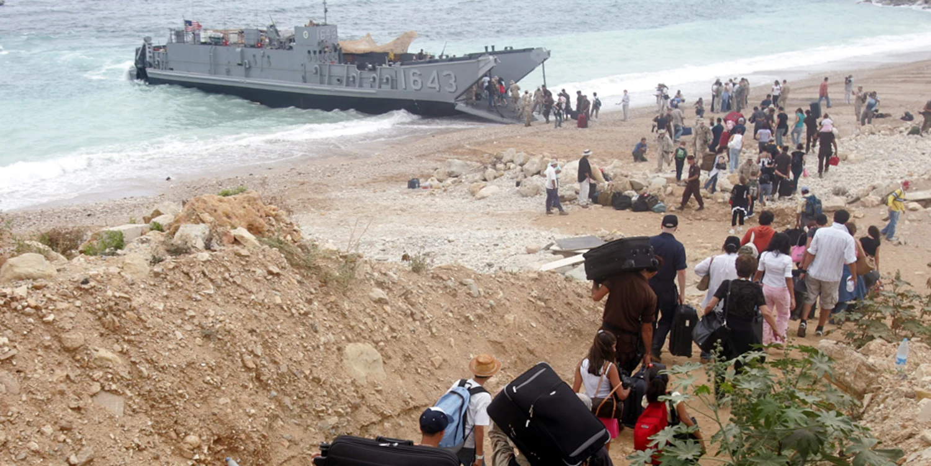
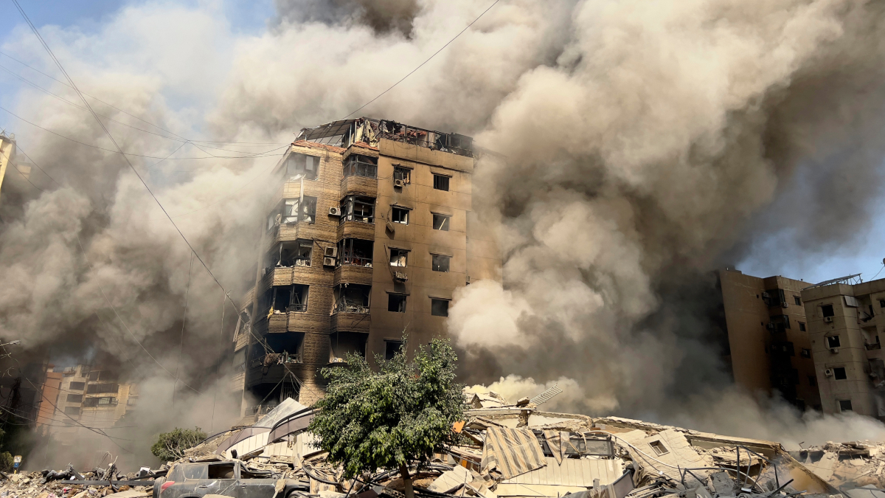
Friday – Feast of St Francis of Assisi
Today we celebrate St Francis of Assisi, who is remembered for being a man of deep peace.
This is contrasted with the violence, war and unrest in he world. Today we remember especially the people of Lebanon who are fleeing their homes after bombing raids.
We can feel helpless when confronted with these scenes in the news. Although can feel like prayer is not enough, sometimes pray is all we can do.

Slide 20
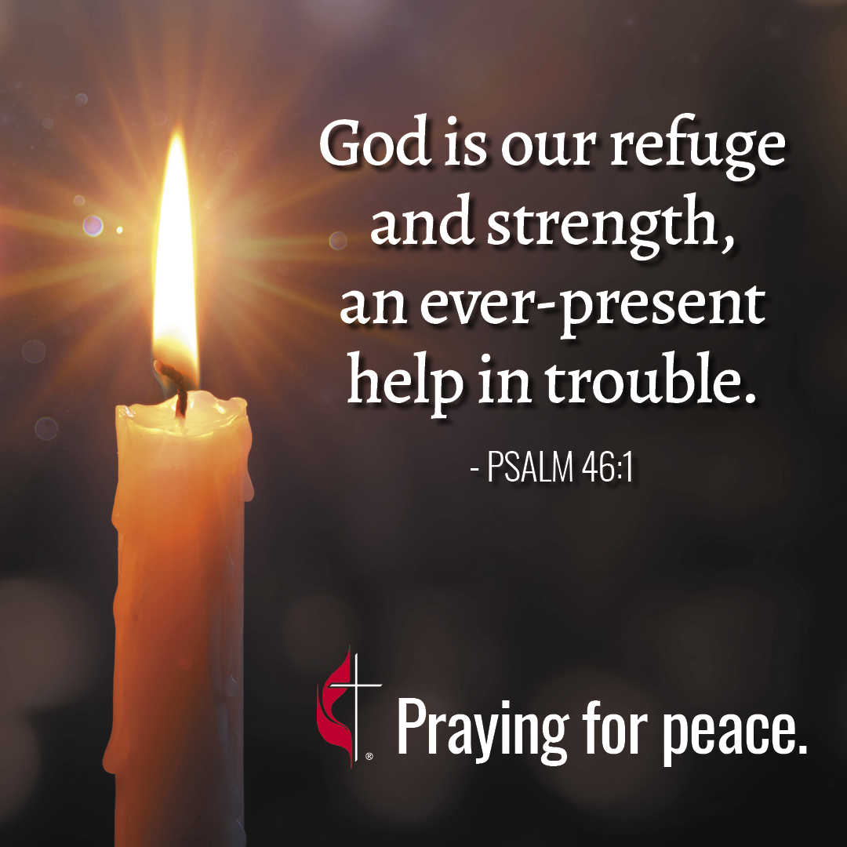
Let us have a time of silent prayer for all those living in war, violence and conflict.

Slide 21
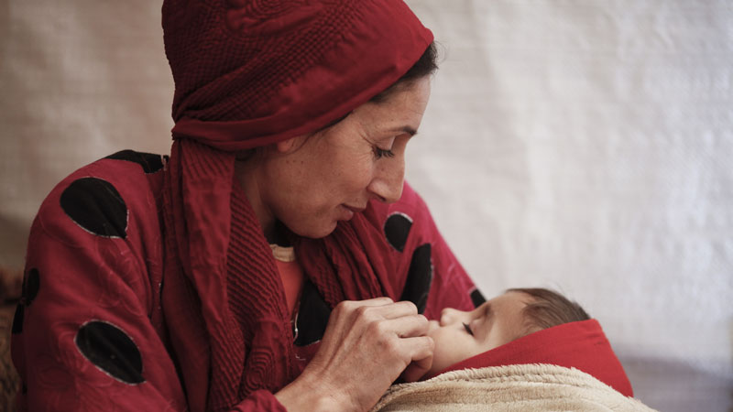
Friday let us pray
God of peace, bearer of hope, we seek your help for the peoples of the Middle East.
Quiet the clamour of war and guide us towards peace.
Where there is hatred and division sow seeds of calm and openness.
Where there is destruction help us to rebuild.
Where children are crying bring an end to tears.
Shelter your peoples and protect them Guide them and keep them from harm.
Show us how to break down the barriers of history and fear and breathe whispers of hope. Amen.
St Francis of Assisi: Pray for us

