Slide 1
Daily prayer
4-6 September 2023

Slide 2
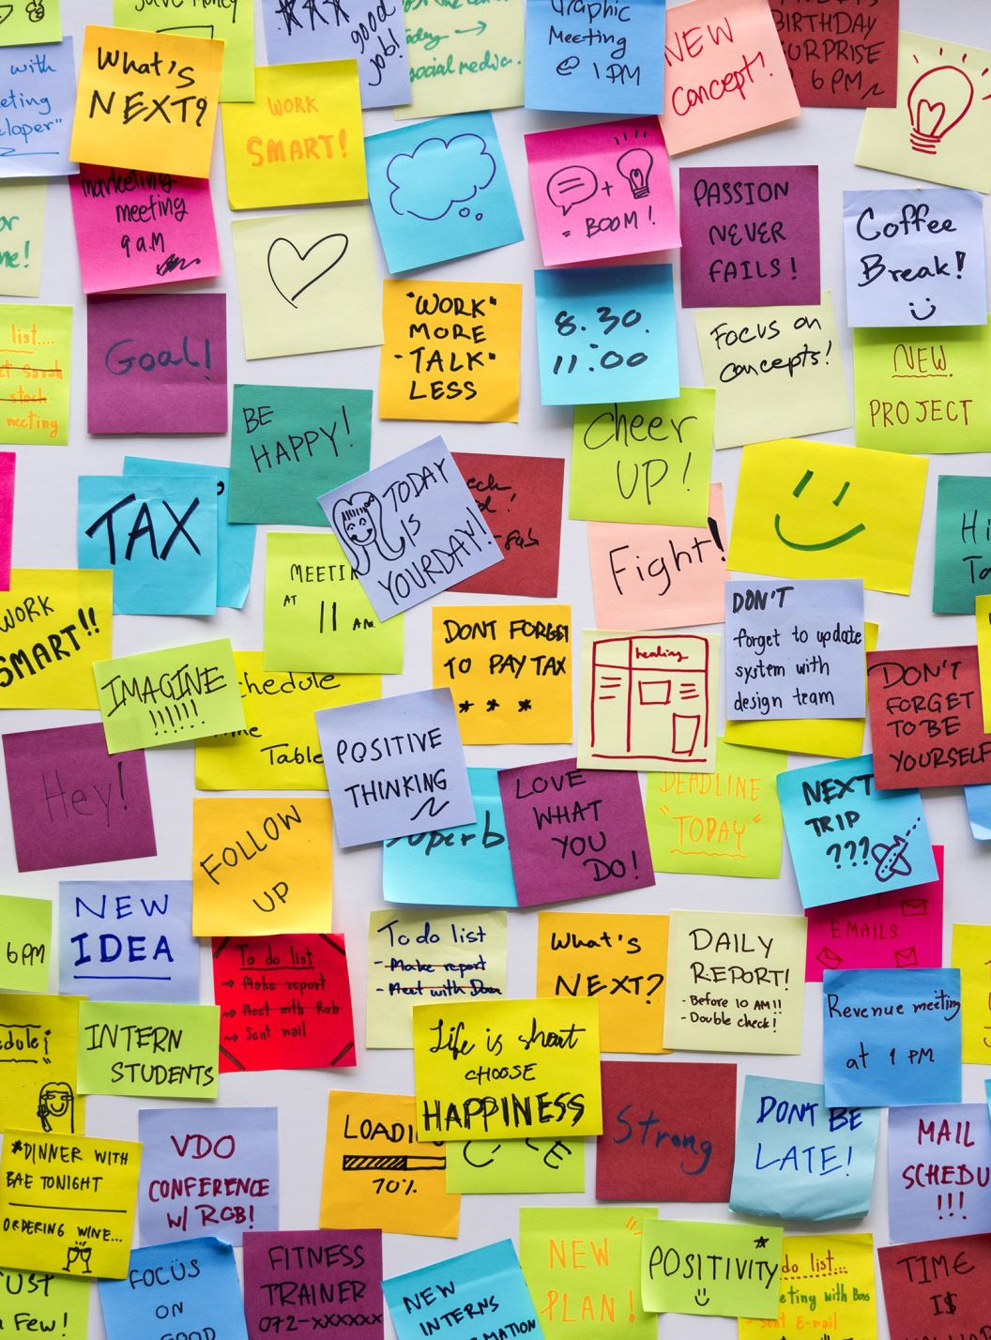
Wednesday Notices
2024-25 Lunchtime Activities for this term Please bring in a Packed lunch
 | Monday | Tuesday | Wednesday | Thursday | Friday
Football Astro | Year 7 | Year 8 & 9 | Year 7 | Year 8 & 9 | Years 7 – 9 (Reward)
Gym Just Dance | All years | All years | All years |  | All years

Slide 3
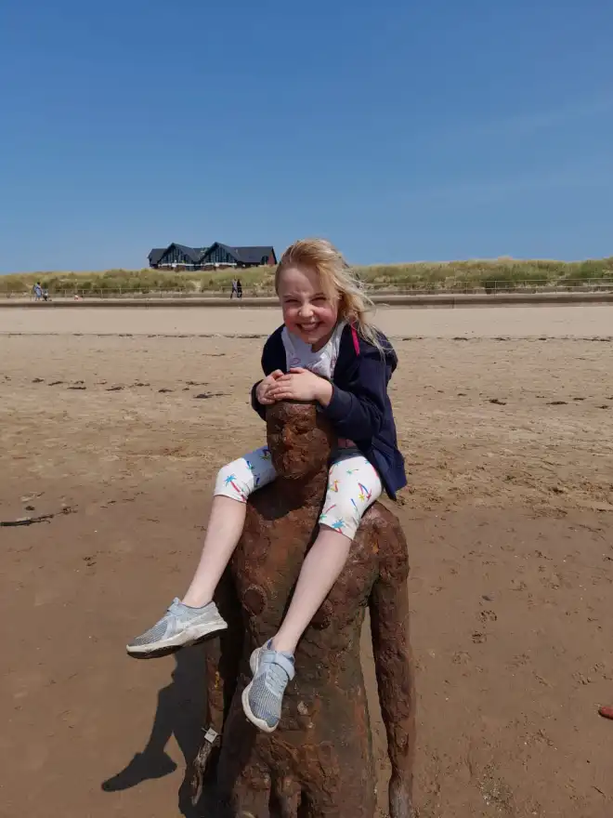
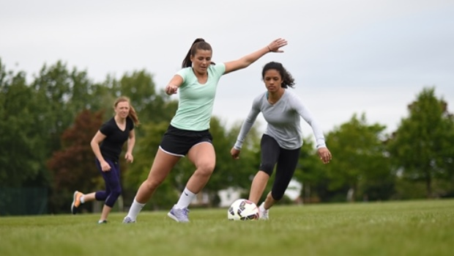
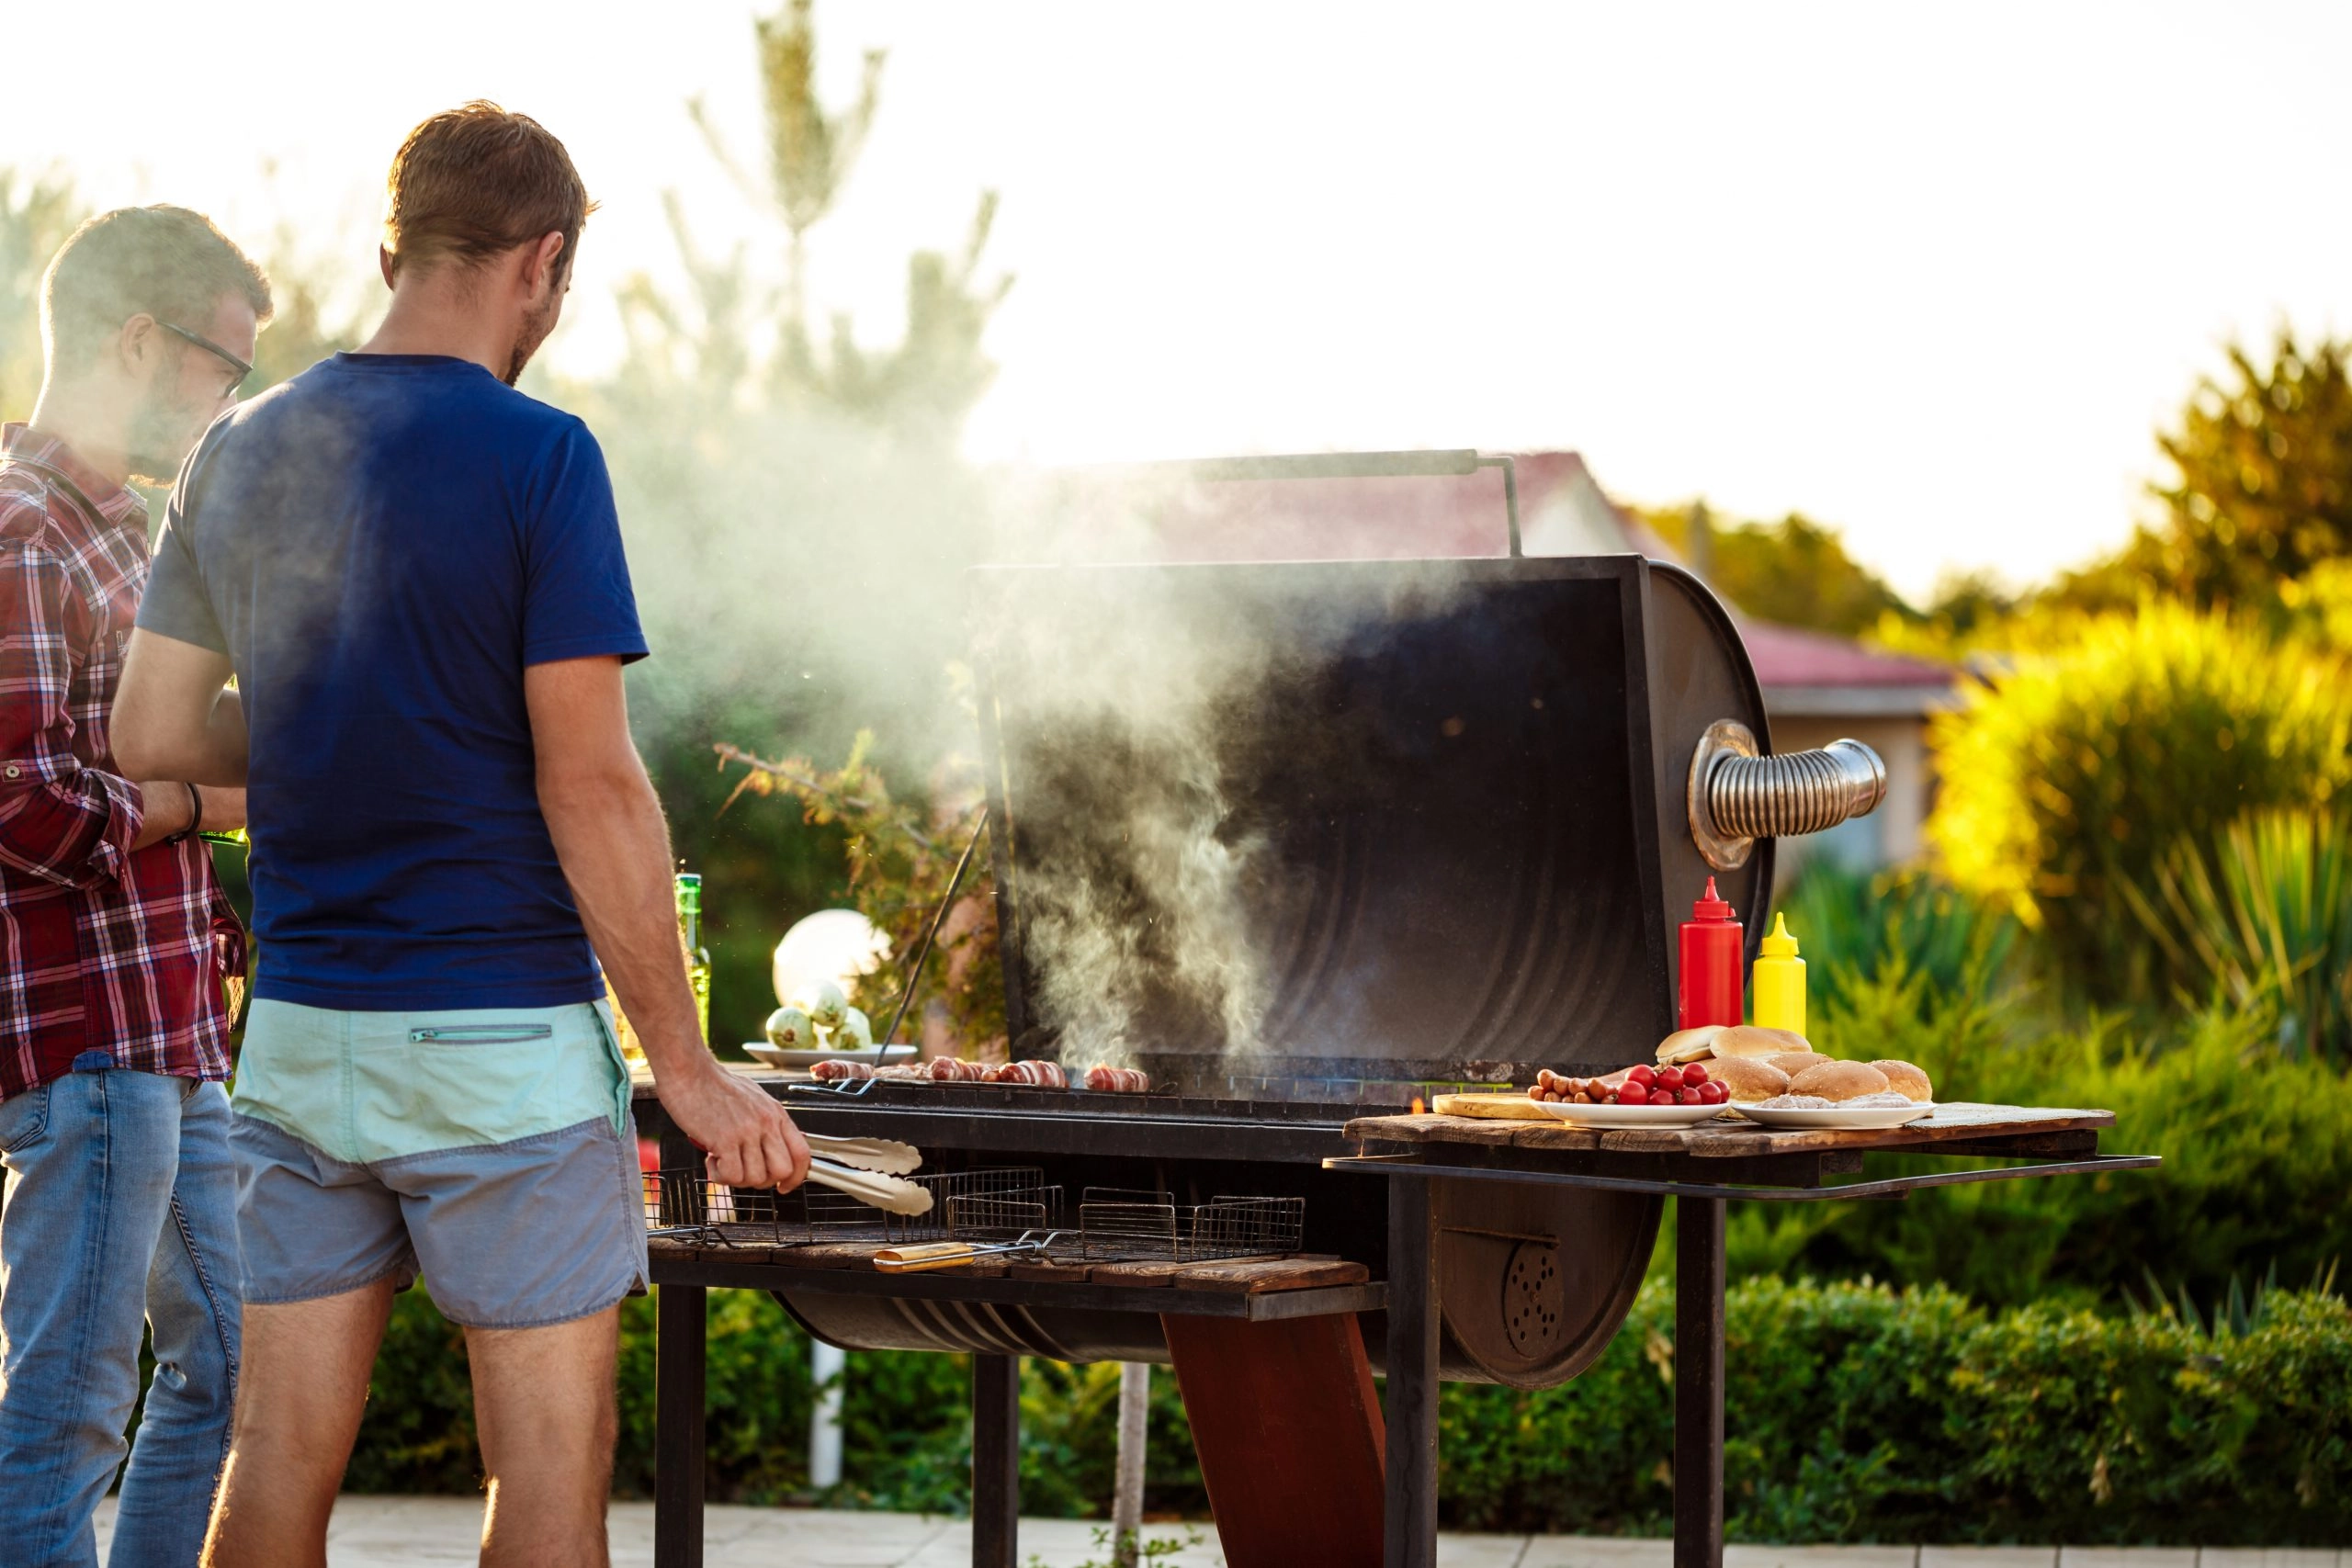
Wednesday Season of Creation
How was your summer? Whether you went away or stayed at home, remember some of the good moments. Where were you? Were you alone or with others?
Did you spend any time outdoors? September is known as the season of creation. It is a time to give thanks for the freedom, joy and wonder of time spent in God’s creation.

Slide 4
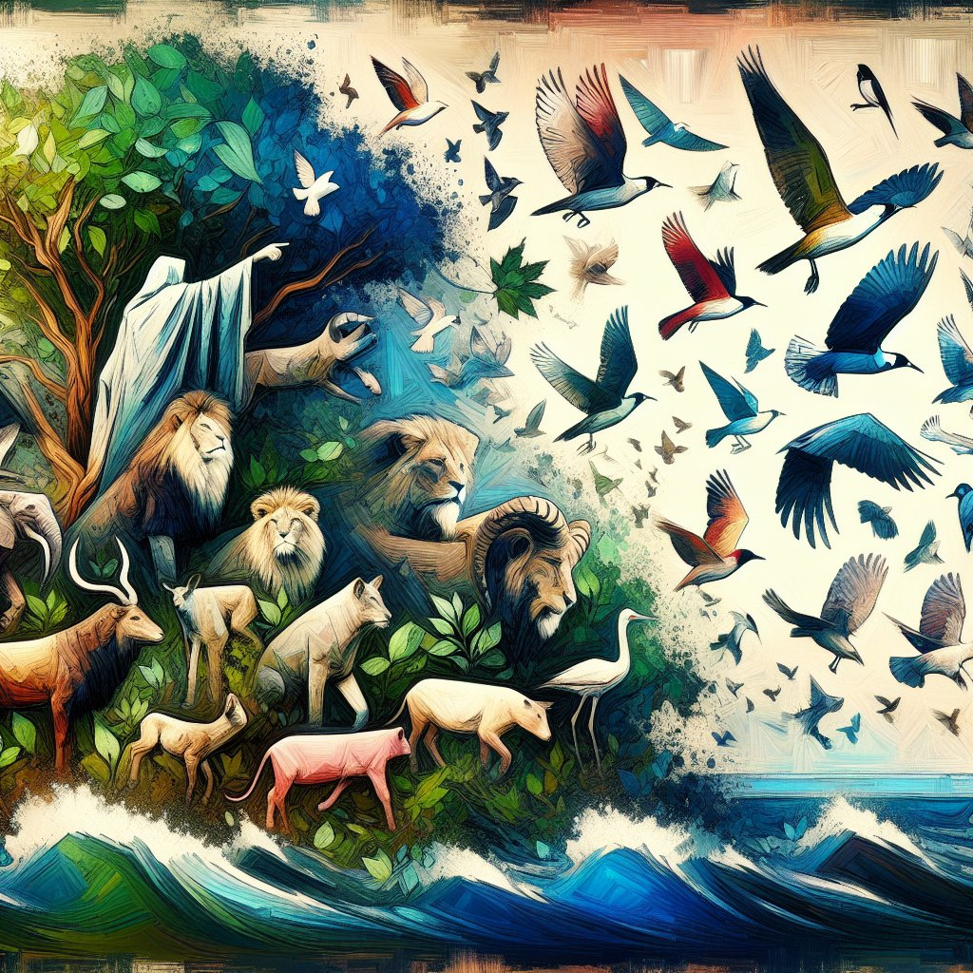
Wednesday God's Word
A reading from the book of Job
Job 12:7-10
‘But ask the animals, and they will teach you; the birds of the air, and they will tell you; ask the plants of the earth, and they will teach you; and the fish of the sea will declare to you. Who among all these does not know that the hand of the Lord has done this? In his hand is the life of every living thing and the breath of every human being.
The word of the Lord We all respond: Thanks be to God

Slide 5
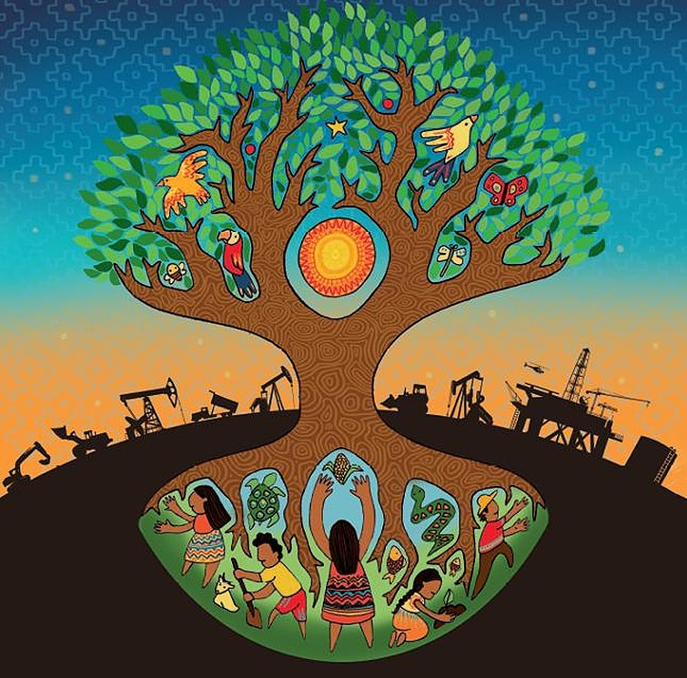
Wednesday Let us pray
Creator God, You show us what love is through the beauty of the earth and the gift of your Son. For the love of… animal and plant, mountain and forest, sea and city, woman and man, friend and family, those who live far from us, and those yet to be born… move us to live more simply, to protect the earth and to speak up for those in need. Amen.
St Edward: pray for us

Slide 6
Thursday Notices

Slide 7
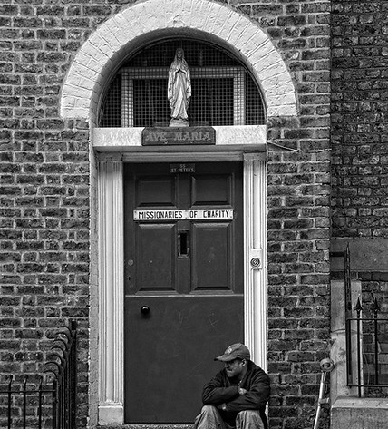
Thursday St Teresa of Kolkata
Today we celebrates the feast of Mother Teresa. Her life reminds us that God has a special love for the poor and forgotten.
Mother Teresa gave up all luxuries to care for those she saw around her in need. Today her work is continued across the world by the sisters of the Missionaries of Charity. Our sixth form students regularly volunteer with them at their soup kitchen in Liverpool city centre.

Slide 8
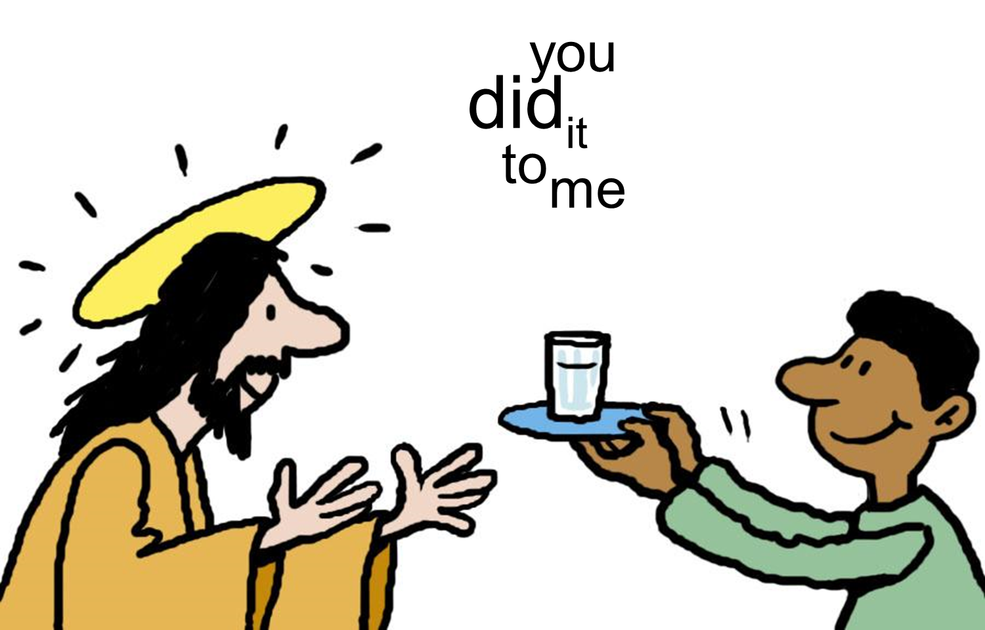
Thursday God's Word
Matthew 25
Mother Teresa said:
'You and I, we are the Church, no? We have to share with our people. Suffering today is because people are hoarding, not giving, not sharing. Jesus made it very clear. Whatever you do to the least of my brethren, you do it to me. Give a glass of water, you give it to me. Receive a little child, you receive me.'

Slide 9
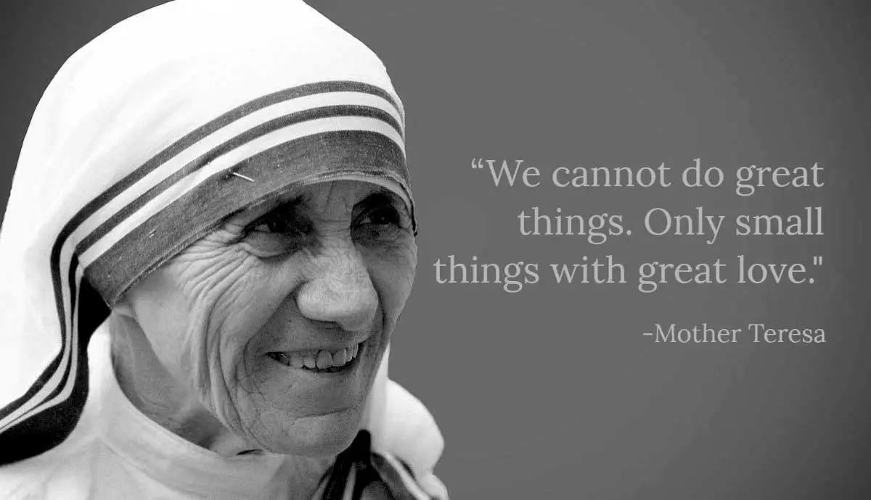
Thursday Let us pray
Inspired by the example of St Teresa let us offer ourselves to serve others today
Lord Jesus, I give you my hands to do your work; I give you my feet to go your way; I give you my eyes to see as you do; I give you my tongue to speak your words; I give you my mind, Lord, that you may think in me; I give you my spirit that you may pray in me, I give you my whole self, that you may live and work and pray in me.
Amen.
St Edward: pray for us

Slide 10
Friday Notices
Next Monday
8.15am Mass in the chapel – all welcome (years 7-11 enter school via the front door)
Period 1 year 10 Mass in the hall
Sacrament of reconciliation (confession)
Sacrament of Reconciliation (Confession) with Fr Taras​ Available at breaktime in the chaplaincy on Monday, drop in anytime 10.40-11.20 ​ ​ You just spend a few minutes telling God the things you are sorry for and then Fr Taras gives you God's forgiveness​

Slide 11
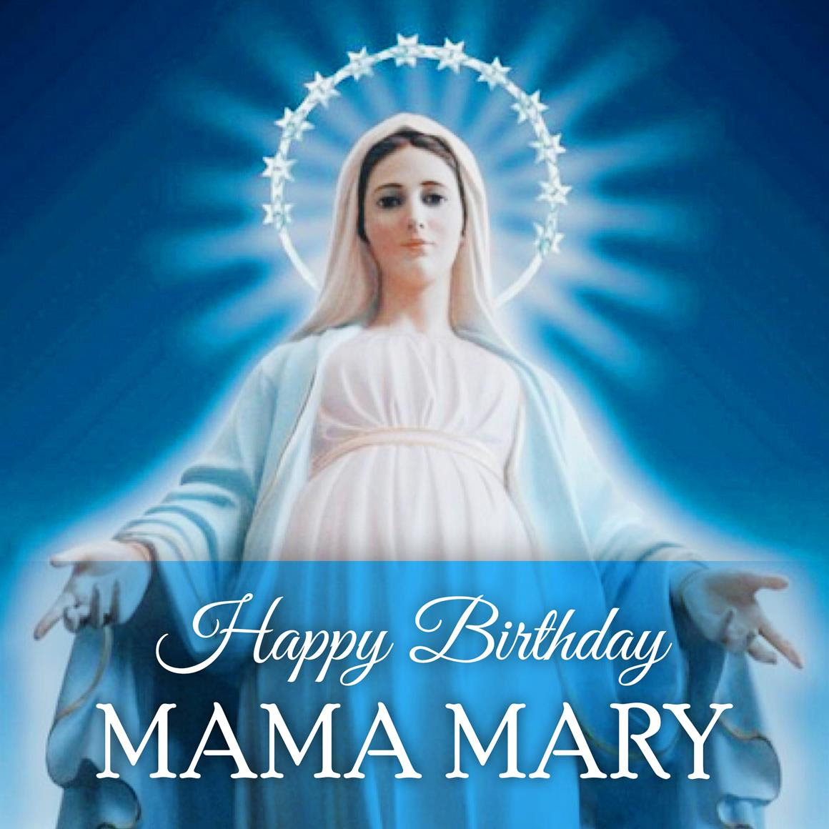
Friday The Nativity of The Blessed Virgin Mary
Tomorrow we celebrates the birth of Mary: Our Lady’s birthday.
We celebrate this day together with Catholics throughout the world. In the Philippines today is a national holiday when thousands of people will process and carry statues of Mary through the streets.
Our Mother Mary does not need any gifts, but think of one thing today that you can do to bring her joy. A kind word or action towards another person is the perfect gift for her.

Slide 12
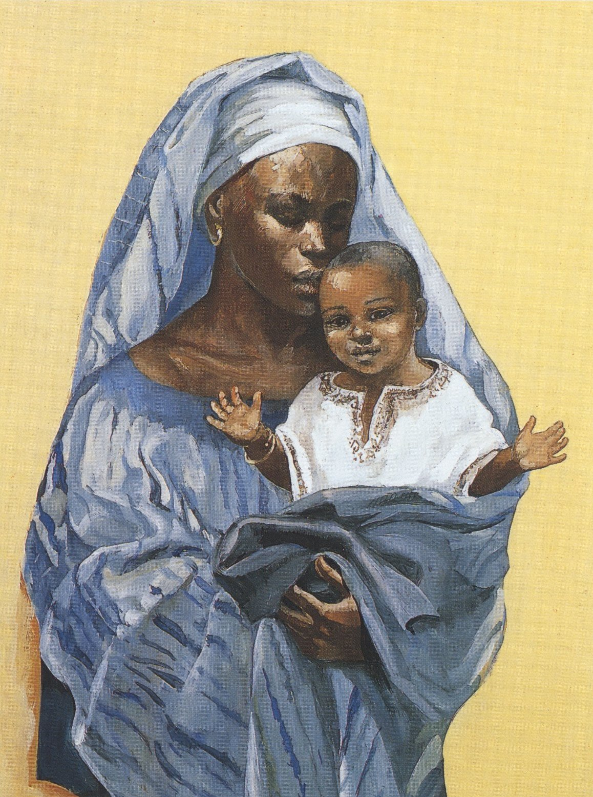
Friday God's Word
Mary's Song of Praise: The Magnificat
And Mary said,
My soul proclaims the greatness of the Lord, my spirit rejoices in God my Saviour, for he has looked with favour on his lowly servant. From this day all generations will call me blessed: the Almighty has done great things for me, and holy is his Name. He has mercy on those who fear him in every generation. He has shown the strength of his arm, he has scattered the proud in their conceit. He has cast down the mighty from their thrones, and has lifted up the lowly. He has filled the hungry with good things, and the rich he has sent away empty. He has come to the help of his servant Israel for he has remembered his promise of mercy, the promise he made to our fathers, to Abraham and his children forever
We all respond: Thanks be to God
To think about
In this passage Mary proclaims God’s vision for the world. In today’s world who are the proud? The lowly? The rich?

Slide 13
Friday Let us pray
What do you want to pray for today?
Keep this in mind as we ask Mary our mother to intercede for us.
We say together:
Hail Mary, Full of Grace, The Lord is with thee. Blessed art thou among women, and blessed is the fruit of thy womb, Jesus. Holy Mary, Mother of God, pray for us sinners now, and at the hour of death.
Amen.
St Edward: pray for us

