Slide 1
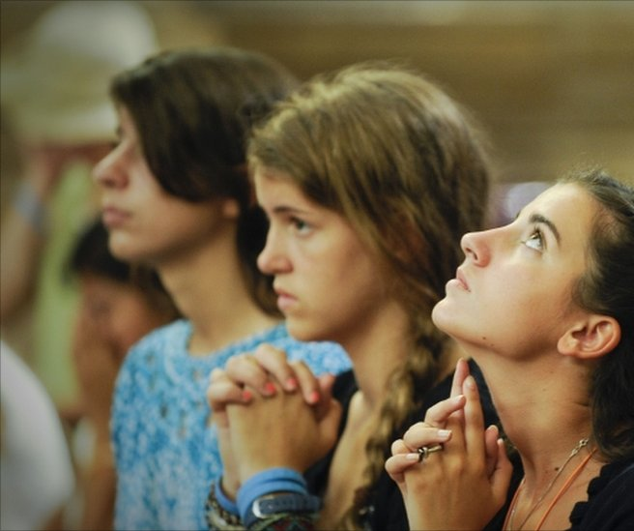
Daily Prayers
6-8 November

Slide 2
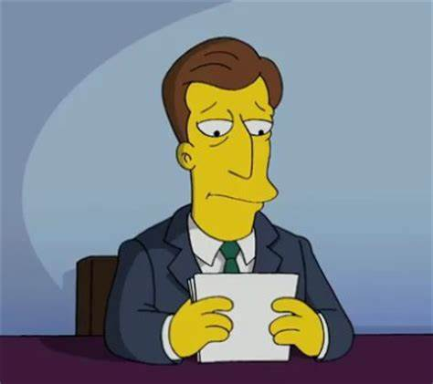
Wednesday Notices

Slide 3
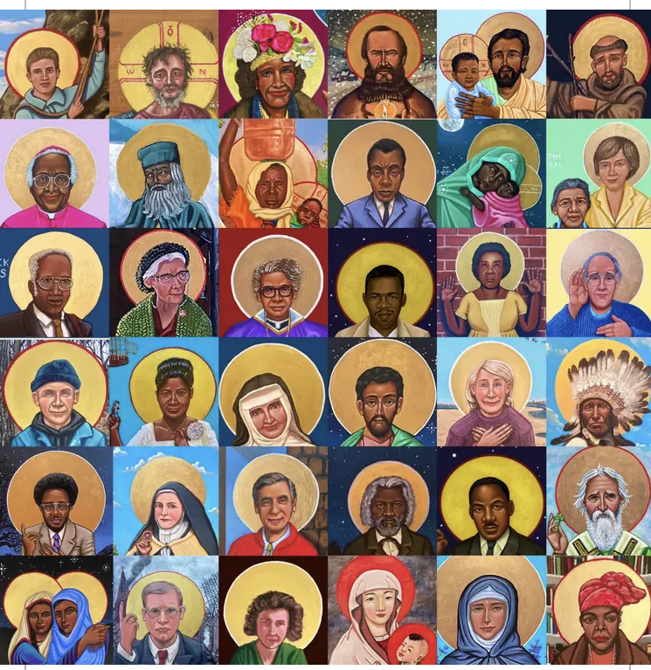
Wednesday: All Saints
Last week we celebrated the feast of All Saints. This is the day when we remember those people who lived good and holy lives and who now live with God in heaven. In addition to those who we traditionally call 'Saint' we also remember all those nameless people who dedicated their lives to love.
The saints lived good lives, but they were not exceptions, they were human beings like us who were brave enough to follow God's call. Today you are called to follow them.
To think about
Who is the most saintly person you know?
What can you do today to be more like them?

Slide 4
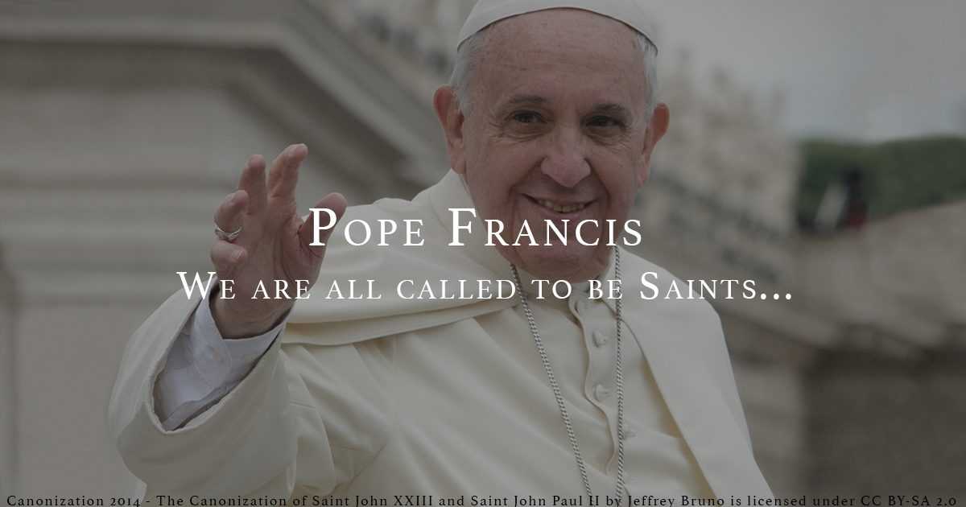
Wednesday:
Words from Pope Francis
'We are all called to become saints!
So often, we are tempted to think that holiness is granted only to those who break away from the ordinary tasks, to devote themselves to prayer. But it is not so! Indeed, it is by living with love in our daily tasks that we become saints.
"But, father, I work in a factory ... I work as an accountant, I cannot be a saint there..." - "Yes, you can! There, where you work you can become a saint. Always and everywhere you can become a saint. Be holy by becoming a visible sign of God's love and His presence. At home, on the streets, at work, in the moment and in the life that you have.

Slide 5
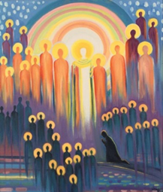
Wednesday Let us pray
Thank you, gentle God,
for the saints who inspire us and watch over us.
Help us to share in their good and holy lives,
so we may reflect the wonder of heaven
here and now on earth.
Amenn.

Slide 6
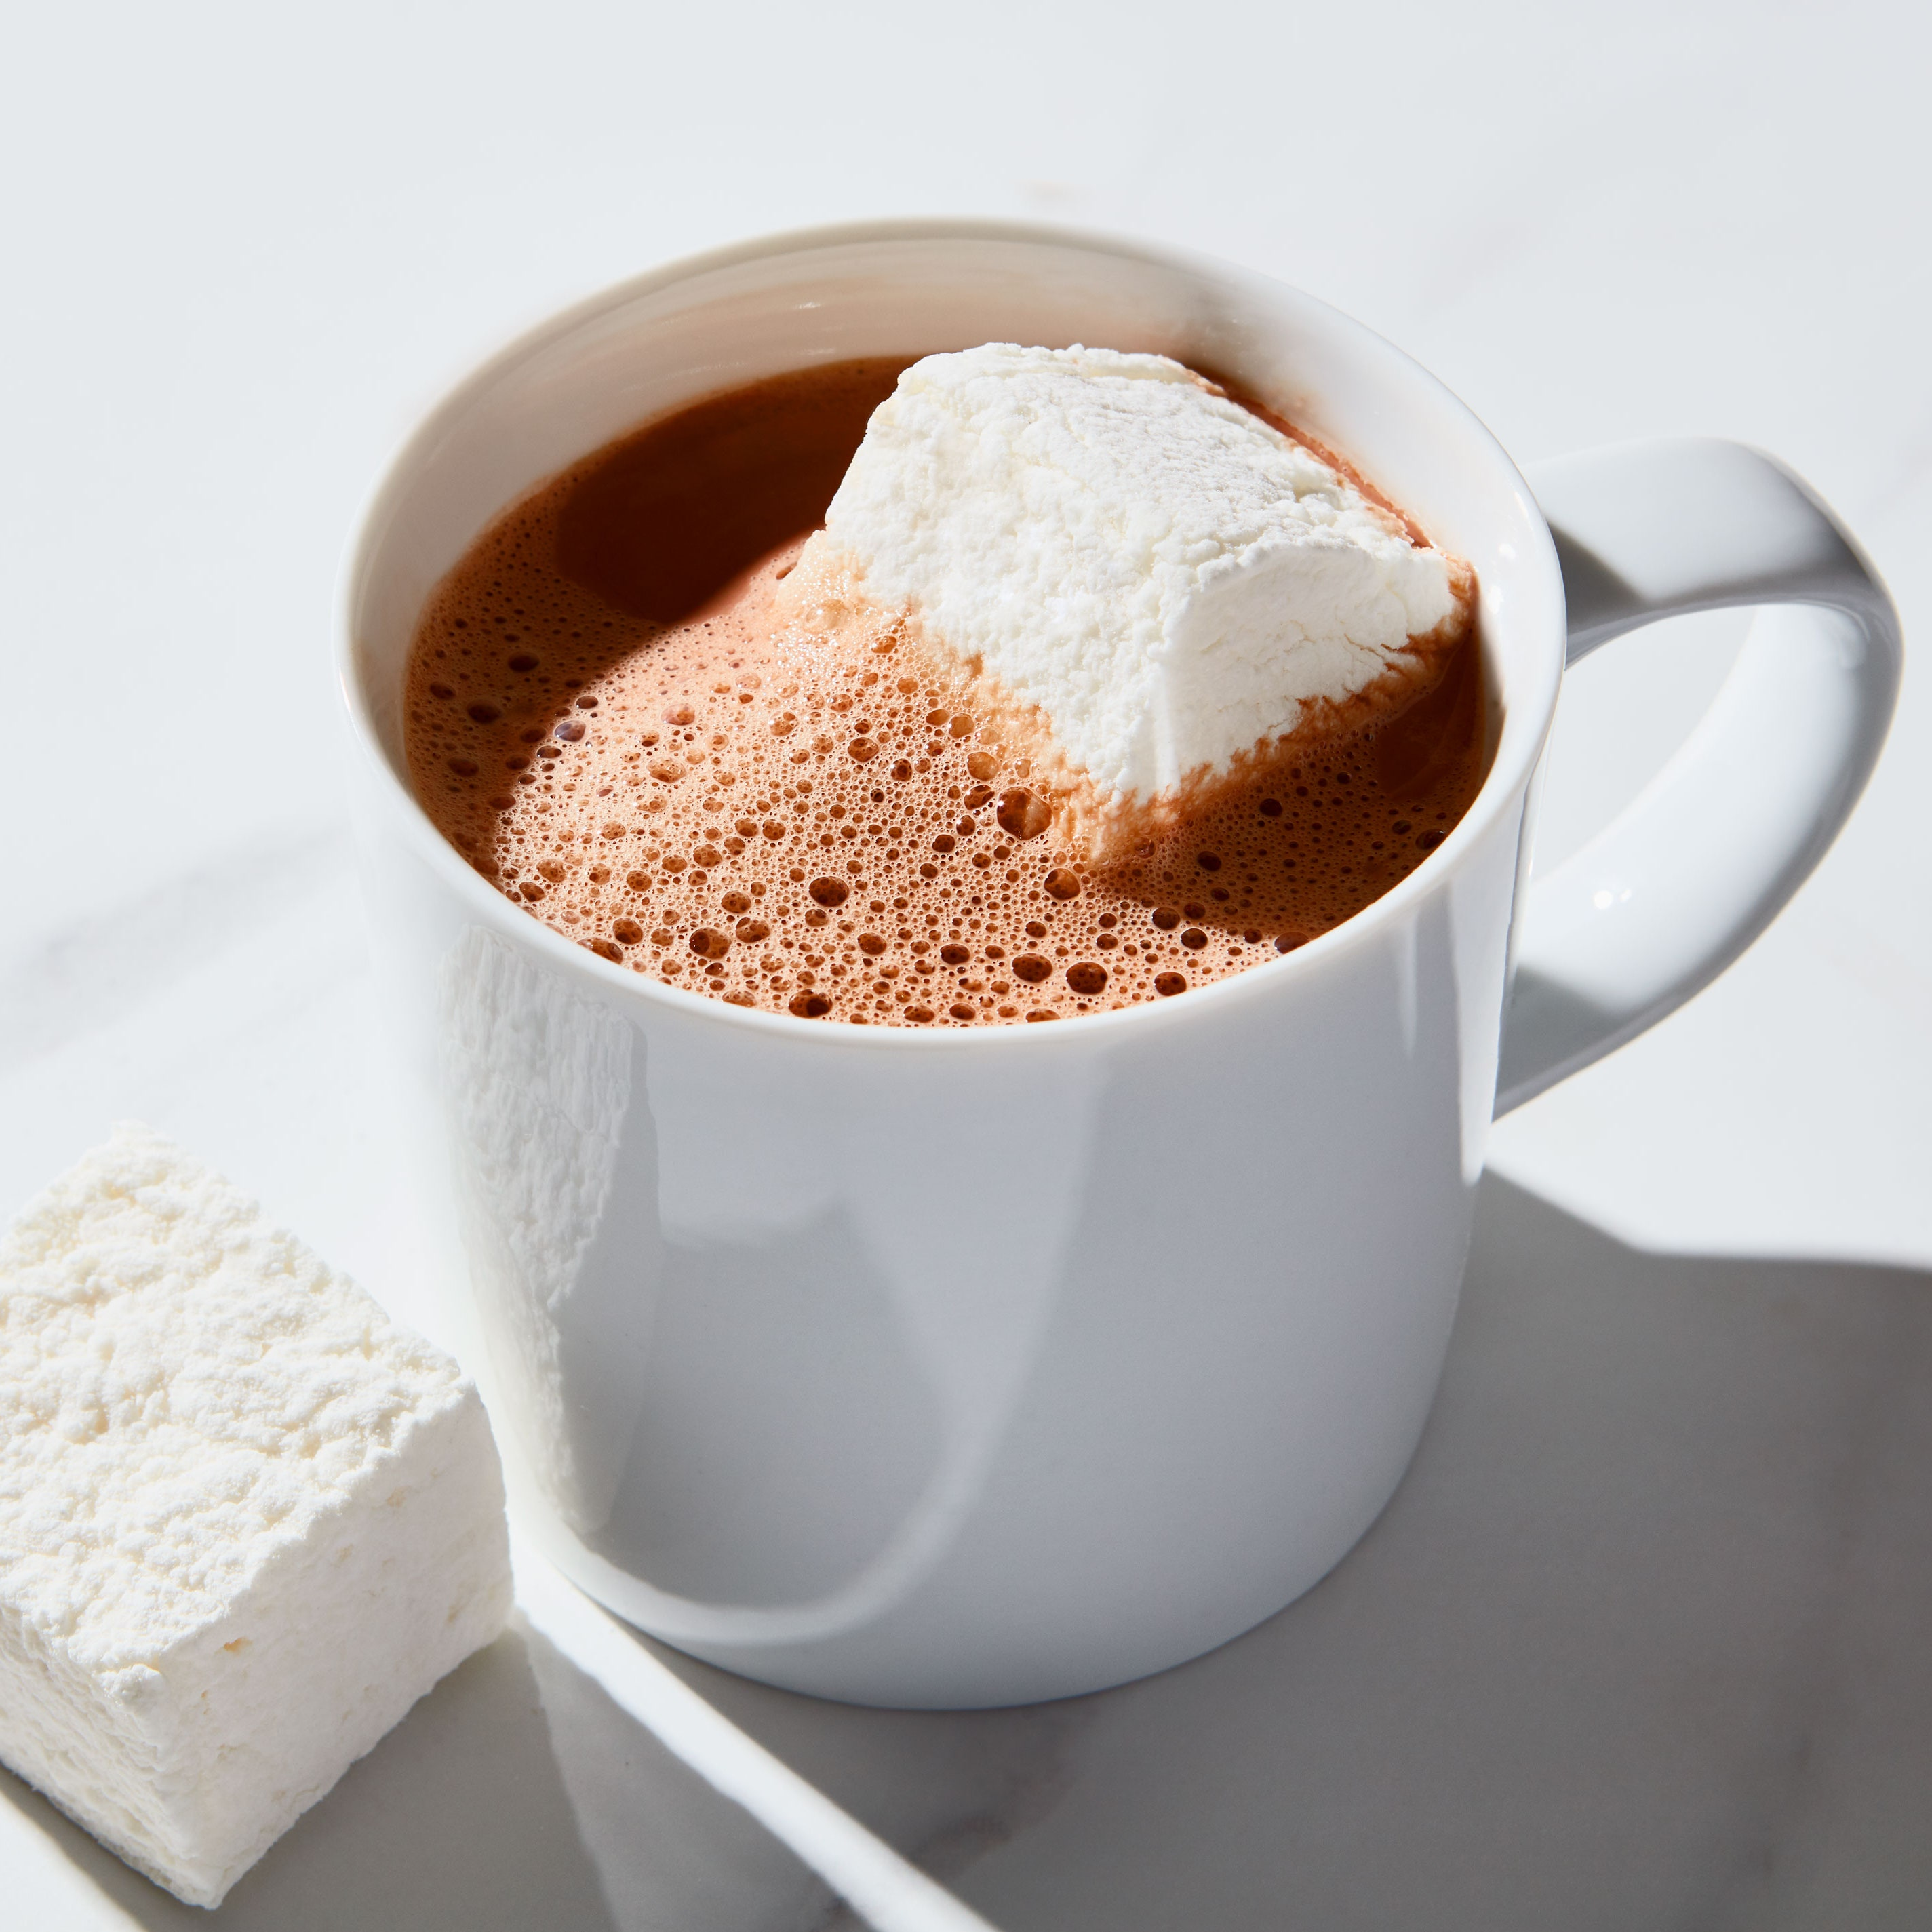
Thursday
Notices
Tomorrow (Friday)
Breakfast with God
8.20am in the chapel.
Morning meditation: arrive early for hot chocolate & a pastry

Slide 7
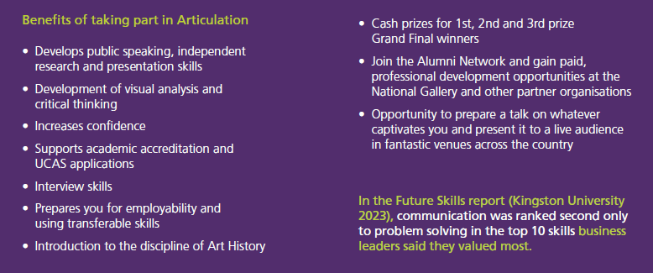
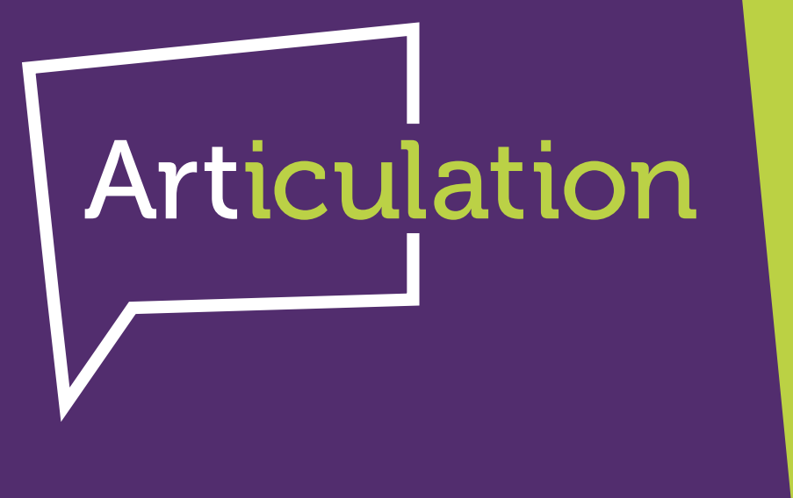
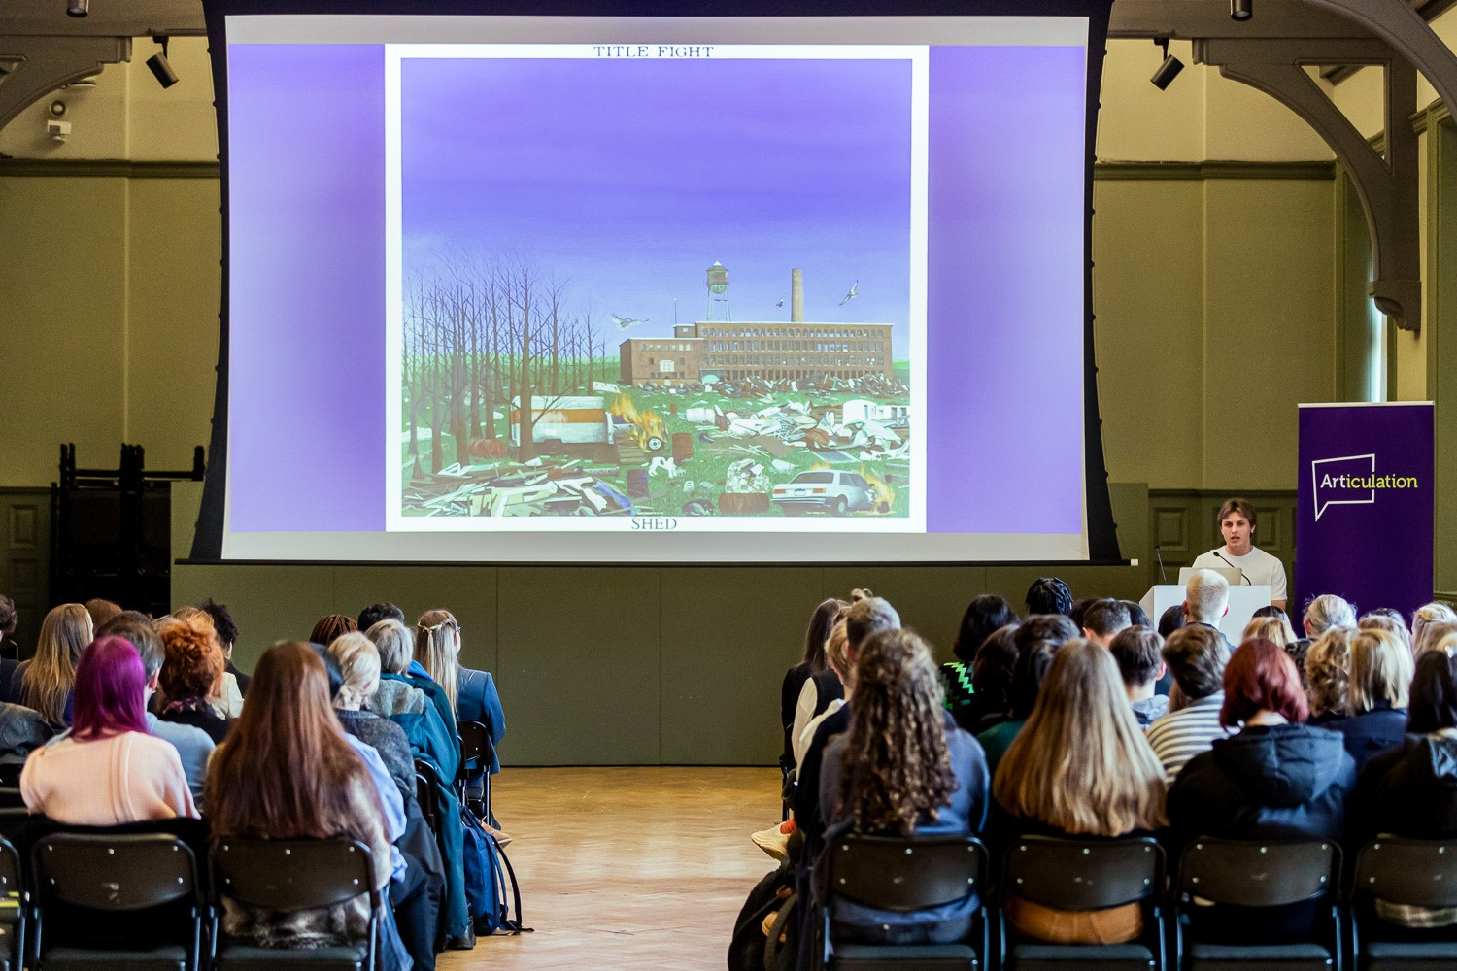
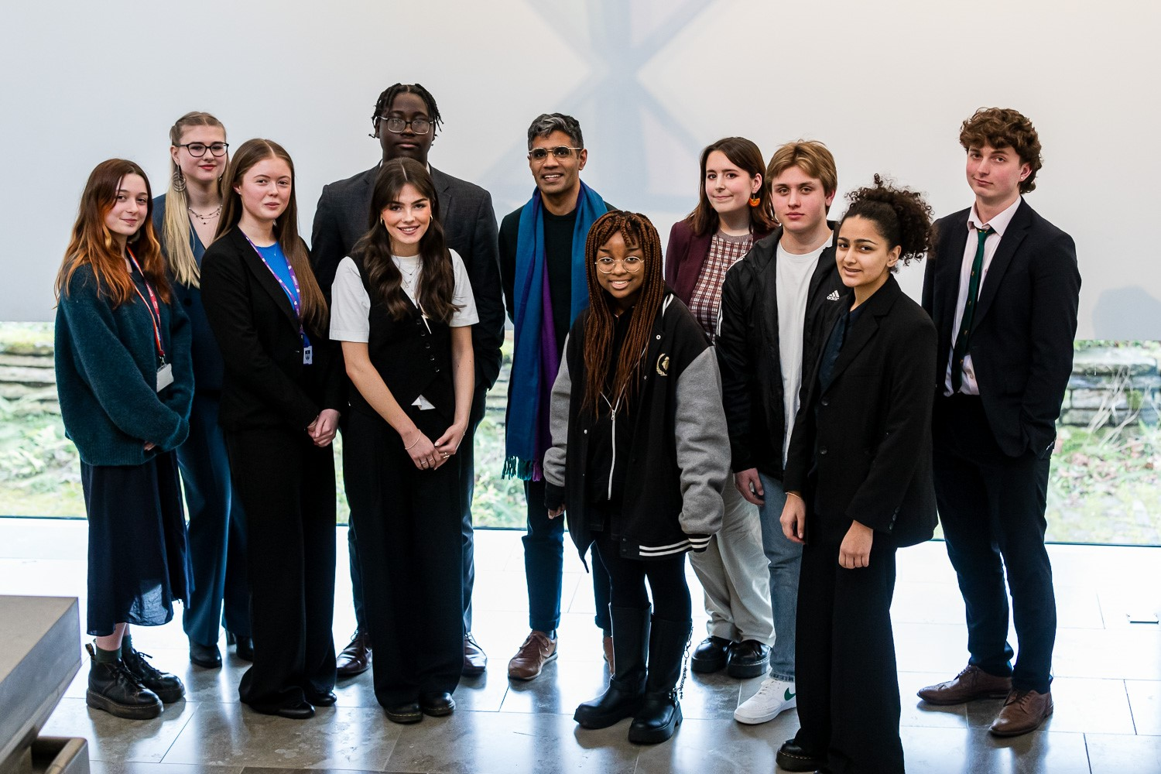
Thursday Notices 2
Year 12 and 13
We have a great opportunity to be involved in this exciting event and would love you to take part.
Articulation is a public speaking competition, run by the National Gallery, which invites students to deliver a 10-minute presentation to an audience about a work of art, architecture, film or an artefact. Internal and regional heats take place before contestants are selected for the grand final with winning prize money amounting to £300! Internal heats will take place later this term so please see Mr Lamin by Friday 15 November if you would be interested.
Michael D representing the College at last year’s regional heat held at the Whitworth Gallery, Manchester.

Slide 8
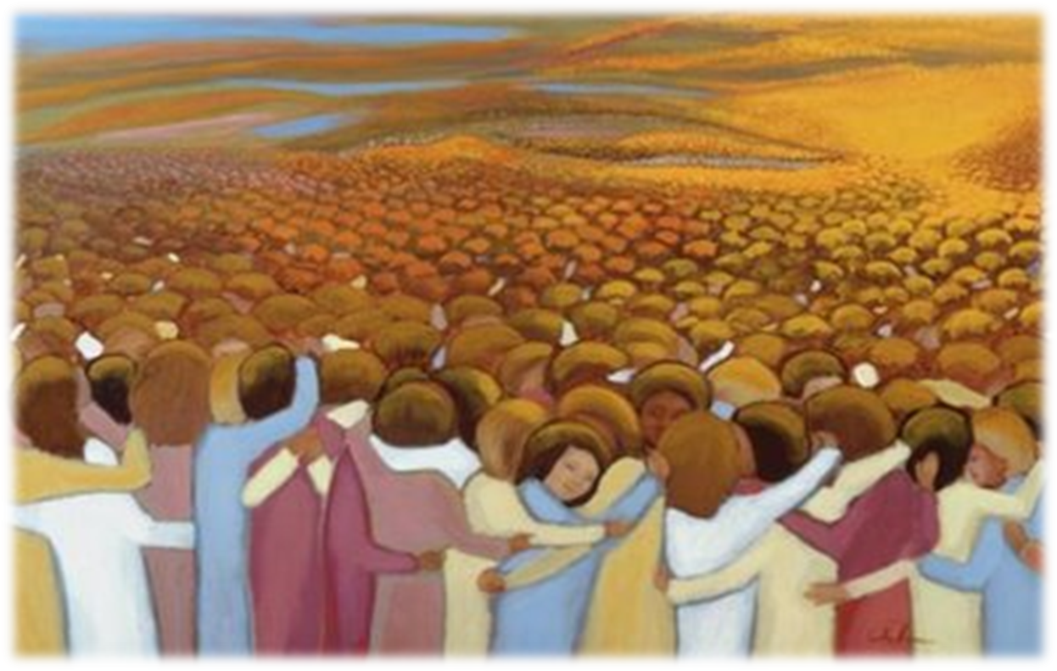
Thursday – Remembering the Holy Souls
The whole month of November is traditionally a time when Catholic Christians remember the ‘Holy Souls’ –all those who have died. Throughout the month we will remember and pray for those who have died in the hope and promise of eternal life.
Throughout the month all are invited to write the names of family and friends who have died in our Book of Remembrance. The names of those written in the book will be remembered in an All Souls Mass on Monday 25th November.

Slide 9
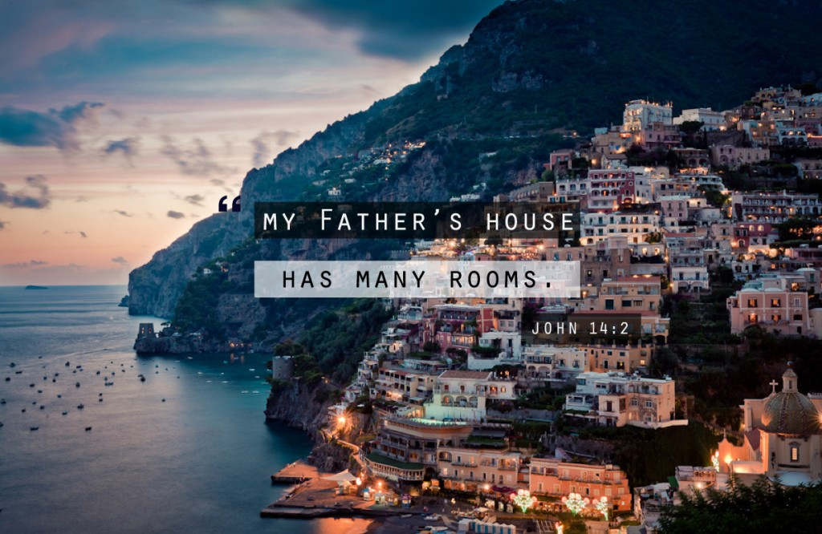
Thursday: God's Word
Jesus promises the eternal life of heaven (John 14:1-3)
Jesus said to his disciples: ‘Do not let your hearts be troubled. Trust in God still and trust in me. There are many rooms in my Father’s house if there were not, I should have told you. I am going now to prepare a place for you and after I have gone and prepared a place for you I shall return to take you with me so that where I am, you may be too.’
The word of the Lord
Thanks be to God

Slide 10
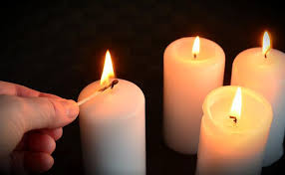
Thursday: Let us pray
Let us keep in mind our family and friends who have died as we say:
Eternal rest grant unto them, O lord;
And let perpetual light shine upon them.
May they rest in peace
Amen

Slide 11
Friday Notices
Year 12 and 13
We have a great opportunity to be involved in this exciting event and would love you to take part.
Articulation is a public speaking competition, run by the National Gallery, which invites students to deliver a 10-minute presentation to an audience about a work of art, architecture, film or an artefact. Internal and regional heats take place before contestants are selected for the grand final with winning prize money amounting to £300! Internal heats will take place later this term so please see Mr Lamin by Friday 15 November if you would be interested.
Michael D representing the College at last year’s regional heat held at the Whitworth Gallery, Manchester.

Slide 12
Friday
Notices
Today
Year 11 form captains please go to the chapel in form time
Next week:
Early Mass Monday 8.15am in the chapel – all welcome
Year 11 Mass period 3 Monday

Slide 13
Today’s prayer has been written by a year 13 student
This prayer is for everyone who has been feeling anxious, as everyone has their own troubles in and outside of school. I believe facing God will relief our peace of mind and allow us to let go of things that are holding us back; allowing God in gives us the guidance and wisdom for our chaotic lives.

Slide 14
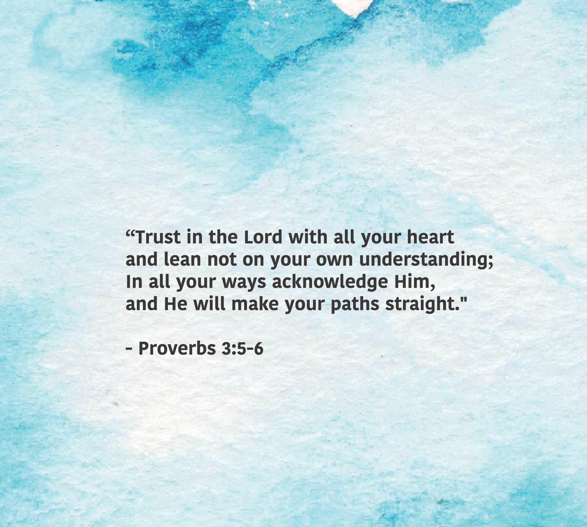
Repeat these words slowly to yourself several times.
To think about:
What does it mean to ‘lean not on your own understanding’?
What situations do you find it hard to understand?
What paths would you like God to straighten?

Slide 15
Let us pray,
My soul is like a turbulent sea.
I can’t seem to find my balance so I stumble and worry constantly.
Loving God, please grant me peace of mind and calm my troubled heart.
Give me strength and clarity to find purpose and walk the path you’ve laid out for me.
Amen

Slide 16
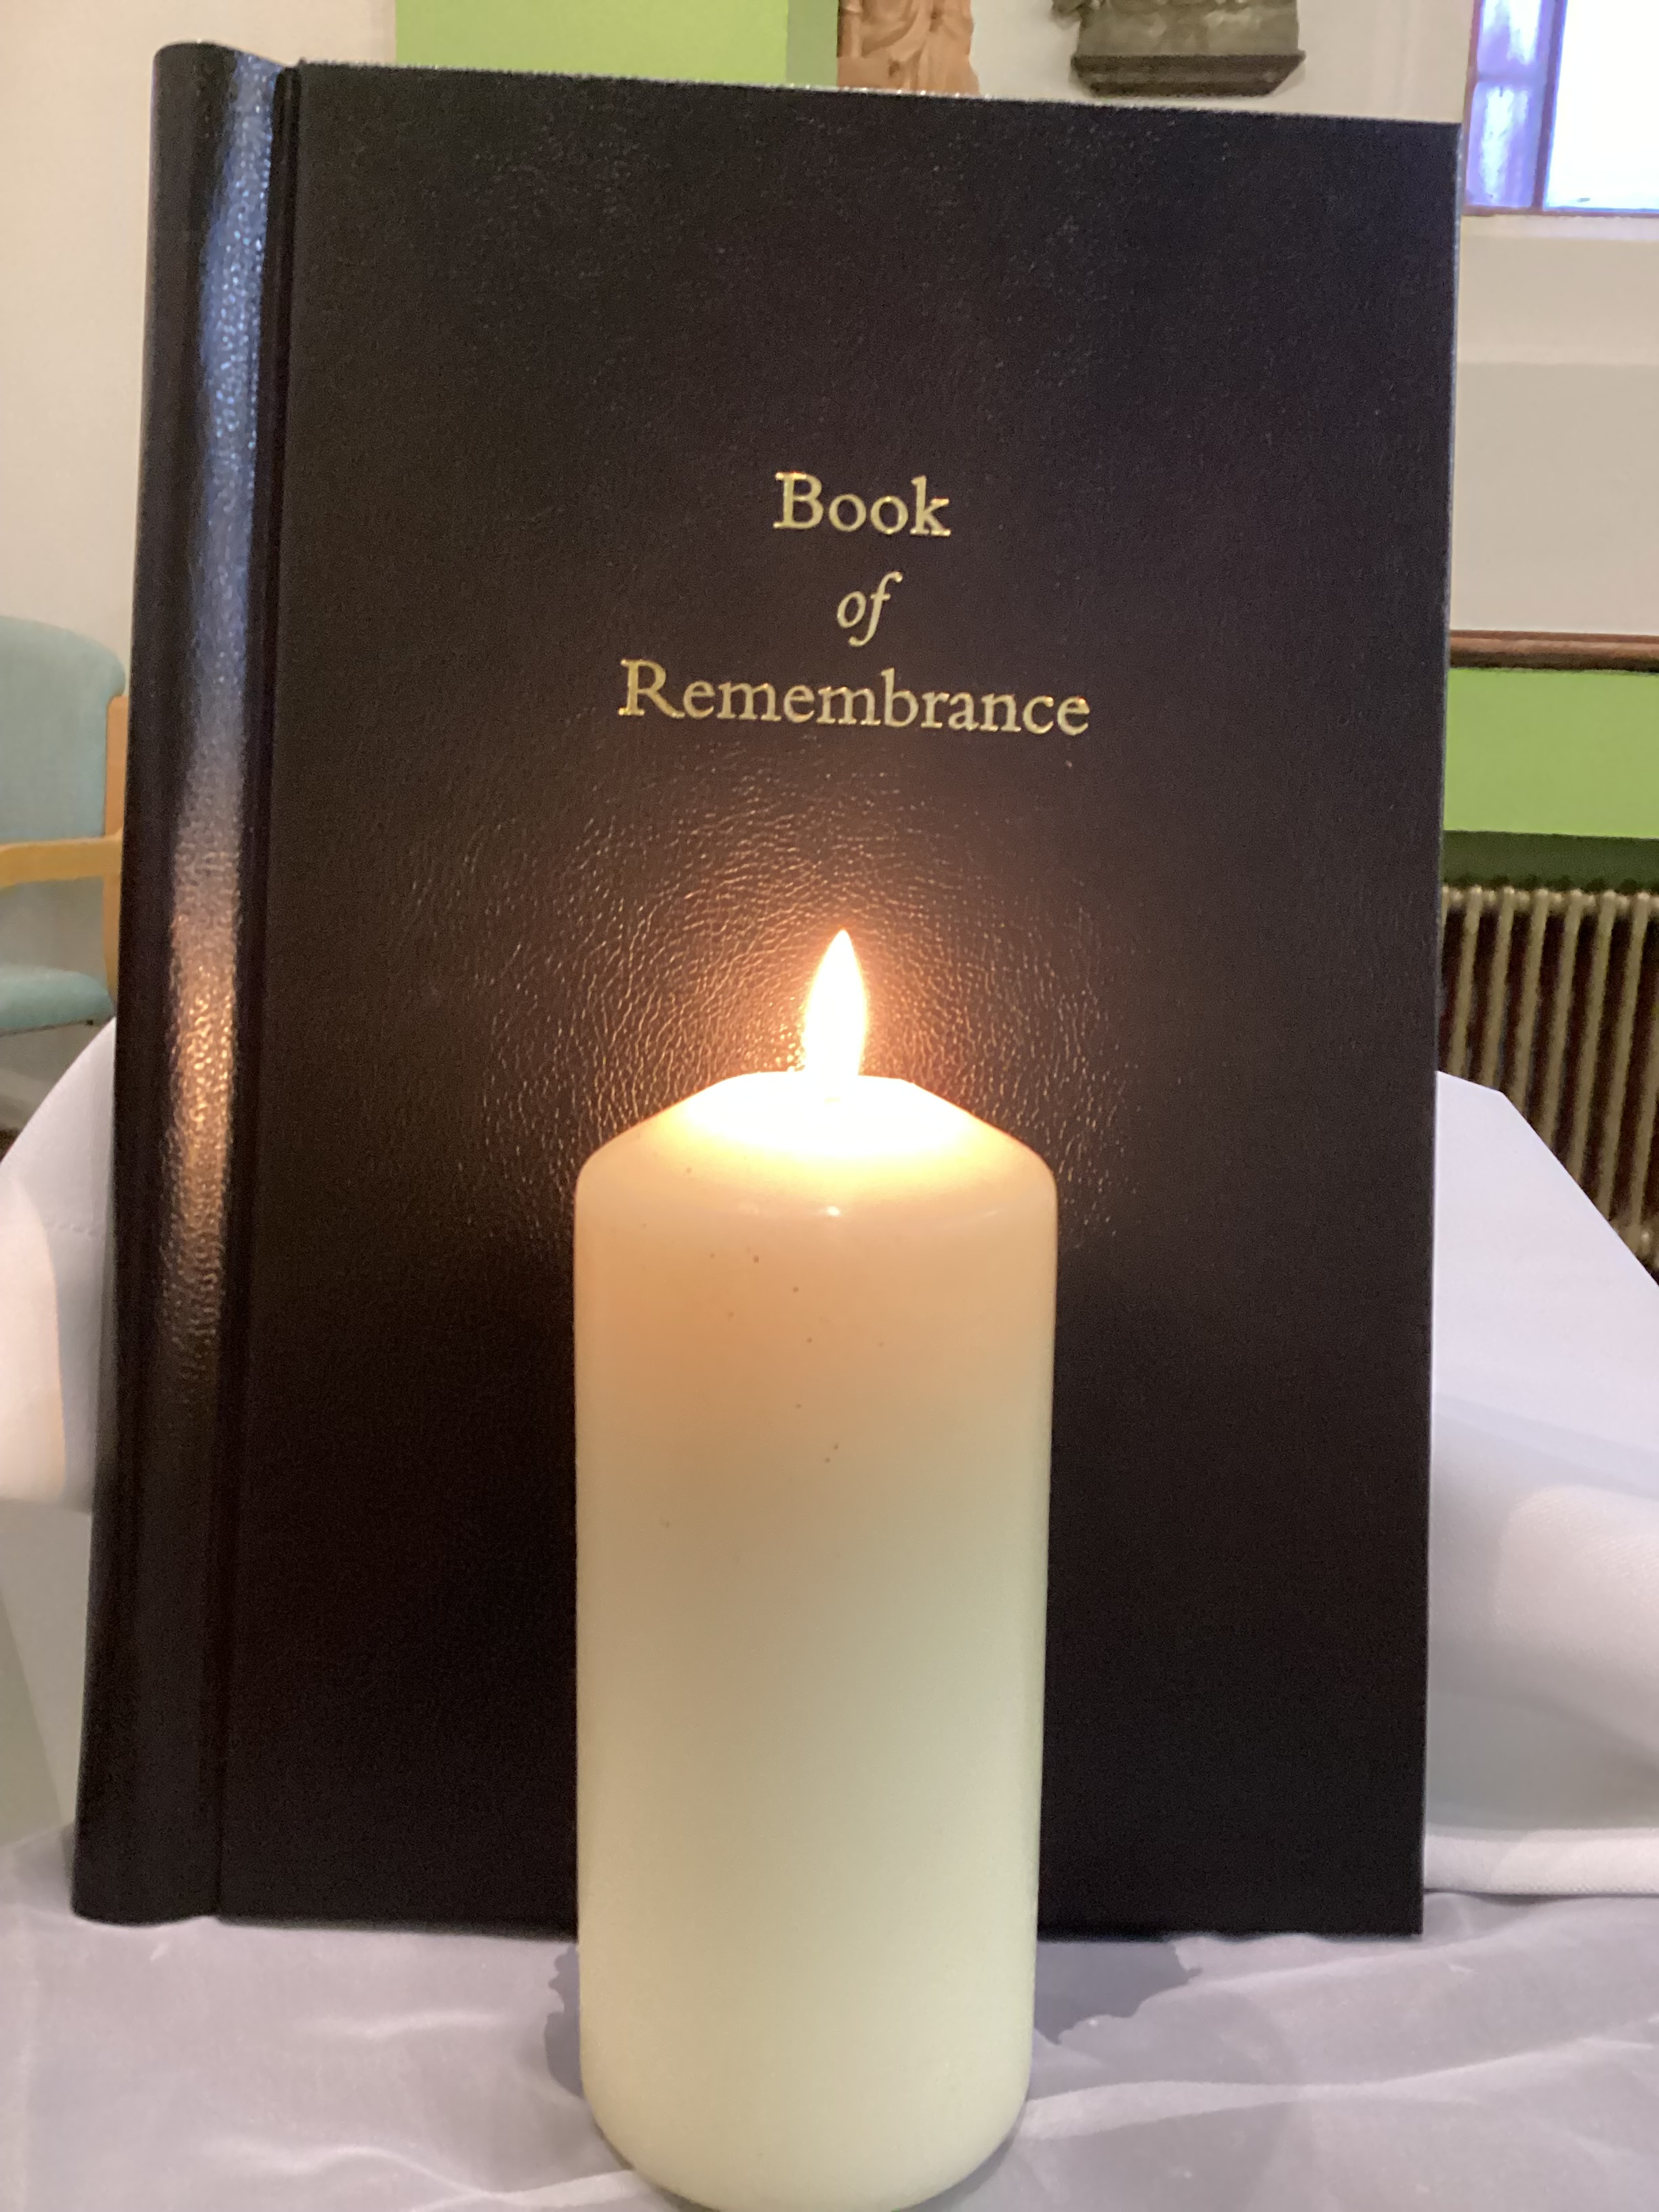
Friday Notices 2
St Edward’s College
Book of Remembrance
Is now open in the chapel.
During November you are invited to write in the names of loved ones who have died in our Book of Remembrance.
They will prayerfully be remembered throughout the month and especially at our All Souls Mass on Monday 25th November..
Pupils are welcome in the chapel at breaktimes, lunchtime and before or after school.

