Slide 1
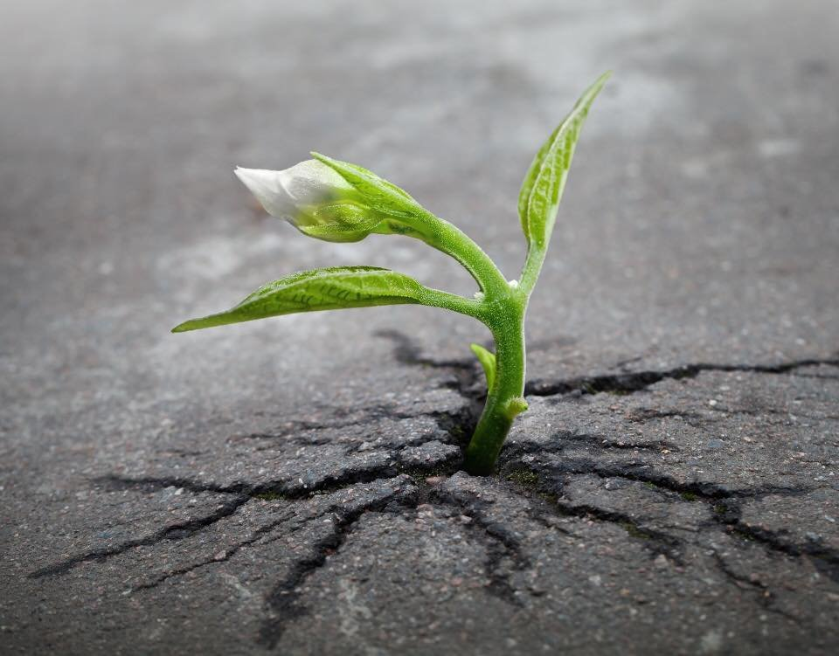
Daily prayer
9-13 September 2024

Slide 2
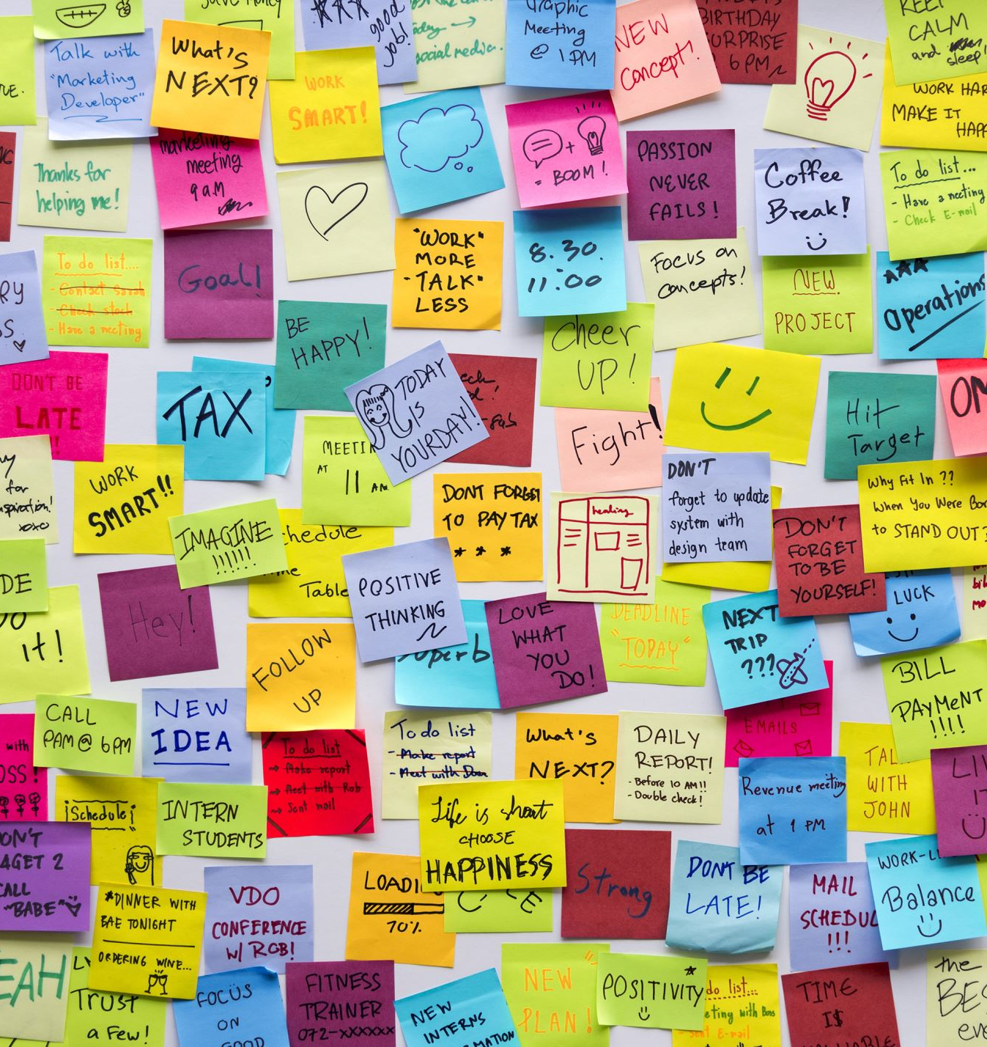
Monday Notices
Year 10 Mass period 1 today
TODAY: Sacrament of Reconciliation (Confession) with Fr Taras​
Available at breaktime in the chaplaincy on Monday,
drop in anytime 10.40-11.20 ​
​
You just spend a few minutes telling God the things you are sorry for and then Fr Taras gives you God’s absolution (forgiveness​).

Slide 3
Music clubs
 | Form Time | After-school (3:10-4.10)
Monday | GCSE/A Level Performance & other times Mon/Tues/Wed as arranged M009 (Recital Room) Mr Luxton | Guitar Club M008 Mr Kee Year 9 Music Theory Club (to 3.40) (SMPs Week A; Choristers Week B) M006 (Music Room 2) Dr Howard
Tuesday | Young Voices M009 (Recital Room) Mr O’Keeffe | Senior Choir M009 (Recital Room) Mr O’Keeffe KS3 Music Club (Keyboards, Theory & Instruments) M006 (Music Room 2) Mrs Pritchard & Dr Howard Brass Ensemble M007 (Music Room 1) Mr Knowles
Wednesday | College Consort M009 (Recital Room) Mr O’Keeffe | Flute Choir M009 (Recital Room) Mr Costello
Thursday | Junior Orchestra M009 (Recital Room) Dr Howard | Senior & Chamber Orchestras M009 (Recital Room) Dr Howard
Friday | Young Voices M009 (Recital Room) Mr O’Keeffe | MUSIC RECITAL M009 (Recital Room) Dr Howard

Slide 4
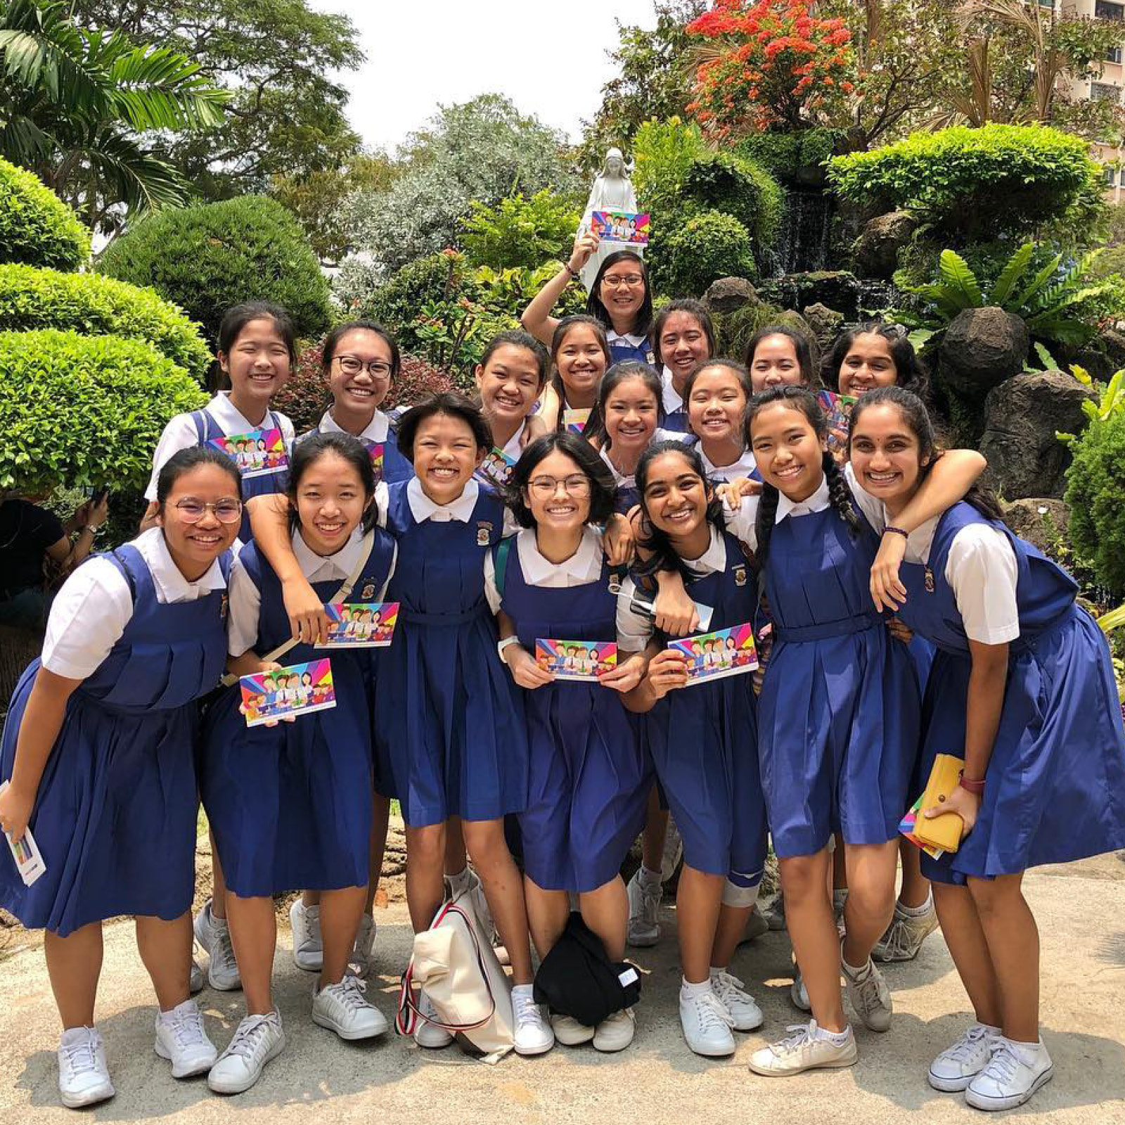
Monday
Catholic Education
Yesterday was Education Sunday. A day to celebrate and pray for Catholic schools throughout the world.
There are approximately
150,000 Catholic schools in the world.
900,000 pupils in Catholic schools in the UK
We are part of an international family that focusses not just on exam results but cares deeply about young people's spiritual, social and academic development.
Our school, like many other Catholic schools, was founded to provide children with an education who did not have the opportunity to go to school. Loreto Catholic school in Rumbek, South Sudan is working hard to provide and education for girls in an area where only 2% of them go to secondary school. Watch thisshort video to find out more https://youtu.be/UlbupkVrlPs

Slide 5
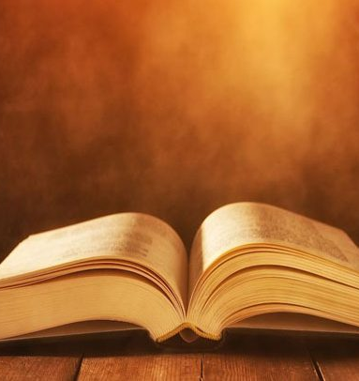
Monday God's Word
A reading from Matthew's Gospel
Then people brought little children to Jesus for him to place his hands on them and pray for them. But the disciples rebuked them.
Jesus said, “Let the little children come to me, and do not hinder them, for the kingdom of heaven belongs to such as these.” When he had placed his hands on them, he went on from there.
The word of the Lord
We all respond: Thanks be to God

Slide 6
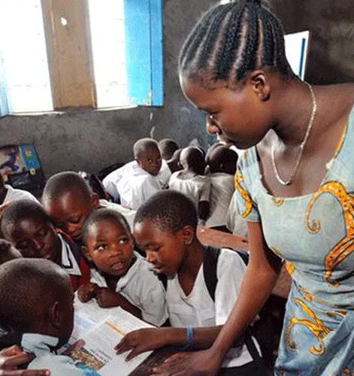
Monday
Let us pray
Lord, Thank you for the gift of Catholic schools.
Thank you for all those throughout history who have given their talents to educating our young people.
Let us pray for all those who contribute to the running of our schools: leaders and classroom teachers, support staff, kitchen staff, maintenance staff, governors and chaplains. We thank them for their dedication and pray that they may know your blessing in their work.
Thank you for our pupils. May your love strengthen and nurture them through the influence and example of those who care for them. We pray that through their time at school they will flourish and grow to discover who you have called them to be.
We all respond: Amen.

Slide 7
Tuesday Notices

Slide 8
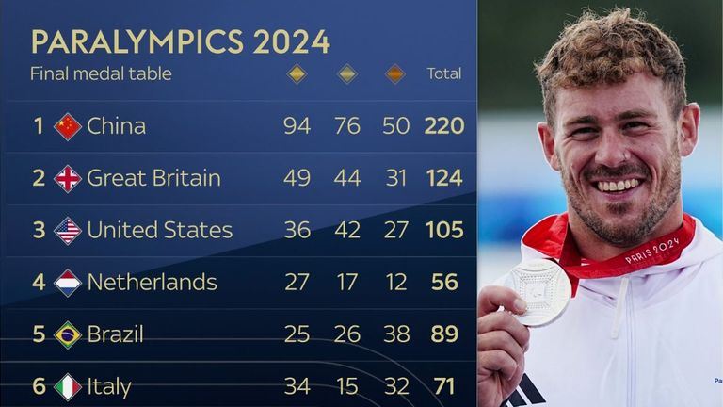
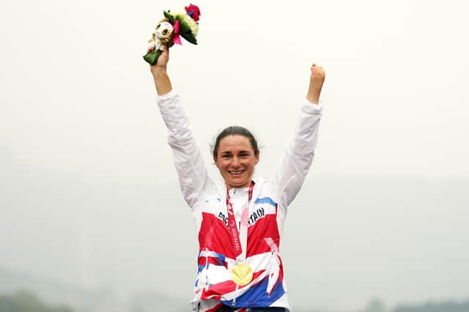

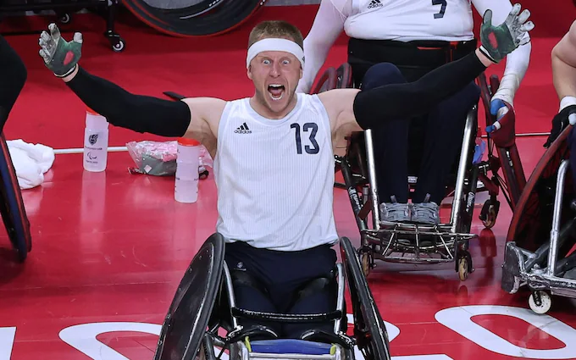
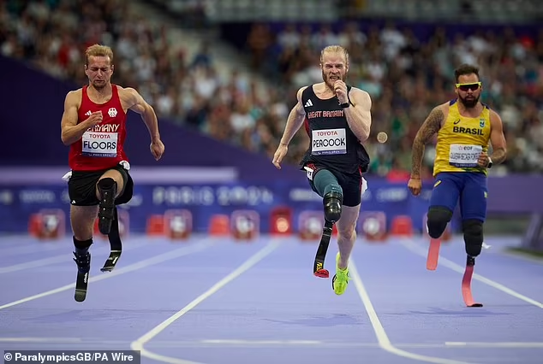
Tuesday –
To think about
The Paralympics ended with on Sunday. Great Britain came second overall with 49 gold medals. It has been an inspiring fortnight showcasing amazing athletes performing at the top of their disciplines. The men’s amputee 100m record is only 1 second behind Usain Bolt’s world record of 9.58 seconds.
The Paralympians have all had extra hurdles to overcome, but are competing because they have a disability – their disability has allowed them to excel. This is what St Paul is talking about in today’s reading when he says ‘in my weakness I am strong.’
None of us is perfect – but we often feel that we should be, or feel a failure when we are not. Christianity teaches us that our weaknesses are part of us and God can use them to do great things. Imperfection is part of our humanity and we should be proud of it.

Slide 9
Tuesday God's Word
2 Corinthians 12:7-10
St Paul writes:
I was given a thorn in the flesh, an angel of Satan to beat me and stop me from getting too proud! About this thing, I have pleaded with the Lord three times for it to leave me, but he has said, ‘My grace is enough for you: my power is at its best in weakness.’ So I shall be very happy to make my weaknesses my special boast so that the power of Christ may stay over me, and that is why I am quite content with my weaknesses, and with insults, hardships, persecutions, and the agonies I go through for Christ’s sake. For it is when I am weak that I am strong.
The word of the Lord
We all respond: Thanks be to God
To think about:
What do you think St Paul’s weakness was that he is writing about?
How do you feel about not being perfect?

Slide 10
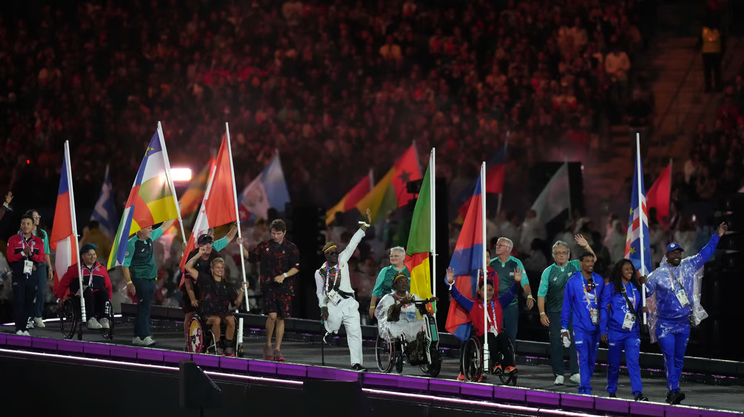
Tuesday
Let us pray
Let’s give thanks for the glorious diversity of humanity, our flaws and imperfections as we say together:
Glory be to the father,
And to the son
And to the Holy Spirit
As it was in the beginning,
Is not and ever shall be
World without end
We all respond: Amen.
St Edward: Pray for us!

Slide 11
Wednesday Notices

Slide 12
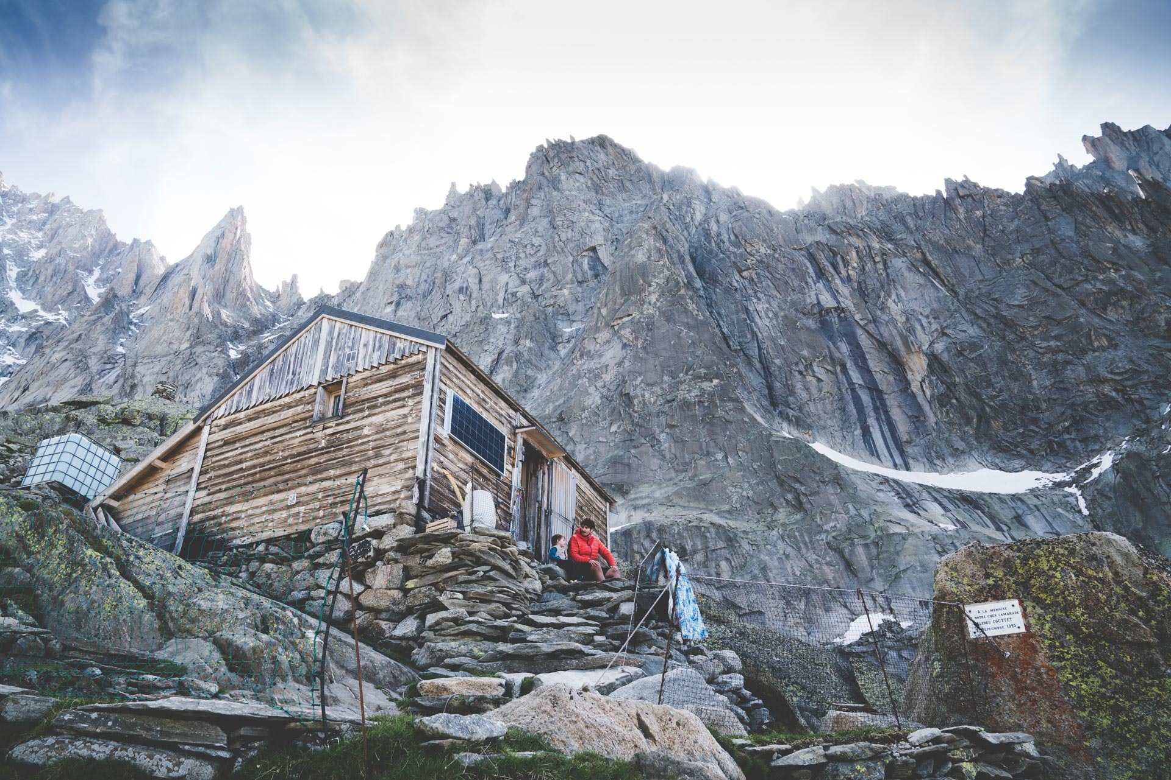
Wednesday
God our Refuge
A refuge is a building or place which provides safety and shelter from danger.
For thousands of years people have prayed to God as a refuge, that we can trust him to provide us with protection and safety through all of life's difficulties.
To think about
Who and where do you go to when life is difficult?
Who are the people in the world today who need God’s protection?

Slide 13
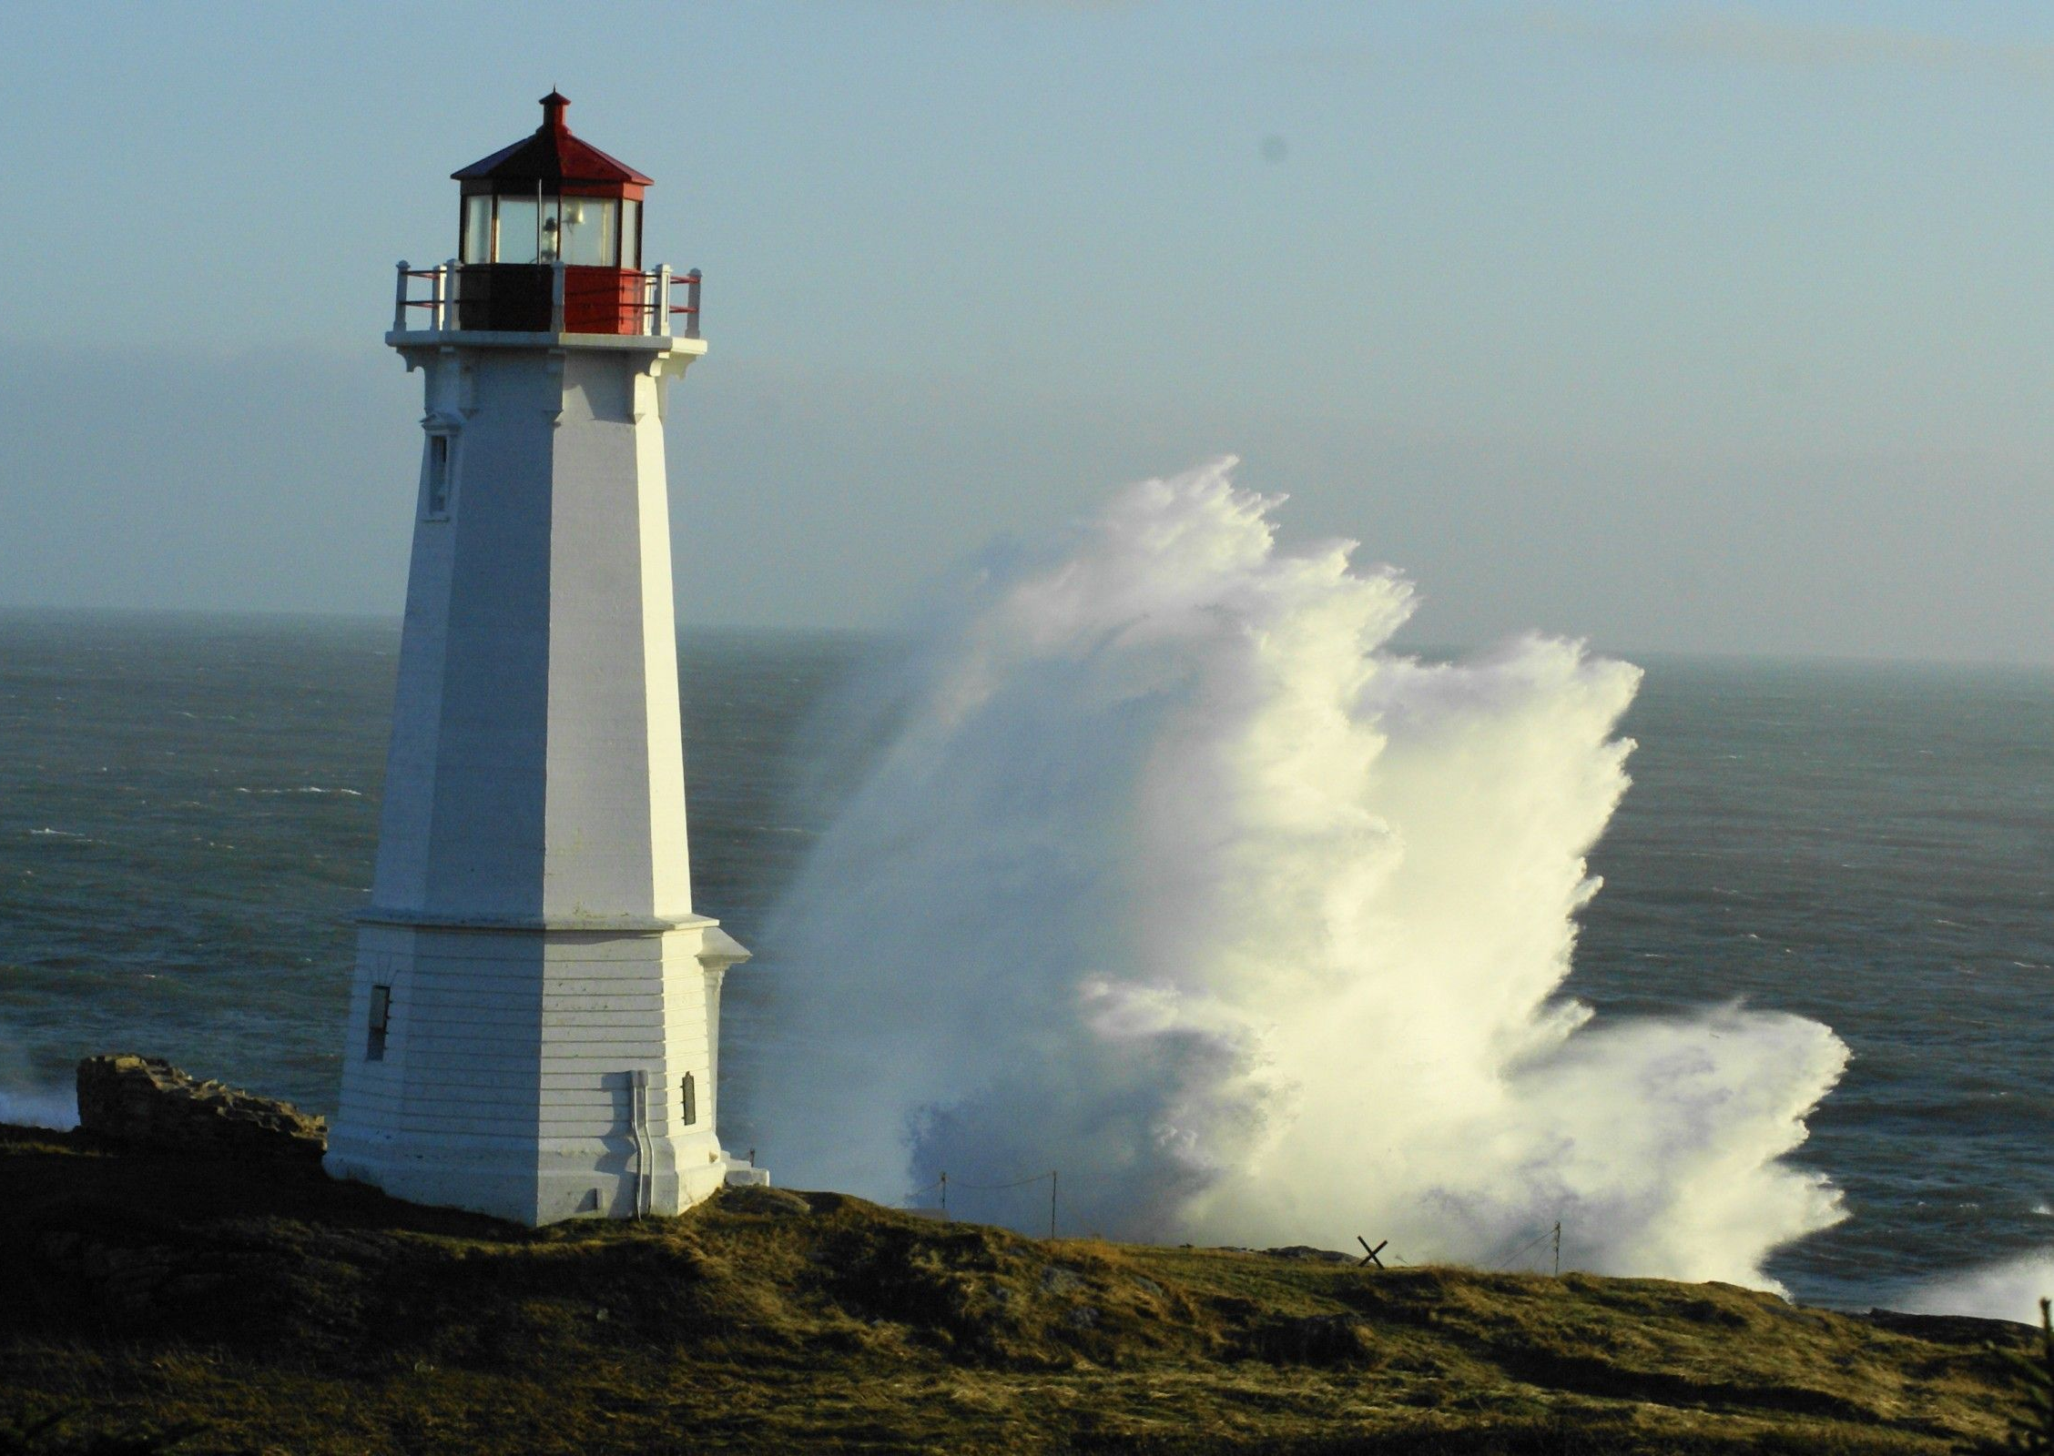
Wednesday
God's Word
Psalm 61
In God alone be at rest, my soul;
for my hope comes from him.
He alone is my rock, my stronghold,
my fortress: I stand firm.
Take refuge in God, all you people.
Trust him at all times.
Pour out your hearts before him
for God is our refuge.
We say together:
In God is my safety and glory

Slide 14
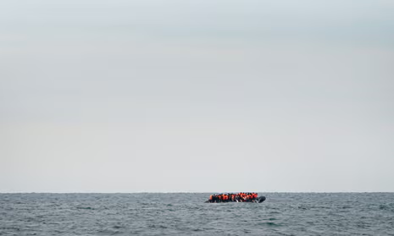
Wednesday
Let us pray
Heavenly Father,
we thank you that you are the God of refuge. You are mighty, powerful, righteous, and true. Today, we come to you in prayer asking for your love, protection, and provision.
Be a place of refuge and a constant presence of love and support for all those experiencing fear, anxiety, and loneliness.
We pray especially for those who have no choice but to rely on your protection.
Help us turn to you for hope and guidance during times of uncertainty. Allow us to be a refuge for others.
We all respond: Amen.

Slide 15
THursday Notices

Slide 16
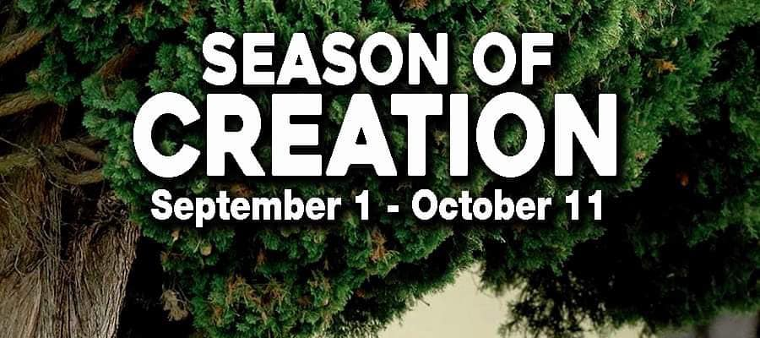
Thursday
The joy of being God's creature
September is a special time of prayer for creation.
Today’s prayer is a meditation on Psalm 139. Please follow this link and listen to the first 3 minutes of the audio track: Pray as you go - (pray-as-you-go.org)
To prepare for this meditation please sit down, close your eyes or put your head on the desk. Take care not to distract those around you while they are listening.

Slide 17
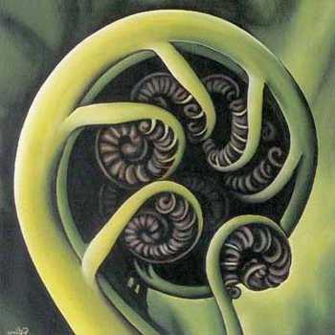
Thursday
Let us pray
Keeping the atmosphere of calmness and silence, spend a few moments talking to God in your heart.
What would you like to thank him for?
Is there anything which you would like him to help you with today?
Let’s give thanks to God our creator for the gift of ourselves as we say together:
Glory be to the father,
And to the Son
And to the Holy Spirit.
As it was in the beginning,
Is now and ever shall be,
World without end
Amen.
St Edward: Pray for us!

Slide 18
Friday Notices
Next Monday
8.15am Mass in the chapel – all welcome
(years 7-11 enter school via the front door)
Period 1 year 9 Mass in the hall
Faith in Action club starts for year 8 – F104
Sacrament of Reconciliation (Confession) with Fr Taras​
Available at breaktime in the chaplaincy on Monday,
drop in anytime 10.40-11.20 ​
​You just spend a few minutes telling God the things you are sorry for and then Fr Taras gives you God's forgiveness​

Slide 19
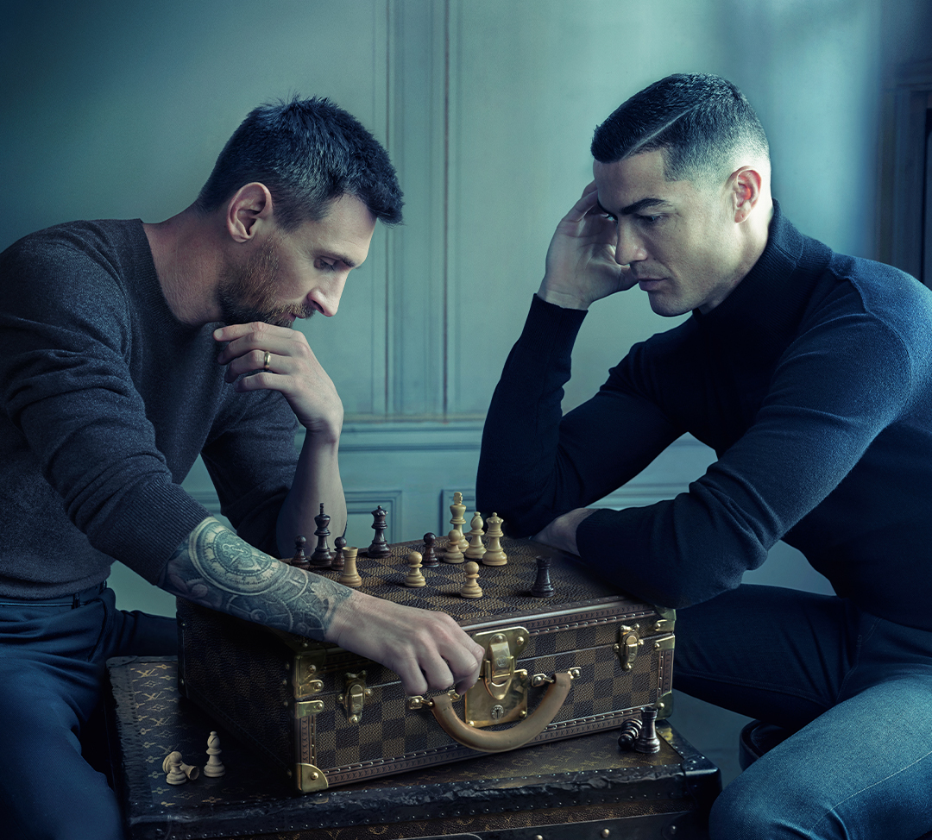
CHESS CLUB STARTS on MONDAY
Chess Club ‘SEC MATE’ starts on Monday. 310pm in the Recital Room.
Join in!

Slide 20
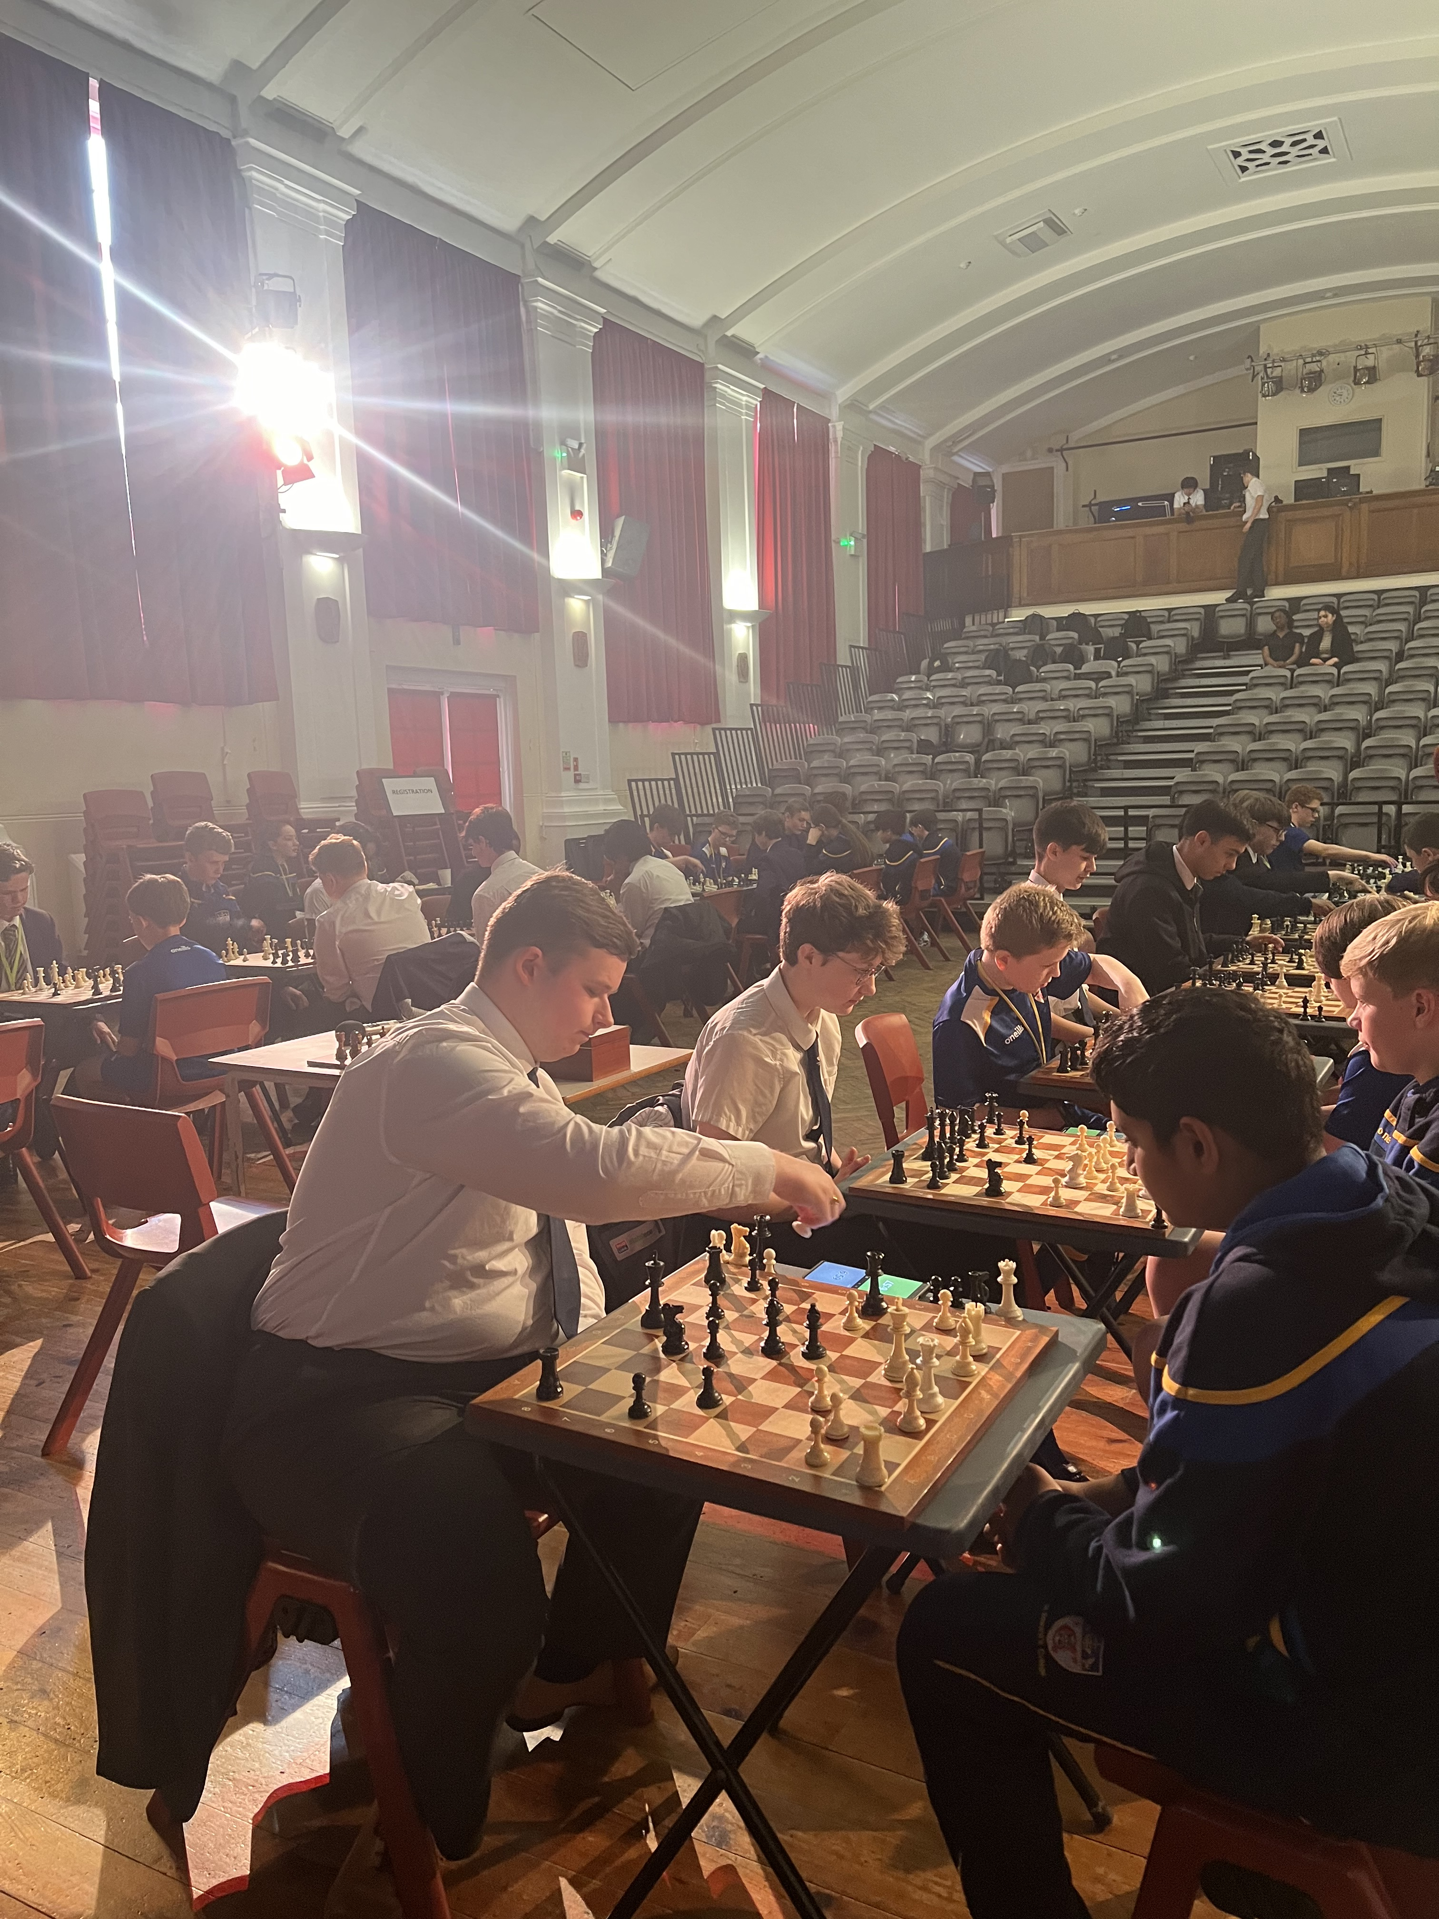
CHESS CLUB STARTS on MONDAY
Chess Club ‘SEC MATE’ starts on Monday. 310pm in the Recital Room.
Join in!

Slide 21
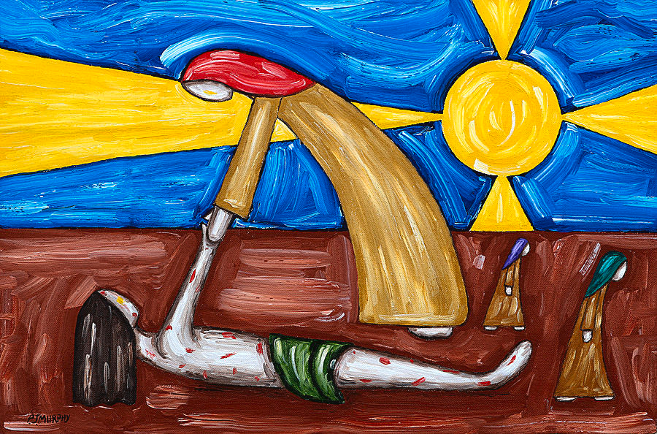
Friday
God's Word
A reading from Luke’s Gospel
A teacher of the Law asked Jesus, “Who is my neighbour?”
Jesus answered,
“There was once a man who was going down from Jerusalem to Jericho when robbers attacked him, stripped him, and beat him up, leaving him half dead. It so happened that a priest was going down that road; but when he saw the man, he walked on by on the other side. In the same way a Levite also came there, went over and looked at the man, and then walked on by on the other side. But a Samaritan who was traveling that way came upon the man, and when he saw him, his heart was filled with pity. He went over to him, poured oil and wine on his wounds and bandaged them; then he put the man on his own animal and took him to an inn, where he took care of him.
The next day he took out two silver coins and gave them to the innkeeper. ‘Take care of him,’ he told the innkeeper, ‘and when I come back this way, I will pay you whatever else you spend on him.’”
And Jesus concluded,
“In your opinion, which one of these three acted like a neighbor toward the man attacked by the robbers?”
The teacher of the Law answered, “The one who was kind to him.”
Jesus replied, “You go, then, and do the same.”
The word of the Lord
We all respond: Thanks be to God
Friday
God's Word

Slide 22
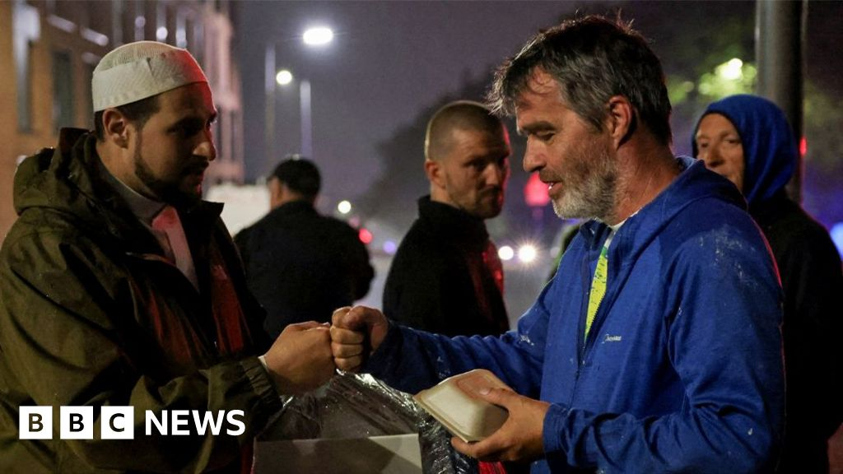
Friday
Praying with 8 Clare
Our prayers and readings today were chosen and written by 8 Clare​
The story of the Good Samaritan teaches us that we should always help anyone in need even if they are our enemies or we don't know them. We could do this in our daily life by helping a homeless person on the streets, helping some of the new Year 7s find their way around the school or by having good sportsmanship in sports.
An amazing example of someone being a good Samaritan happened during the summer holidays. Adam Kelwick is an Imam at a local mosque in Kensington. During the riots in Liverpool this summer, the mosque was targeted by the rioters. Instead of being unfriendly towards the rioters he gave out soft drinks and snacks to those rioting outside the mosque. Adam showed love to the rioters even though they were showing hate to him and this is an amazing act of kindness just like what the Good Samaritan did. LM

Slide 23
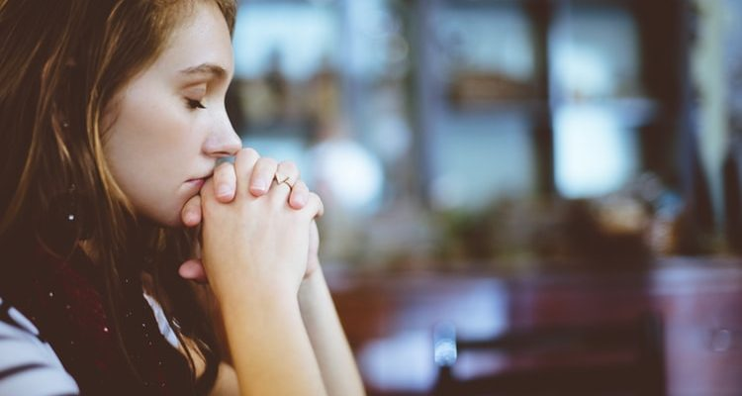
Friday Let us pray
Today we pray especially for pupils of 8 Clare, their families and friends and their form teacher Mr Stanford​
Dear God,
We pray for refugees and migrants who have had no choice but to flee from war, persecution and danger in their original countries/cities. Make sure they feel welcome to their new homes and help them find a new start where they can be happier and safer with their families.
We pray similarly for the people who don’t understand that strangers aren’t all bad, we also ask you to help the people who don’t understand that racism, homophobia and many more learn to see past unfair judgments and try to change for the better.
Finally Lord, we ask that you give us the courage we need to allow us to reach out to those who are different to us.
We all respond: Amen.
St Edward: Pray for us!
Prayer by MG

